Slide 1
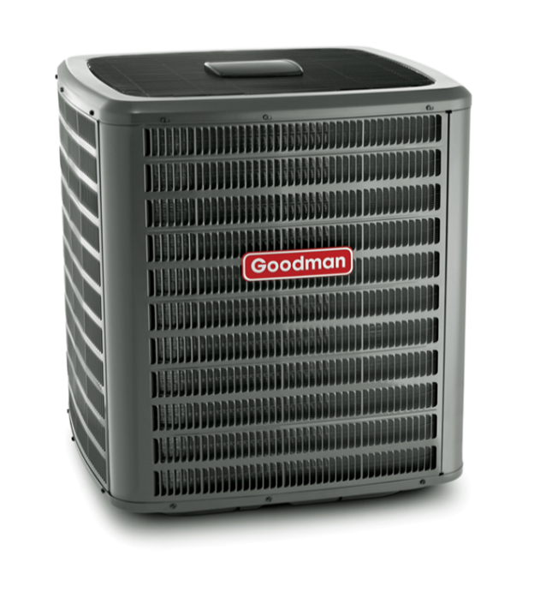
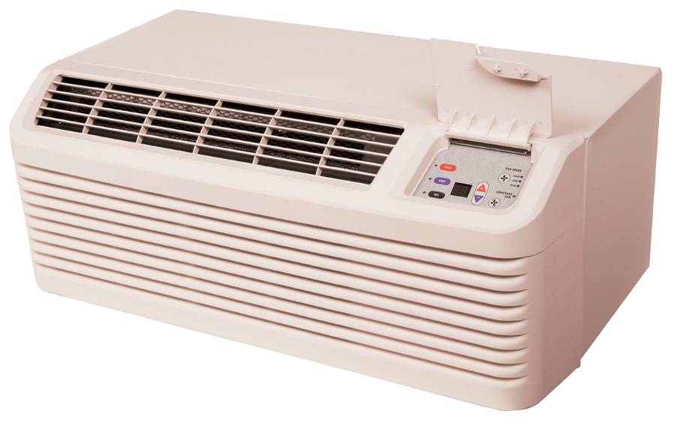

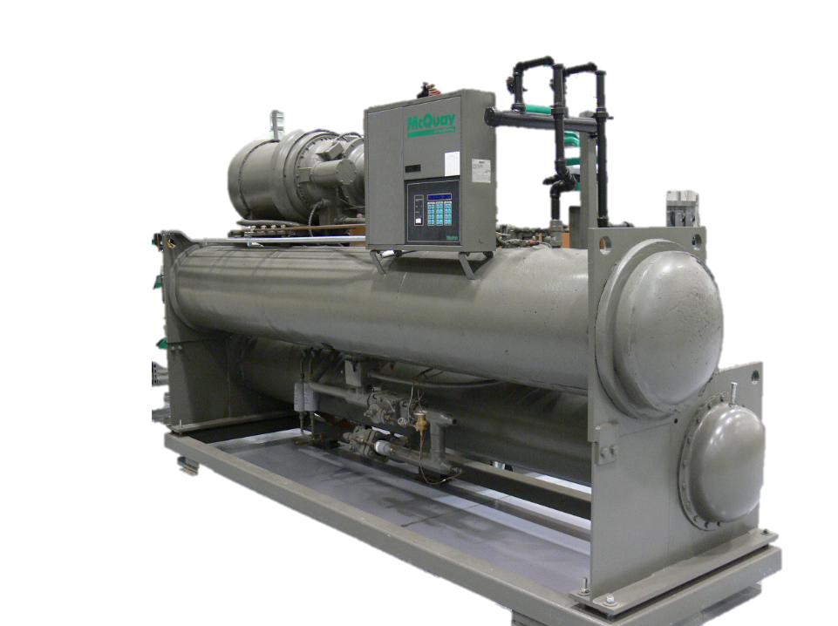
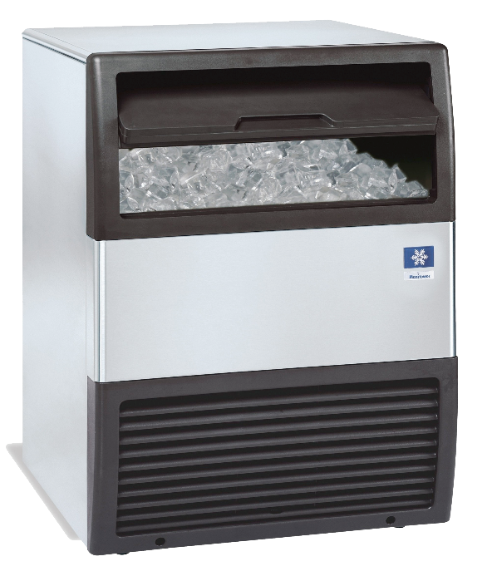
EPA Section 608 Preparatory Class
Notes:
ESCO EPA Section 608 Preparatory Manual 9th Edition Page 4
This power point is intended to prepare technicians for the Environmental Protection Agency’s (EPA) Section 608 Certification examination and contains information a technician will require to successfully complete the exam. This power point is meant to serve as a guide for reviewing material related to Section 608 of the Clean Air Act Amendment, and is not intended as a formal refrigeration training course. Technicians preparing for this examination should be familiar with the basic vapor-compression refrigeration cycle, common service equipment, and procedures.
This power point has been developed with the most current information available at the time of this edition. Should EPA regulations change after a technician becomes certified, it is the responsibility of the technician to comply with any future changes. The EPA also reserves the right to modify the test questions and/or require new certification or recertification based on advancements in technology. The ESCO Institute will update this manual as necessary to reflect current EPA regulations and testing requirements

Slide 2
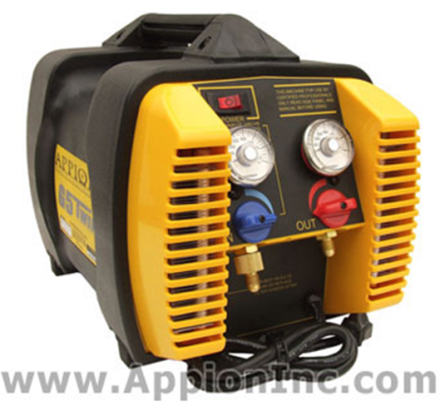
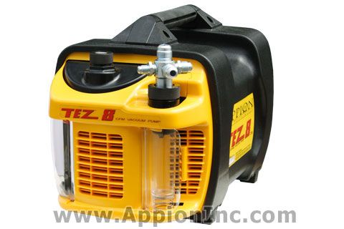
Introduction

Slide 3
Overview of the Examination
Federal regulation requires anyone servicing, repairing or disposing of any equipment containing a controlled refrigerant to have in his/her possession a card certifying that he/she has obtained the proper level of certification for the work he/she is performing.
THIS MEANS YOU CANNOT WORK UNDER ANOTHER PERSON’S CERTIFICATION.
Notes:
ESCO EPA Section 608 Preparatory Manual 9th Edition Page 4
Federal regulation requires anyone servicing, repairing or disposing of any equipment containing a controlled refrigerant to have in his possession a card certifying that he has obtained the proper level of certification for the work he/she is performing.
This means you cannot work under another person’s certification.

Slide 4
Overview of the Examination
Distributors can only sell refrigerant to an EPA certified technician or a company that employs certified Section 608 employees.
Notes:
ESCO EPA Section 608 Preparatory Manual 9th Edition Page 4
Distributors can only sell refrigerant to an EPA certified technician or company that employs certified Section 608 employees.
Automotive refrigerant handling is covered under section 609 of the CCA.

Slide 5

Overview of the Examination
There are four (4) categories of technician certification:
  Type I
  Type II
  Type III
  Universal
Notes:
ESCO EPA Section 608 Preparatory Manual 9th Edition Page 4 & 5
The test contains four sections: the Core, and sections I, II, and III. Each section contains twenty five (25) multiple-choice questions. A technician MUST achieve a minimum passing score of 70 percent in each group/section in which they are to be certified. For example, a technician seeking Universal certification must achieve a minimum score of 70 percent, or 18 out of 25 correct, on each section of the test. If a technician fails one or more of the sections, they may retake the failed section(s) without retaking the section(s) in which they earned a passing score. In the meantime, the technician will be certified in the Type for which they received a passing score. There is one exception; a technician MUST achieve a passing score on the Core plus any one Type to receive any certification.

Slide 6
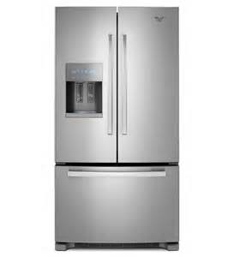
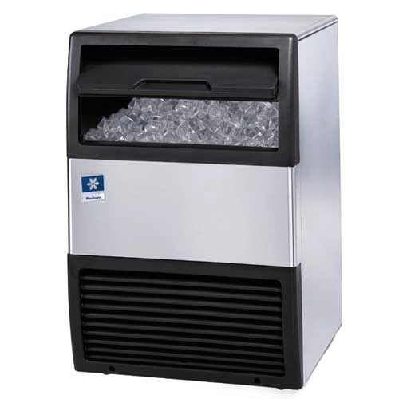
Type I
Persons who maintain, service, or repair small appliances must be certified as Type I or Universal technicians.
Notes:
ESCO EPA Section 608 Preparatory Manual 9th Edition Page 4
Type I. Persons who maintain, service, repair, or dispose of small appliances must be certified as Type I technicians. A small appliance is defined as a pre-assembled unit, hermetically sealed and factory charged with 5 lbs. or less of refrigerant. Examples include equipment such as water coolers, window units, refrigerators, freezers, de-humidifiers, ice machines, and package terminal air conditioning.
The key to Type 1 is that the equipment must be factory sealed and have 5 pounds or less of refrigerant.

Slide 7
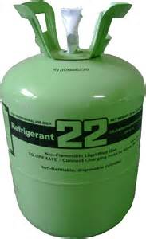
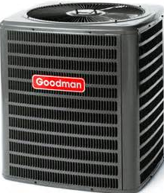
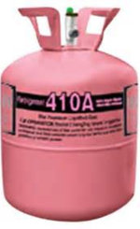
Type II
Persons who maintain, service, repair, or dispose of medium, high and very high-pressure appliances containing more than 5 lbs. of refrigerant, or if the installation of such equipment requires refrigerant charging, must be certified as Type II or Universal technicians.
Notes:
ESCO EPA Section 608 Preparatory Manual 9th Edition Page 4
Type II. Persons who maintain, service, repair, or dispose of medium, high and very high-pressure appliances containing more than 5 lbs. of refrigerant, or if the installation of such equipment requires refrigerant charging, must be certified as Type II technicians.
It is important to understand the refrigerant pressure of each certification category. Type II certification includes medium- pressure, high-pressure, and very high-pressure appliances. If a system requires refrigerant line connections or charging in the field, even if it is less than 5 lbs., the technician must be certified as Type II.
High-pressure refrigerants have a pressure between 155 psig & 340 psig at a liquid phase temperature of 104°F and medium- pressure refrigerants have a pressure between 30 psig & 155 psig at a liquid phase temperature of 104°F. Type II certification does not include small appliances or motor vehicle air conditioning systems (MVAC ).

Slide 8
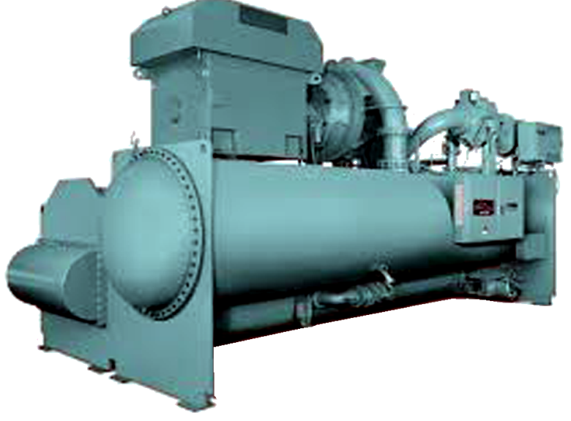
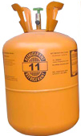
Type III
Persons, who maintain, service, repair, or dispose of low-pressure appliances must be certified as Type III or Universal technicians.
Notes:
ESCO EPA Section 608 Preparatory Manual 9th Edition Page 5
Type III. Persons who maintain, service, repair, or dispose of low-pressure appliances (centrifugals and chillers) must be certified as Type III technicians. Low-pressure refrigerants have pressures of 30 psig or lower at a liquid phase temperature of 104°F.

Slide 9
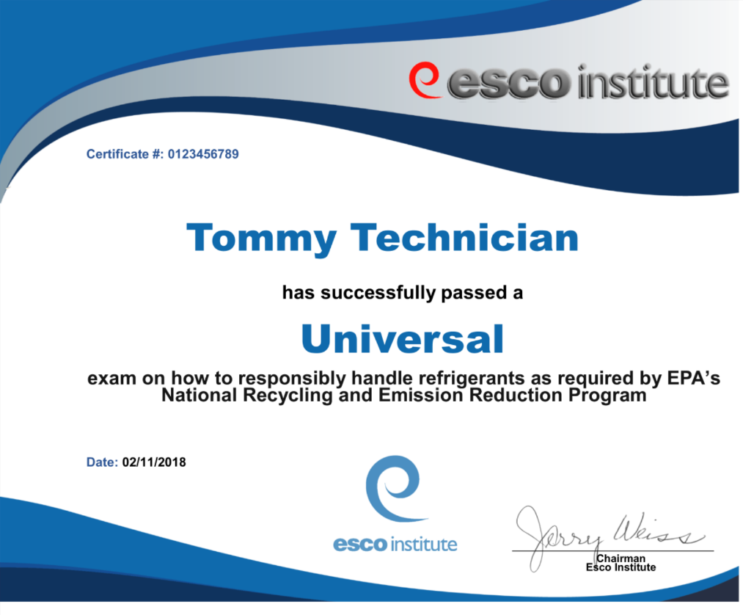
Universal
Persons, who obtain Type I, Type II and Type III certification levels are certified as Universal technicians.
Notes:
ESCO EPA Section 608 Preparatory Manual 9th Edition Page 5
Persons, who obtain Type I, Type II and Type III certification levels are certified as Universal technicians.

Slide 10
Test Format
The Core contains 25 general knowledge questions relating to:
Stratospheric ozone depletion (ODP)
Rules and regulations of the Clean Air Act (CAA)
The Montreal protocol
Refrigerant recovery, recycling and reclaiming, recovery devices
Substitute refrigerants and oils
Recovery techniques
Dehydration
Recovery cylinders
Safety
Shipping
Global Warming Potential (GWP)
Notes:
ESCO EPA Section 608 Preparatory Manual 9th Edition Page 5
The Core contains 25 general knowledge questions relating to stratospheric ozone depletion, rules and regulations of the Clean Air Act, the Montreal Protocol, refrigerant recovery, recycling and reclaiming, recovery devices, substitute refrigerants and oils, recovery techniques, dehydration, recovery cylinders, safety, and shipping.

Slide 11

Test Format
Federal Regulations require the test to be a closed book, proctored exam.
Notes:
ESCO EPA Section 608 Preparatory Manual 9th Edition Page 5
This is a Federal Certification examination and must be conducted as a closed book, proctored exam.
The only outside materials allowed during the test are a temperature pressure chart and a basic four function calculator. Phones are NOT allowed to be used during the examination and MUST be turned off and put away (not on the desktop) during the examination.
All examination participants will be included in an online registry/lookup by name, city and state, as well as certification achieved. (No personal information will be included in the public registry.) Technicians will be able to opt out of this registry by logging into the ESCO website at www.escogroup.org or by contacting customer service at 800-726-9696.

Slide 12
Test Format
PERSONAL INFORMATION REQUIRED FOR THE EXAM:
Picture Identification
Social security number
Home/mailing address
Date of Birth
Phone Number
Email address
Notes:
ESCO EPA Section 608 Preparatory Manual 9th Edition Page 5
All proctors must ask for:
• Picture Identification (Exam proctors will ask for this to verify your identity – this is required.)
• Social security number
All proctors must make sure the following are filled out:
• Home/mailing address
• Date of Birth
• Phone Number
• Email address

Slide 13
Test Format
Free EPA practice exams can be found online at: www.escogroup.org
Notes:
ESCO EPA Section 608 Preparatory Manual 9th Edition Page 5

Slide 14
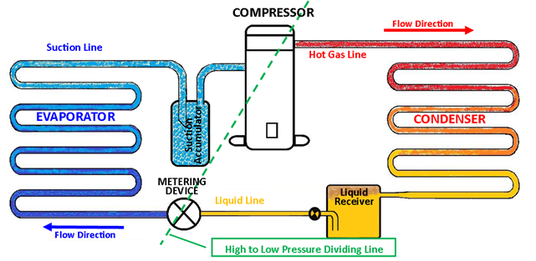
Vapor / Compression Refrigeration Cycle
Notes:
ESCO EPA Section 608 Preparatory Manual 9th Edition Page 6
Vapor / Compression Refrigeration Cycle
The compressor is the heart of the vapor-compression refrigeration cycle. Low-pressure, low-temperature superheated refrigerant vapor entering the compressor is compressed, changing it to a high-pressure, high-temperature, superheated vapor. It then moves to the condenser where the heat is removed, de-superheating and condensing it into a liquid. Before it leaves the condenser, the liquid refrigerant is subcooled to a point below the liquid saturation temperature. It then flows to the metering device as a high-pressure, subcooled liquid. As the refrigerant flows through the metering device, the liquid is reduced to a low- pressure causing a small percentage of the liquid to flash to a vapor (flash-gas) lowering the remaining refrigerant to its saturation temperature. The low-pressure, low-temperature refrigerant flows into the evaporator as a low-temperate liquid. As the refrigerant absorbs heat, it evaporates into a low-temperature vapor. During this process the refrigerant vapor is superheated above its saturation temperature and then enters the suction line. From the suction line, refrigerant enters the compressor as a low-pressure, low-temperature superheated vapor to repeat the cycle. The compressor and the metering device are the dividing points between the low-pressure and high-pressure sides of the system.

Slide 15
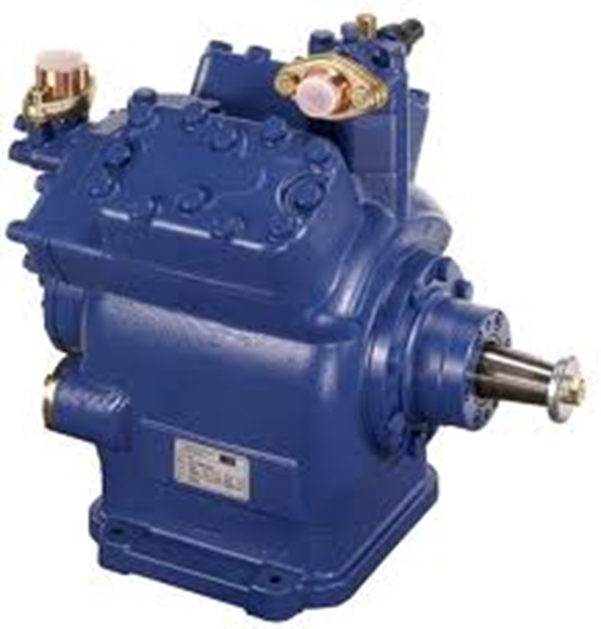
Compressor
Low-pressure and temperature superheated vapor in
High-pressure & temperature highly superheated vapor out
Notes:
ESCO EPA Section 608 Preparatory Manual 9th Edition Page 6
The compressor is the heart of the vapor-compression refrigeration cycle. Low-pressure, low-temperature superheated refrigerant vapor entering the compressor is compressed, changing it to a high-pressure, high-temperature, superheated vapor.

Slide 16
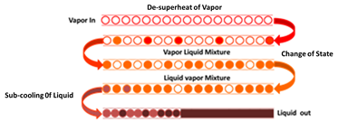
Condenser
Three stages of the condenser
De-superheats
Change of state (Vapor to Liquid)
Sub-cools
Notes:
ESCO EPA Section 608 Preparatory Manual 9th Edition Page 6
The refrigerant then moves to the condenser where the heat is removed, de-superheating and condensing it into a liquid. Before it leaves the condenser, the liquid refrigerant is sub-cooled to a point below the liquid saturation temperature.

Slide 17
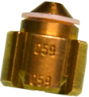
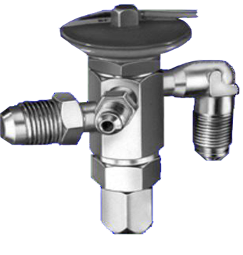
Metering Device
High-pressure Sub-cooled Liquid in
Low-pressure Liquid and Flash Gas out
Notes:
ESCO EPA Section 608 Preparatory Manual 9th Edition Page 6
The refrigerant then flows to the metering device as a high-pressure, sub-cooled liquid. As the refrigerant flows through the metering device, the liquid is reduced to a low-pressure causing a small percentage of the liquid to flash to a vapor (flash-gas) lowering the remaining refrigerant to its saturation temperature.

Slide 18
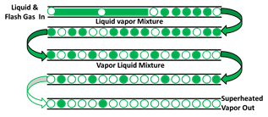
Evaporator
Low-Pressure & Temperature superheated vapor leaves
Low-Pressure & Temperature Liquid with some flash-gas enters
Notes:
ESCO EPA Section 608 Preparatory Manual 9th Edition Page 6
The low-pressure, low-temperature refrigerant flows into the evaporator as a low-temperate liquid with some flash-gas. As the refrigerant absorbs heat, it evaporates into a low-temperature vapor. Before refrigerant vapor exits the evaporator and enters the suction line, additional heat superheats the vapor above its saturation temperature

Slide 19
Refrigeration Cycle with Accessories
Notes:
ESCO EPA Section 608 Preparatory Manual 9th Edition Page 6
Accessories shown in the basic diagram are the liquid receiver and a suction accumulator. Use of these components depends on system design and/or the type of metering device used. A system that uses a thermostatic expansion valve (TEV) is usually equipped with a receiver located in the liquid line directly following the condenser. A system that uses a thermostatic expansion valve (TEV), capillary tube, or fixed bore metering device may be equipped with an accumulator located in the suction line, which prevents liquid from entering the compressor.

Slide 20
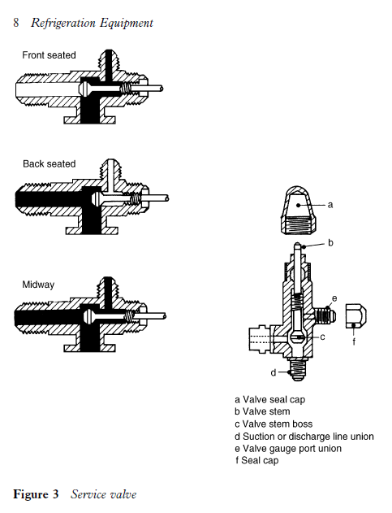
Accessories
Service valve in back-seated position
Service Port
Back-Seated
Position
Line
Port
Line
Port
Compressor
Port
Notes:
ESCO EPA Section 608 Preparatory Manual 9th Edition Page 6
Before using a recovery unit you should always check the service valve positions.
Notice the black section of the valve is what is open in the back-seated position. The line port and compressor port are open and the service port is closed. The black solid color is where the refrigerant will flow.
This valve is in position for normal operation.

Slide 21
Accessories
Service valve in front-seated position.
Service
Port
Front- Seated
Position
Line Port
Compressor
Port
Notes:
ESCO EPA Section 608 Preparatory Manual 9th Edition Page 6
The black solid color is where the refrigerant will flow in the front-seated position. The line port is closed and compressor port is open to the service port.

Slide 22
Accessories
Service Valve in Crack position.
Service
Port
Crack
Position
Line Port
Compressor
Port
Notes:
ESCO EPA Section 608 Preparatory Manual 9th Edition Page 6
All three connections are open in the crack-seat position. The line port, compressor port and service port are all open.
This position is for servicing, and checking pressures.

Slide 23
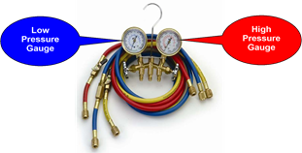
Gauge Manifold Set
One of the most important tools for an HVACR technician is the gauge manifold set.
The compound gauge measures low-pressure (psig) and vacuum (inches Hg).
Depending on the refrigerant, the high-pressure gauge may be rated at 500 or 800 psig.
Notes:
ESCO EPA Section 608 Preparatory Manual 9th Edition Page 7
GAUGE MANIFOLD SET
One of the most important tools for an HVACR technician is the gauge manifold set. The left side, compound gauge (blue) and the right side, high-pressure gauge (red), are attached to the manifold to measure system pressures. Hoses are used to connect the manifold to the refrigeration system’s access ports or service valves to gain access to system pressures. The compound gauge measures low-pressure (psig) and vacuum (inches Hg). The high-pressure gauge measures high side (discharge) pressure. Depending on the refrigerant, the high-pressure gauge may be rated at 500 or 800 psig. The manifold is also equipped with a center port, (usually a yellow hose), that can be connected to a recovery device, evacuation vacuum pump, or charging device.

Slide 24
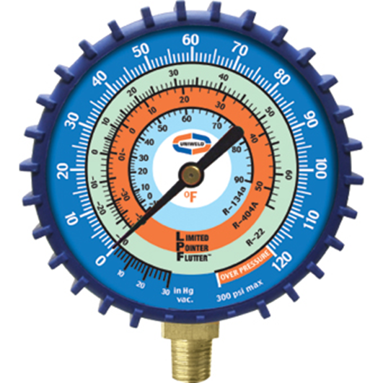
Gauge Manifold Set
Compound gauge measures low-pressure & vacuum.
Vacuum
Retard
Notes:
ESCO EPA Section 608 Preparatory Manual 9th Edition Page 7
The compound gauge measures low-pressure (psig) and vacuum (inches Hg).
It is normally blue color.
This gauge is not intended to read deep vacuums.
The retard section of the gauge is to prevent damage in case the gauge is connected to pressures greater than rated pressure.

Slide 25
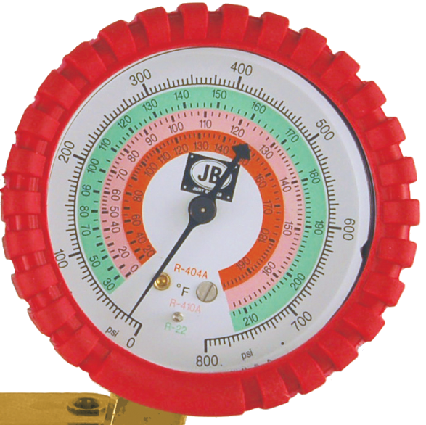
Gauge Manifold Set
High-Pressure Gauge
PSI
Refrigerant Saturation
Temperatures
Notes:
ESCO EPA Section 608 Preparatory Manual 9th Edition Page 7
The high-pressure gauge measures high-side (discharge) pressure.
It is normally red in color.
Atmospheric pressure is shown as 0 psi or psig (pound per square inch gauge).
Depending on the refrigerant the high-pressure gauge may be rated at 500psig or 800psig.

Slide 26
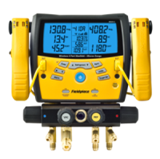
Gauge Manifold Set
An electronic manifold may have combined temperature probes to measure refrigerant line temperatures for calculating system superheat and sub-cooling.
Notes:
ESCO EPA Section 608 Preparatory Manual 9th Edition Page 7
An electronic manifold or gauge may have combined temperature probes to measure refrigerant line temperatures for calculating system superheat and sub-cooling.

Slide 27
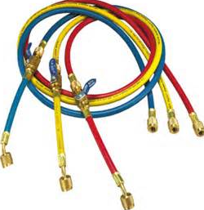
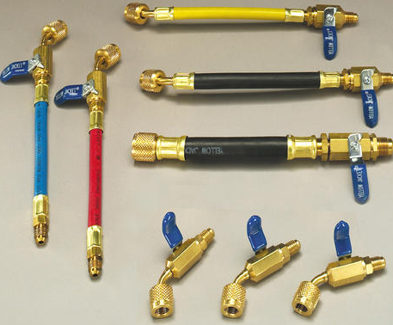
Gauge Manifold Set
EPA regulations require that hoses be equipped with low-loss fittings.
Notes:
ESCO EPA Section 608 Preparatory Manual 9th Edition Page 7
EPA recommends that hoses be equipped with low-loss fittings or valves that manually close or which close automatically to minimize refrigerant loss when hoses are disconnected. The hoses used for service and with recovery equipment must be equipped with low-loss fittings.

Slide 28
De-Minimis Release
Minor releases when connecting or disconnecting hoses for service or recovery are considered to be a De-Minimis release.
Notes:
ESCO EPA Section 608 Preparatory Manual 9th Edition Page 7
Minor releases when connecting or disconnecting hoses for service or recovery are considered to be a de-minimis release.

Slide 29
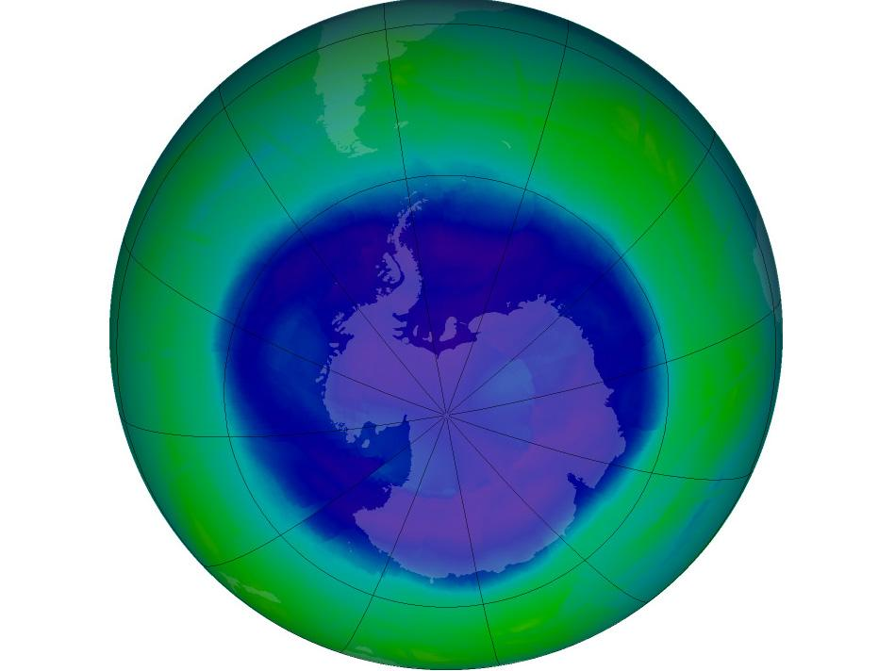
Science of Ozone Depletion
Core
This Photo by Unknown Author is licensed under CC BY-SA

Slide 30
Core Contents
STRATOSPHERIC OZONE DEPLETION
OZONE DEPLETION POTENTIAL
CLEAN AIR ACT
MONTREAL PROTOCOL
THE THREE R’S
RECOVERY DEVICES
SALES RESTRICTION
REFRIGERANTS & OILS
RECOVERY TECHNIQUES
LEAK DETECTION
DEHYDRATION
RECOVERY CYLINDERS
SAFETY
SHIPPING & TRANSPORTING
Notes:
ESCO EPA Section 608 Preparatory Manual 9th Edition Page 8
There are 14 topics in the core section.

Slide 31

Stratospheric Ozone Depletion
The stratosphere is Earth's security blanket.
Located between 7 and 30 miles above sea level, the stratosphere is comprised of ozone and other gases.
Notes:
ESCO EPA Section 608 Preparatory Manual 9th Edition Page 8
The introduction of Chlorofluorocarbons (CFCs) and Hydrochlorofluorocarbons (HCFCs) have dramatically changed our lifestyles. ASHRAE’s safety classification of A-1, the safest for most of the common refrigerants, does not consider the environmental effects. Little did we know that the use and release of these compounds into the atmosphere would have far reaching, long-term effects on our environment. The greatest effect is in the stratosphere far removed from the Earth's surface.

Slide 32
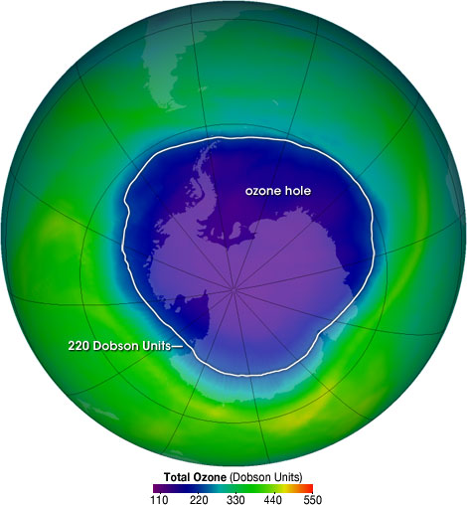
The Ozone Hole
Source: http://ozonewatch.gsfc.nasa.gov/facts/hole.html
Notes:
The ozone hole image shows the very low values (blue and purple colored area) centered over Antarctica on October 4, 2004.
The biggest hole recorded was in 2006.

Slide 33
Stratospheric Ozone Depletion
30 Miles
EARTH
Stratosphere
7 Miles
Notes:
ESCO EPA Section 608 Preparatory Manual 9th Edition Page 8
Brief explanation of the Earth’s atmosphere layers.
Based on the vertical temperature distribution in Earth's atmosphere, four semi-horizontal layers or spheres can be distinguished: the troposphere, stratosphere, mesosphere, and thermosphere. The stratosphere and mesosphere together are called the middle atmosphere, and their region also overlaps with the ionosphere, which is a region defined on the basis of the electric charges of the particles there.
The stratosphere is part of the earth's atmosphere which extends from the top of the troposphere from 7 miles to about 30 miles above the surface. This is the part of the atmosphere we are concerned about.

Slide 34
What is the Ozone Layer?
Stratospheric ozone is a naturally-occurring gas that filters the Sun's ultraviolet (UV) radiation.
Acts as a shield in the stratosphere.
Protects life on Earth from the Sun's UV rays.
Notes:
ESCO EPA Section 608 Preparatory Manual 9th Edition Page 8
Stratospheric ozone is a naturally-occurring gas that filters the Sun's ultraviolet (UV) radiation.
Acts as a shield in the stratosphere.
Protects life on Earth from the Sun's UV rays.

Slide 35

Stratospheric Ozone Depletion
An Ozone molecule consists of three oxygen atoms (O₃).
Notes:
ESCO EPA Section 608 Preparatory Manual 9th Edition Page 8
An Ozone molecule, consisting of three oxygen atoms (O3), protects us from harmful ultraviolet radiation and helps maintain stable Earth temperatures.

Slide 36

Stratospheric Ozone Depletion
Fluorine
Chlorine
CL
FL
CARBON
UV Radiation
CL
CL
CFC Molecule
Notes:
ESCO EPA Section 608 Preparatory Manual 9th Edition Page 8
The ultraviolet radiation from the Sun sheers the chlorine atom from a CFC or HCFC molecule. This chlorine atom is then attracted to an ozone molecule.

Slide 37
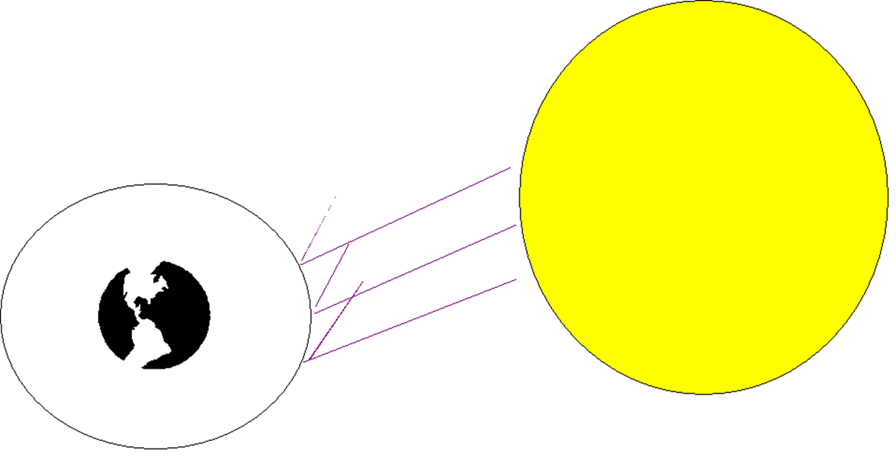

Stratospheric Ozone Depletion
Stratospheric Ozone depletion is a global issue that can lead to problems such as:
Crop Loss
Increase in Eye Diseases
Skin Cancer
Reduced Marine Life
Deforestation
Increased Ground Level Ozone
Notes:
ESCO EPA Section 608 Preparatory Manual 9th Edition Page 8
Stratospheric Ozone depletion is a global issue that can lead to problems such as:
CROP LOSS
INCREASE IN EYE DISEASES
SKIN CANCER
REDUCED MARINE LIFE
DEFORESTATION
INCREASED GROUND LEVEL OZONE

Slide 38
Stratospheric Ozone Depletion
CFCs and HCFCs which contain Chlorine, have been found in air samples taken from the stratosphere.
When CFCs and HCFCs are released into the atmosphere the Chlorine in them causes depletion of the Ozone layer.
Chlorine is the Culprit
Notes:
ESCO EPA Section 608 Preparatory Manual 9th Edition Page 8
CFCs (chlorine, fluorine & carbon) and HCFCs, (hydrogen, chlorine, fluorine & carbon) which contain Chlorine, have been found in air samples taken from the stratosphere. When CFCs and HCFCs are released into the atmosphere the Chlorine in them causes depletion of the Ozone layer.

Slide 39
Stratospheric Ozone Depletion
When CFCs and HCFCs reach the stratosphere, the sun’s UV radiation causes them to break apart.
O
O
O
O
Cl
O
Cl
O
Chlorine
Atom
Ozone Molecule
Made of up 3
Oxygen Atoms
Chlorine
Monoxide
Diatomic
Oxygen
Notes:
ESCO EPA Section 608 Preparatory Manual 9th Edition Page 8
The chlorine atom that breaks away from the refrigerant molecule breaks and attaches itself to an Oxygen atom from the ozone molecule. This forms a compound called Chlorine Monoxide (CIO) and leaves an O2 molecule. The Chlorine Monoxide will collide with another Ozone molecule, release its Oxygen atom, forming two O2 molecules, and leave the chlorine free to attack another Ozone molecule.

Slide 40
Stratospheric Ozone Depletion
A single Chlorine atom can destroy 100,000 Ozone molecules
O
CL
O
O
Notes:
ESCO EPA Section 608 Preparatory Manual 9th Edition Page 8
A single Chlorine atom can destroy 100,000 Ozone molecules.

Slide 41
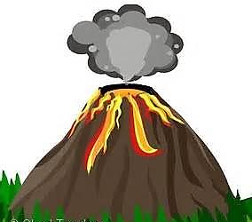
Stratospheric Ozone Depletion
Source of Chlorine in the Stratosphere
Air samples taken over erupting volcanoes show that volcanoes contribute only a small quantity of Chlorine as compared to CFCs and HCFCs.
Notes:
ESCO EPA Section 608 Preparatory Manual 9th Edition Page 8
There has been a great deal of controversy over the subject of ozone depletion. Some believe that the Chlorine found in the stratosphere comes from natural sources such as volcanic eruptions, however, air samples taken over erupting volcanoes show that volcanoes contribute only a small quantity of Chlorine as compared to refrigerants containing Chlorine.

Slide 42
Stratospheric Ozone Depletion
The rise in Chlorine measured in the stratosphere matches the rise in the amount of Fluorine, which has different natural sources than Chlorine, over the past two decades.
The rise in Chlorine measured in the stratosphere matches the rise in CFC & HCFCs emissions.
Notes:
ESCO EPA Section 608 Preparatory Manual 9th Edition Page 8
The rise in the amount of Chlorine measured in the stratosphere over the past two decades matches the rise in the amount of Fluorine, which has different natural sources than Chlorine over the same period. Also, the rise in the amount of Chlorine measured in the stratosphere over the past twenty years, matches the rise in CFC and HCFC emissions over the same period.
The evidence is clear, chlorine containing refrigerants have changed the natural balance, thus depleting the ozone layer.

Slide 43
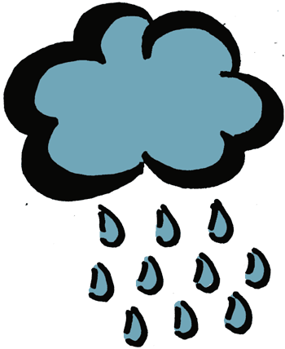
Stratospheric Ozone Depletion
The chlorine in CFCs & HCFCs will neither dissolve in water nor break down into compounds that dissolve in water, so it does not rain out of the atmosphere.
Naturally occurring chlorine will dissolve in water and rain out of the atmosphere.
Notes:
ESCO EPA Section 608 Preparatory Manual 9th Edition Page 8
Unlike other Chlorine compounds and naturally occurring chlorine, the chlorine in CFC's will neither dissolve in water nor break down into compounds that dissolve in water, so it does not rain out of the atmosphere.

Slide 44
Ozone Depletion Potential
Ozone Depletion Potential (ODP) is a measurement of a substance such as CFC’s or HCFC’s ability to destroy ozone.
    CFC's have the highest ODP.
HFCs are made up of hydrogen, fluorine and carbon.
Global Warming Potential (GWP).
Notes:
ESCO EPA Section 608 Preparatory Manual 9th Edition Page 8
Ozone Depletion Potential (ODP) is a measurement of substance such as CFC’s or HCFC's ability to destroy ozone. CFCs have the highest ODP.
HFCs are made up of hydrogen, fluorine and carbon. They do not contain chlorine that effects the ozone layer, but do have a high Global Warming Potential (GWP).

Slide 45
Greenhouse Gases
Warm the Earth in two ways:
By absorbing energy, slowing the rate at which it escapes to space.
Acting like a blanket insulating the Earth.
Notes:
ESCO EPA Section 608 Preparatory Manual 9th Edition Page 8
Greenhouse Gases
Greenhouse gases (GHGs) warm the Earth in two ways: by absorbing energy, slowing the rate at which it escapes to space and by acting like a blanket insulating the Earth. Examples of greenhouse gases and their effects on the atmosphere.

Slide 46
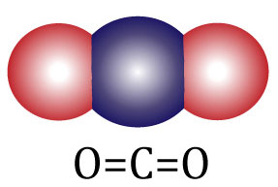
Greenhouse Gases
R-744 Carbon dioxide (CO₂) is a natural gas.
Very high-pressure refrigerant (R-744) with 0 ODP and a Global Warming Potential (GWP) of 1 (one).
Notes:
ESCO EPA Section 608 Preparatory Manual 9th Edition Page 8 & 9
Carbon dioxide (CO₂): CO₂ is a natural gas, created through respiration and absorbed through photosynthesis, a relatively balanced cycle. The addition of manmade CO₂ creates an overabundance and results in excess GHGs that enter the atmosphere as a result of burning fossil fuels (coal, natural gas, and oil), solid waste, wood/products, and is the result of certain chemical reactions such as cement manufacturing. Carbon Dioxide is used as a very high-pressure HC refrigerant (R-744) with 0 ODP and a Global Warming Potential (GWP) of 1 (one). R-744 is used primarily in commercial and industrial process systems and does not require Section 608 certification for purchasing or servicing.

Slide 47
Flammable Refrigerants
Require a red color marking on all process tubes and other pipes through which a flammable refrigerant passes and the service connection.
The color marking must extend one inch in both directions from service locations.
Notes:
ESCO EPA Section 608 Preparatory Manual 9th Edition Page 9
Flammable refrigerants: require a red color marking on all process tubes and other pipes through which a flammable refrigerant passes and the service connection. The color marking must extend one inch in both directions from service locations.

Slide 48
Flammable Refrigerants
Propane (R-290) used as refrigerant must meet the purity standards set for HVACR equipment.
Propane purchased for grilling contains impurities which will damage refrigeration equipment.
Propane and Isobutane (R-600a) are examples of “A3” flammable refrigerants that do not require recovery.
Notes:
ESCO EPA Section 608 Preparatory Manual 9th Edition Page 9
Flammable refrigerants:
When propane is used as refrigerant it must meet the purity standards set for HVACR equipment. Propane purchased for grilling or cooking contains impurities which will damage refrigeration equipment. Propane and isobutane are examples of “A3” flammable refrigerants that do not require recovery. If any flammable refrigerant is recovered, a ground explosion proof recovery machine must be used.

Slide 49
Fluorinated Gases
Fluorinated gases such as the CFCs, HCFCs and HFCs are referred to as High Global Warming Potential gases.
"High GWP gases"
Notes:
ESCO EPA Section 608 Preparatory Manual 9th Edition Page 9
Fluorinated gases: Hydrofluorocarbons, perfluorocarbons, sulfur hexafluoride, and nitrogen trifluoride are synthetic, powerful greenhouse gases that are emitted from a variety of industrial processes. Fluorinated gases such as the CFCs, HCFCs and HFCs are referred to as High Global Warming Potential gases ("High GWP gases").

Slide 50
Fluorinated Gases
R-245fa (Pentafluoropropane) An HFC with (ODP) of 0 and global warming potential (GWP) 1,030 times greater than carbon dioxide.
Low-pressure refrigerant used in commercial industries such as chillers and foams.
Notes:
Additional Information
R-245fa (Pentafluoropropane) An HFC with ozone depletion potential (ODP) of 0 and global warming potential (GWP) 1,030 times greater than carbon dioxide.
Low-pressure refrigerant used in commercial industries such as chillers in place of R-11 and foams.

Slide 51
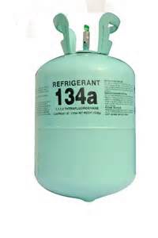
Fluorinated Gases
R-134a (Tetrafluoroethane) An HFC with (ODP) of 0 and global warming potential (GWP) 1,430 times greater than carbon dioxide.
Medium-range pressure refrigerant used in auto, domestic and commercial industries.
Notes:
ESCO EPA Section 608 Preparatory Manual 9th Edition Page 9
R-134a: (Tetrafluoroethane) is an HFC with an ozone depletion potential (ODP) of 0 and global warming potential (GWP) 1,430 times greater than carbon dioxide. R-134a is a medium-range pressure refrigerant used in auto, domestic refrigeration and commercial industries.

Slide 52
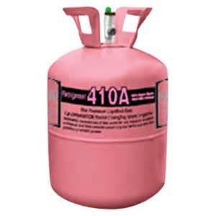
Fluorinated Gases
R-410A (Hydrofluorocarbon)
A high-pressure, HFC refrigerant with an (ODP) of 0 and global warming potential (GWP) 2,090 times greater than carbon dioxide.
A near azeotrope refrigerant that does not fractionate during phase change in HVACR equipment.
Notes:
ESCO EPA Section 608 Preparatory Manual 9th Edition Page 9
R-410A: (Hydrofluorocarbon) is a high-pressure, HFC refrigerant with an ozone depletion potential (ODP) of 0 and global warming potential (GWP) 2,090 times greater than carbon dioxide. R-410A is a near azeotrope refrigerant that does not fractionate during phase change in HVACR equipment. One disadvantage of R-410A is the operating pressure is approximately 50% higher than R-22 and cannot be considered as a drop-in replacement, for retrofitting existing systems.

Slide 53
Hydrofluoro-Olefins Gases
HFOs
R-1234yf Medium-pressure, HFO refrigerant with an (ODP) of 0 Global warming potential (GWP) only 4 times greater than carbon dioxide.
R-1234ze Medium-pressure (New Chillers, heat pumps, and vending machines)
R-1233zd Low-Pressure (New Chillers & Foam blowing)
Notes:
ESCO EPA Section 608 Preparatory Manual 9th Edition Page 9
R-1234yf: (Tetrafluoropropene) R-1234yf is a medium-pressure, HFO refrigerant with an ozone depletion potential (ODP) of 0 and global warming potential (GWP) only 4 times greater than carbon dioxide.
R-1234ze Medium-pressure (New Chillers, heat pumps, and vending machines)
R-1233zd Low-Pressure (New Chillers & Foam blowing)

Slide 54


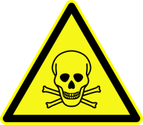
ASHRAE Grouped Refrigerants
Refrigerant Classification
A - Safest
B - Toxicity level to humans
L - Flammability
1 - no flammability
2L- slight flammability
2 - low flammability
3 - high flammability
Safety Group
High Flammability | A3 | B3
Low Flammability | A2 | B2
Slight Flammability | A2L | B2L
No Flammability | A1 | B1
Low
Low
Higher
Toxicity
Notes:
ESCO EPA Section 608 Preparatory Manual 9th Edition Page 9
ASHRAE grouped refrigerants by Class A (Safest) or B, depending on their toxicity level to humans. Flammability is indicated by a 1 (no flammability), 2 (low flammability), or 3 (high flammability). The 2L refrigerants have a burning velocity of 10 cm/s or slower.

Slide 55
CLEAN AIR ACT TITLE Vl
Notes:
ESCO EPA Section 608 Preparatory Manual 9th Edition Page 9
The United States Environmental Protection Agency (EPA) regulates Section 608 of the Federal Clean Air Act which establishes the rules for regulating all Class I (Ozone Depleting Substances such as CFCs), Class II (HCFCs), and substitute refrigerants. Failure to comply could cost you and your company.

Slide 56

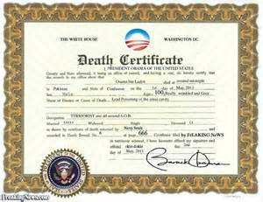

Clean Air Act
Service technicians who violate Clean Air Act provisions may be fined, lose their certification, and be required to appear in Federal Court.
Notes:
ESCO EPA Section 608 Preparatory Manual 9th Edition Page 9
Companies and or service technicians who violate Clean Air Act provisions may lose their certification, be required to appear in Federal Court and be fined up to $44,539 per day, per violation.

Slide 57
Clean Air Act
The EPA may require technicians to demonstrate the ability to properly perform refrigerant recovery/recycling procedures. Failing to demonstrate these skills can result in revocation of certification.
Technicians not following stricter state and local government requirements may lead to other penalties.
Notes:
ESCO EPA Section 608 Preparatory Manual 9th Edition Page 9
The EPA may require technicians to demonstrate the ability to properly perform refrigerant recovery/recycling procedures. Failing to demonstrate these skills can result in revocation of certification. Technicians not following stricter state and local governments requirements may lead to other penalties.

Slide 58
Section 608 Regulations
State and local jurisdictions may impose regulations that are equal to or greater than those under the EPA’s Section 608.
Natural refrigerants such as R744 (Carbon dioxide) that do not pose a threat to health or the environment according to EPA may, be released back into the environment.
Notes:
ESCO EPA Section 608 Preparatory Manual 9th Edition Page 9
State and local jurisdictions may impose regulations that are equal to or greater than those under the EPA’s Section 608. Natural refrigerants such as R744 (Carbon dioxide) that do not pose a threat to health or the environment according to EPA, may be released back into the environment.

Slide 59


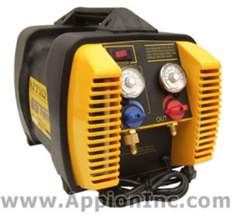
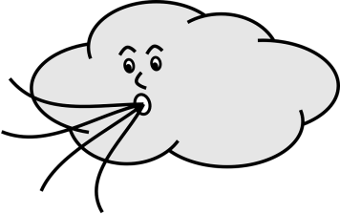
It is a Violation of Section 608 to
Falsify or fail to keep required records.
Fail to reach required evacuation level prior to opening or disposing of appliances.
Knowingly release (vent) ozone depleting and substitute refrigerants (such as CFCs, HCFCs or HFCs) while maintaining, installing, repairing or disposing of appliances or industrial process refrigeration with the exception of de-minimus releases.
Notes:
ESCO EPA Section 608 Preparatory Manual 9th Edition Page 10
Falsify or fail to keep required records.
Fail to reach required evacuation level prior to opening or disposing of appliances.
Knowingly release (vent) ozone depleting and substitute refrigerants (such as CFCs, HCFCs or HFCs) while maintaining, installing, repairing or disposing of appliances or industrial process refrigeration with the exception of de-minimus releases.

Slide 60
De-minimus
So small or minimal in difference that it does not matter and the law does not take it into consideration.
Notes:
De-minimus would be releasing a small amount of refrigerant when disconnecting a refrigerant service hose.

Slide 61
It is a Violation of Section 608 to
Service, maintain, or dispose of appliances designed to contain refrigerants without being appropriately certified.
Fail to recover regulated refrigerants before opening or disposing of an appliance.
Notes:
ESCO EPA Section 608 Preparatory Manual 9th Edition Page 10
It is a Violation of Section 608 to service, maintain, or dispose of appliances designed to contain refrigerants without being appropriately certified.
Fail to recover regulated refrigerants before opening or disposing of an appliance.
;

Slide 62

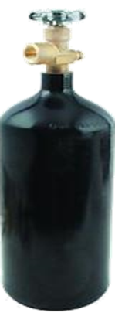
It is a Violation of Section 608 to
Fail to have an EPA approved recovery device, equipped with low-loss fittings that automatically close or have manually operated shut-off valves on the hoses.
Add nitrogen to a fully charged system, for the purpose of leak detection, and thereby causing release of the mixture.
Notes:
ESCO EPA Section 608 Preparatory Manual 9th Edition Page 10
Fail to have an EPA approved recovery device, equipped with low-loss fittings that automatically close or have manually operated shut-off valves on the hoses.
Add nitrogen to a fully charged system, for the purpose of leak detection, and thereby causing a release of the mixture.

Slide 63

It is a Violation of Section 608 to
Dispose of a disposable cylinder without first recovering (to 0 psig) any refrigerant remaining in the cylinder.
Release refrigerant during vandalism or theft of any HVACR equipment.
Notes:
ESCO EPA Section 608 Preparatory Manual 9th Edition Page 10
· Dispose of a disposable cylinder without first recovering (to 0 psig) any refrigerant remaining in the cylinder. (Refrigerant must be recovered from the cylinder, the cylinder must be rendered useless, and then the metal cylinder can be recycled.)
· Release refrigerant during vandalism or theft of any HVACR equipment.

Slide 64
Section 608 Regulations
It is the responsibility of the final person in the disposal chain to ensure that refrigerant has been removed from appliances before scrapping.
Notes:
ESCO EPA Section 608 Preparatory Manual 9th Edition Page 10
It is the responsibility of the final person in the disposal chain to ensure that refrigerant has been removed from appliances before scrapping.

Slide 65
Section 608 Regulations
Technicians disposing of appliances with 5-50 pounds of refrigerant must keep the following records:
The location, date of recovery, and type of refrigerant recovered for each disposed appliance.
The quantity of refrigerant, by type, recovered from disposed appliances in each calendar month.
The quantity of refrigerant, and type, transferred for reclamation or destruction, the person to whom it was transferred, and the date of the transfer.
Notes:
ESCO EPA Section 608 Preparatory Manual 9th Edition Page 10
Technicians disposing of mid-sized appliances with 5-50 pounds of refrigerant must keep the following records:
The location, date of recovery, and type of refrigerant recovered for each disposed appliance;
The quantity of refrigerant, by type, recovered from disposed appliances in each calendar month;
The quantity of refrigerant, and type, transferred for reclamation or destruction, the person to whom it was transferred, and the date of the transfer.

Slide 66

Montreal Protocol
September 1987 – 24 Nations Meet

Slide 67
The Montreal Protocol
An International Treaty.
Regulates the production and use of CFCs, HCFC’s, halons, methyl chloroform, and carbon tetrachloride.
HCFC refrigerant is scheduled for phase out in 2020. When virgin supplies of CFCs and HCFCs are depleted, future supplies will come from only recovered, recycled, or reclaimed refrigerants.
Notes:
ESCO EPA Section 608 Preparatory Manual 9th Edition Page 10
MONTREAL PROTOCOL
Following several years of negotiations, an international agreement (treaty) regulating the production and use of CFCs, HCFCs, halons, methyl chloroform and carbon tetrachloride entered into force in mid 1989. Known as The Montreal Protocol, this landmark agreement initially required a production and consumption freeze. The Montreal Protocol called for a stepwise reduction and eventual production phase-out of various ozone depleting substances (ODS) in developed countries. In the United States, CFCs were the first substance group that was phased-out of production. HCFC refrigerant is scheduled for phase out in 2020. When virgin supplies of restricted refrigerants are depleted, future supplies will come from only recovered, recycled, or reclaimed refrigerants.

Slide 68
The Three Rs (Recover - Recycle - Reclaim)
The processes of recovery, recycling, and reclaiming sound similar, but they are quite different.
Notes:
ESCO EPA Section 608 Preparatory Manual 9th Edition Page 10
The processes of recovery, recycling, and reclaiming sound similar, but they are quite different.

Slide 69
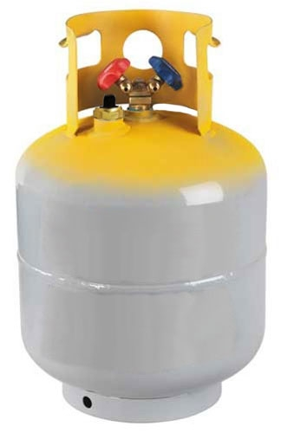

Recovery
To remove refrigerant, in any condition, from an appliance and store it in an EXTERNAL CONTAINER.
Notes:
ESCO EPA Section 608 Preparatory Manual 9th Edition Page 10
Recovery is to remove refrigerant, in any condition, from a system and store it in an external container, to be put back into the same system, recycled, or reclaimed.

Slide 70

Recycle
To clean refrigerant for reuse by separating the oil from the refrigerant and removing moisture by passing it through one or more filter driers.
Notes:
ESCO EPA Section 608 Preparatory Manual 9th Edition Page 10
Recycle is to clean refrigerant for reuse by separating the oil from the refrigerant and removing moisture, and other contaminants from the refrigerant by passing it through one or more filter driers. Recycled refrigerants must meet AHRI 700 Standards before they can be reused in a system owned by someone else.

Slide 71
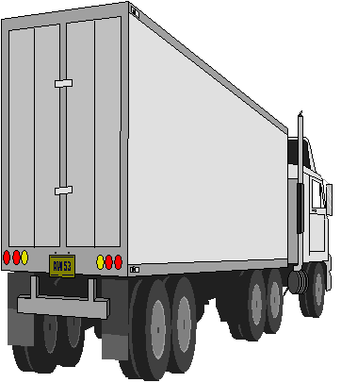
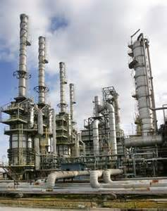
Reclaim
To process refrigerant to a level equal to new product standards as determined by chemical analysis.
Must meet standards set forth in AHRI 700 before it can be resold.
Notes:
ESCO EPA Section 608 Preparatory Manual 9th Edition Page 10
Reclaim is to process refrigerant to a level equal to new (virgin) product specifications as determined by chemical analysis. Reclaimed refrigerants must meet AHRI 740 Standards before they can be reused.

Slide 72
Recovery Devices
Refrigerant recovery and/or recycling equipment manufactured after November 15, 1993, must be certified and labeled by an EPA approved equipment testing organization to meet EPA standards.
Notes:
ESCO EPA Section 608 Preparatory Manual 9th Edition Page 11
Recovery Devices
Refrigerant recovery and/or recycling equipment manufactured after November 15, 1993 must be certified and labeled by an EPA approved equipment testing organization to meet EPA standards.

Slide 73
Recovery Devices
There are two basic types of recovery devices:
System-dependent
Self-contained
Notes:
ESCO EPA Section 608 Preparatory Manual 9th Edition Page 11
There are two basic types of recovery devices:

Slide 74
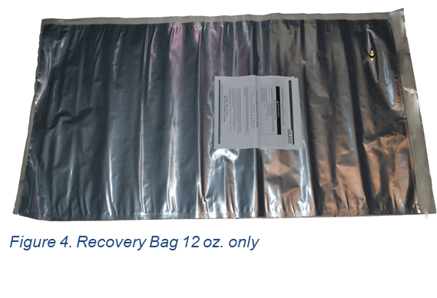
Recovery Devices
“System-dependent” captures refrigerant with the assistance of components in the appliance from which refrigerant is being recovered.
Notes:
ESCO EPA Section 608 Preparatory Manual 9th Edition Page 11
There are two basic types of recovery devices:
“System-dependent” which captures refrigerant with the assistance of components in the appliance from which refrigerant is being recovered.

Slide 75

Recovery Devices
"Self-contained” which has its own means to draw the refrigerant out of the appliance (a compressor).
Notes:
ESCO EPA Section 608 Preparatory Manual 9th Edition Page 11
There are two basic types of recovery devices:
"Self-contained” which has its own means to draw the refrigerant out of the appliance.

Slide 76
Sales Restriction
The sale of CFC and HCFC refrigerants has been restricted to certified technicians since November 14, 1994.
The sale of ozone depleting substances and substitute refrigerants HFC, and HFO refrigerants is restricted to certified technicians as of January 1, 2018.
Notes:
ESCO EPA Section 608 Preparatory Manual 9th Edition Page 11
The sale of CFC and HCFC refrigerants has been restricted to certified technicians since November 14, 1994.
The sale of ozone depleting substances and substitute refrigerants, HFC and HFO refrigerants, is restricted to certified technicians as of January 1, 2018.
Only technicians certified under Section 609 of the Clean Air Act (Motor Vehicle Air Conditioning) are allowed to purchase refrigerants in containers smaller than 20 lbs.

Slide 77
Substitute Refrigerants and Oils
The EPA’s Significant New Alternatives Policy (SNAP) identifies and evaluates substitute refrigerants.
EPA must review and approve new refrigerants before they are introduced for use into HVACR equipment.
Notes:
ESCO EPA Section 608 Preparatory Manual 9th Edition Page 11
The sale of CFC and HCFC refrigerants has been restricted to certified technicians since November 14, 1994. The sale of ozone depleting substances and substitute refrigerants, HFC and HFO refrigerants is restricted to certified technicians as of January 1, 2018. Only technicians certified under Section 609 of the Clean Air Act (Motor Vehicle Air Conditioning) are allowed to purchase refrigerants in containers smaller than 20 lbs.
CFCs or HCFCs can be used for servicing a system that uses the refrigerant after the phaseout. Using CFCs or HCFCs can not be used in new equipment.

Slide 78
Substitute Refrigerants and Oils
EPA's classifications of decisions on alternative substitutes may be listed as:
Acceptable
Acceptable subject to use conditions
Acceptable subject to narrowed use limits
Unacceptable alternatives
Notes:
ESCO EPA Section 608 Preparatory Manual 9th Edition Page 11
EPA's classifications of decisions on alternative substitutes may be listed as:
Acceptable,
Acceptable subject to use conditions,
Acceptable subject to narrowed use limits,
Unacceptable alternatives.

Slide 79
Substitute Refrigerants and Oils
R‐134a is an HFC and is considered ozone friendly.
There is no such thing as a “drop-in” refrigerant
The oils used in most HFC & HFO refrigeration systems are esters. Esters cannot be mixed with other oils.
Notes:
ESCO EPA Section 608 Preparatory Manual 9th Edition Page 11
R‐134a is an HFC and is considered Ozone friendly. R‐134a is the leading candidate for CFC R‐12 retrofit, but it is not a drop‐in substitute. The oils used in most R‐134a refrigeration systems are ESTERS. Esters cannot be mixed with other oils. It is also important to remember that when leak testing an R‐134a system to use pressurized nitrogen.
EPA and compressor manufacturers must approve refrigerant for use. Any change in refrigerant type in a system will change the operating characteristics or void the warranty.

Slide 80
Substitute Refrigerants and Oils
When leak testing an HFC system, use pressurized nitrogen with only a trace amount of refrigerant vapor.
Notes:
ESCO EPA Section 608 Preparatory Manual 9th Edition Page 11
It is also important to remember that, when leak testing an HFC system, use pressurized nitrogen with only a trace amount of refrigerant vapor. In order to avoid contamination use the same refrigerant as the system charge. This is not considered to be a refrigerant that must be recovered.

Slide 81
Substitute Refrigerants and Oils
Ternary blends, a three-part blended mixture.
HCFC 22 and HCFC ternary blends are used with a synthetic alkylbenzene lubricant.
Notes:
ESCO EPA Section 608 Preparatory Manual 9th Edition Page 12
There are several refrigerant blends commonly in use. Some of the blends are called ternary, which means they are a three‐part blend. Ternary blends are used with a synthetic alkylbenzene lubricant. Make certain you are using the correct oil for the refrigerant. Most blends have a temperature glide.

Slide 82

Substitute Refrigerants and Oils
Hygroscopic oil has a high affinity for water.
Most refrigerant oils are hygroscopic.
Notes:
ESCO EPA Section 608 Preparatory Manual 9th Edition Page 12
Make certain you are using the correct oil for the particular refrigerant. Most refrigerant oils are hygroscopic. Hygroscopic oil has a high affinity for water. Some of these oils can absorb water through a plastic container. An oil sample should be taken and analyzed if a system has had a burned compressor winding failure or a major leak allowing moisture to enter the system.

Slide 83
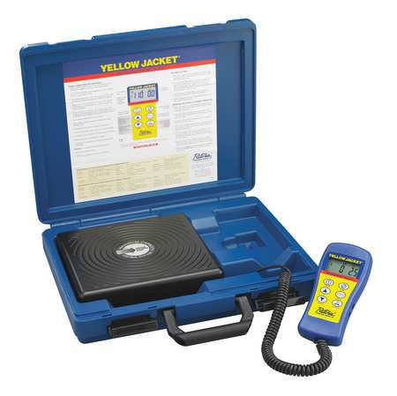
Substitute Refrigerants and Oils
Refrigerant blends are made up of two or more single component refrigerants.
Depending on how strongly the refrigerant molecules are attracted to each other, they may be classified as azeotropic or zeotropic.
Notes:
ESCO EPA Section 608 Preparatory Manual 9th Edition Page 12
Refrigerant blends are made up of two or more single component refrigerants. Depending on how strongly the refrigerant molecules are attracted to each other, they may be classified as azeotropic or zeotropic.

Slide 84
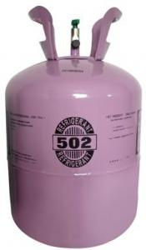
Substitute Refrigerants and Oils
An azeotropic mixture:
Acts like a single component refrigerant over its entire temperature pressure range.
Does not have a temperature glide.
R-502
Notes:
ESCO EPA Section 608 Preparatory Manual 9th Edition Page 12
An azeotropic mixture acts like a single component refrigerant over its entire temperature pressure range. An azeotrope does not have a temperature glide.

Slide 85
Substitute Refrigerants and Oils
Zeotropic blends:
Behave like a mixture of the individual components with predictable properties based on combinations of the original refrigerant’s properties.
Notes:
ESCO EPA Section 608 Preparatory Manual 9th Edition Page 12
Zeotropic blends behave like a mixture of the individual components with predictable properties based on combinations of the original refrigerant’s properties.

Slide 86
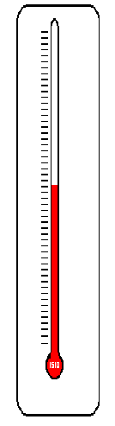

Substitute Refrigerants and Oils
Temperature glide refers to a refrigerant blend that has a range of boiling points and/or condensing points throughout the evaporator and condenser respectively.
Refrigerant fractionation can occur from a continuous leak due to the difference in pressures from the combined refrigerants.
Notes:
ESCO EPA Section 608 Preparatory Manual 9th Edition Page 12
You will need to know the term “temperature glide” as it refers to refrigerants that have a range of boiling points or condensing points throughout the evaporator and condenser pressures. Refrigerant fractionation can occur from a continuous leak due to the difference in pressures from the combined refrigerants. Temperature glide can range as low as 1 tenth of a degree to more than10 degrees.

Slide 87

Substitute Refrigerants and Oils
The R-400 series of refrigerants are blended and the components of a blended refrigerant can leak from a system at uneven rates due to different vapor pressures.
Notes:
ESCO EPA Section 608 Preparatory Manual 9th Edition Page 12
The R-400 series of refrigerants are blended and the components of a blended refrigerant can leak from a system at uneven rates due to different vapor pressures. Then the percentages of the refrigerant blend change due to leaking. The out of balance refrigerant is said to be fractionated.

Slide 88
Substitute Refrigerants and Oils
The proper charging method for blended refrigerants is to weigh into the high side of the system as a liquid.
When adding to an undercharged system, liquid refrigerant is throttled into the low side while the system is operating.
Notes:
ESCO EPA Section 608 Preparatory Manual 9th Edition Page 12
The proper charging method for blended refrigerants is to weigh into the high side of the system as a liquid. When adding to an undercharged system, liquid refrigerant is throttled into the low side while the system is operating.

Slide 89
Substitute Refrigerants and Oils
Bubble and Dew points are used to indicate condensing and evaporation temperatures for blended refrigerants on a pressure temperature saturation chart.
Bubble point is used when charging by condenser sub-cooling.
Dew point is used for charging by suction or evaporator superheat.
Notes:
ESCO EPA Section 608 Preparatory Manual 9th Edition Page 12
The Bubble and Dew points are used to indicate condensing and evaporation temperatures for blended refrigerants on a pressure temperature saturation chart. Bubble point is used when charging by condenser sub-cooling and dew point is used for charging by suction or evaporator superheat. This relationship of pressures and temperatures is based on the refrigerant’s temperature glide. Temperature glide can range a few tenths of a degree to 12 degrees or more.

Slide 90
Substitute Refrigerants and Oils
Even though operating characteristics may be almost the same, the refrigerants cannot be interchanged.
Due to flammability of some of the HC’s and HFO’s, the equipment must be designed to handle the refrigerant.
Notes:
ESCO EPA Section 608 Preparatory Manual 9th Edition Page 12
Even though the pressure temperature relationship, and the operating characteristics may be almost the same, the refrigerants cannot be interchanged. Due to flammability of some of the HC’s and HFO’s, the equipment must be designed to handle the refrigerant. Therefore, EPA regulates the maximum amount of refrigerant that can be use in the new systems by their type and use.

Slide 91
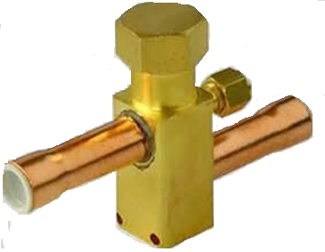
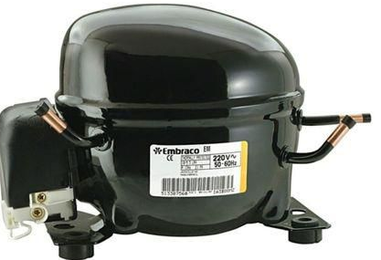
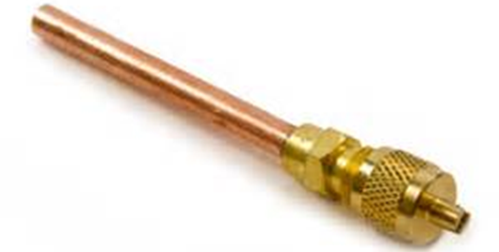
Recovery Techniques
EPA regulations require a service aperture or process stub on all appliances that use a regulated refrigerant in order to make it easier for recovery.
Notes:
ESCO EPA Section 608 Preparatory Manual 9th Edition Page 12
EPA regulations require a service aperture or process stub on all hermetically sealed appliances that use a
regulated refrigerant in order to make it easier to recover refrigerant.

Slide 92
Recovery Techniques
Do not mix refrigerants in a recovery cylinder.
If you discover that two or more refrigerants have been mixed in a system, you must recover the mixture into a separate tank.
Mixtures may be impossible to reclaim.
Badly contaminated and mixed refrigerants must be destroyed at your expense.
Notes:
ESCO EPA Section 608 Preparatory Manual 9th Edition Page 12
When servicing a system, if you discover that the refrigerant is contaminated, two or more refrigerants have been mixed in a system, you must recover the mixture into a separate tank to be turned in for reclamation. It is important NOT to mix different refrigerants in the same recovery tank because the mixture may be impossible to reclaim. Recover only one type of refrigerant into a recovery tank. The number of recovery tanks required by a person or company depends on the variety of equipment worked on and the types of refrigerants.

Slide 93
Recovery Techniques
A strong odor is an excellent indicator of a compressor burn-out.
If you suspect a compressor burn-out, flush the system & watch for signs of contamination in the oil.
If nitrogen is used to flush debris out of the system, the nitrogen may be vented.
A suction line filter drier should be installed to trap any debris that may damage the new compressor.
Notes:
ESCO EPA Section 608 Preparatory Manual 9th Edition Page 12
If a strong odor is detected during the recovery process, a compressor burn‐out has likely occurred. When recovering refrigerant from a system that experienced a compressor burn‐out, watch for signs of contamination in the oil. After recovering refrigerant, if nitrogen is used to flush debris out of the system, the nitrogen may be legally vented. A suction line filter drier should be installed to trap any debris that may damage the new compressor.

Slide 94

Recovery Techniques
The efficiency of the recovery process can be effected by:
The size of the equipment
Amount of moisture
Length of the hose between the unit being recovered from and the recovery machine
The ambient temperature
Notes:
ESCO EPA Section 608 Preparatory Manual 9th Edition Page 12 & 13
The size of the equipment, amount of moisture, length of the hose between the unit being recovered from and the recovery machine, and the ambient temperature can all effect the efficiency of the recovery process. Long hoses will cause excessive pressure drop, increased recovery time, and have a potential for increased emissions or venting from the recovery machine. Excessive venting of the recovery machine or cylinder is illegal.

Slide 95
Recovery Techniques
Refrigerant Pressure/Temperature
Since all refrigerants have a pressure temperature relationship, lower ambient temperatures, result in slower recovery rates.
120
80
Pressure psig.
40
0
20
40
60
80
Temperature ºF
Notes:
ESCO EPA Section 608 Preparatory Manual 9th Edition Page 13
Since all refrigerants have a pressure temperature relationship, the lower the ambient temperature, surrounding the equipment being serviced, the slower the recovery rate will be.

Slide 96
Recovery Techniques
Guard against trapping liquid refrigerant between the service valves.
Recovered refrigerant cannot change ownership.
Notes:
ESCO EPA Section 608 Preparatory Manual 9th Edition Page 13
After completing the transfer of liquid refrigerant between a recovery unit and a refrigeration system, you should guard against trapping liquid refrigerant between the service valves.
Recovered refrigerant may not meet the AHRI standard for virgin refrigerant, therefore it can only be reused in the same system or another system of the same owner. It cannot change ownership.

Slide 97
Leak Detection
Determine the general area of a leak, using an electronic or ultrasonic leak detector.
Soap bubbles will aid in pinpointing the leak.
Notes:
ESCO EPA Section 608 Preparatory Manual 9th Edition Page 13
In order to determine the general area of a leak, use an electronic or ultrasonic leak detector after pressurizing the system with nitrogen and a trace amount of refrigerant. Once the general area of the leak is located, the use of soap bubbles will aid in pinpointing the leak. Finding and repairing leaks in a system will conserve refrigerant for future use.

Slide 98
Leak Detection
Two verification tests are required when an appliance containing 50 pounds of refrigerant or more has triggered the leak rate threshold and subsequently been repaired.
Before the appliance is recharged.
After the appliance returns to normal operating conditions.
Notes:
ESCO EPA Section 608 Preparatory Manual 9th Edition Page 13
Two verification tests are required when an appliance containing 50 pounds of refrigerant or more has triggered the leak rate threshold and subsequently been repaired. One must be performed before the appliance is recharged and one after the appliance returns to its normal operating conditions.

Slide 99
Leak Detection
Section 608 of the Clean Air Act uses three categories to define applicable leak rates for systems that are not considered to be small appliances.
Industrial Process Refrigeration (IPR)
Commercial Refrigeration
Comfort Cooling
Notes:
ESCO EPA Section 608 Preparatory Manual 9th Edition Page 13
Industrial Process Refrigeration (IPR) refers to refrigeration equipment used in agriculture, crop production, oil and gas extraction, ice rinks, manufacture of frozen food, dairy products, food and beverages, ice, petrochemicals, chemicals, machinery, medical equipment, plastics, paper, and electronics.
Commercial Refrigeration refers to refrigerated warehousing and storage facilities, supermarkets, grocery stores, warehouse clubs, supercenters, convenience stores, and refrigerated transport.
Comfort Cooling refers to air-conditioning equipment, and others uses not listed.

Slide 100
Leak Detection
When an appliance is designed for multiple use, the category will be considered industrial process refrigeration equipment if 50 percent or more of its operating capacity is used for industrial process refrigeration.
Notes:
ESCO EPA Section 608 Preparatory Manual 9th Edition Page 13
When an appliance is designed for multiple use, the category will be considered industrial process refrigeration equipment if 50 percent or more of its operating capacity is used for industrial process refrigeration.

Slide 101
Dehydration
Reason for dehydrating a refrigeration system is to remove water and water vapor.
Not possible to over evacuate a system.
Most manufacturers require an evacuation to 500 microns or lower.
Notes:
ESCO EPA Section 608 Preparatory Manual 9th Edition Page 13
Dehydration
The reason for dehydrating a refrigeration system is to remove water and water vapor. It is important to follow proper dehydration procedures. If moisture is allowed to remain in an operating refrigeration system, hydrochloric and hydrofluoric acids may form. Evacuation of a system is the suggested method of dehydration. It is not possible to over evacuate a system. Most manufacturers require an evacuation to 500 microns or lower.

Slide 102
Dehydration
The factors affecting the speed and efficiency of evacuation are:
Size of equipment being evacuated
Ambient temperature
Amount of moisture in the system
The size of the vacuum pump and suction line
Notes:
ESCO EPA Section 608 Preparatory Manual 9th Edition Page 14
The factors that affect the speed and efficiency of evacuation are: size of equipment being evacuated, ambient temperature, amount of moisture in the system, the size of the vacuum pump and suction line. In addition, vacuum lines should be equal to or larger than the pump intake connection. The piping connection to the pump should be as short a length as possible and as large in diameter as possible.

Slide 103
Dehydration
        Vacuum Measurement
        Measuring a system’s vacuum should be done with the system isolated and the vacuum pump turned off.
        Vacuum gauge should be as far away from the vacuum pump as possible.
        Dehydration is complete when the vacuum gauge shows that you have reached and held the required finished vacuum.
Notes:
ESCO EPA Section 608 Preparatory Manual 9th Edition Page 13 & 14
Measuring a systems vacuum should be done with the system isolated, the vacuum pump turned off and the vacuum gauge connected as far away as possible from the vacuum pump. Dehydration is complete when the vacuum gauge shows that you have reached and held the required finished vacuum.

Slide 104
Dehydration
        Heat the refrigeration system to decrease dehydration time.
        Tapping a compressor with a rubber mallet will aid in releasing trapped refrigerant from the oil.
Notes:
ESCO EPA Section 608 Preparatory Manual 9th Edition Page 14
During evacuation you may wish to heat the refrigeration system to decrease dehydration time. Tapping a compressor with a rubber mallet will aid in releasing trapped refrigerant from the oil.

Slide 105

Dehydration
Never operate the compressor while the system is in a deep vacuum; internal electrical arcing could occur burning the motor windings.
Notes:
ESCO EPA Section 608 Preparatory Manual 9th Edition Page 14
Never operate the compressor while the system is in a deep vacuum; internal electrical arcing could occur burning the motor windings.

Slide 106
MICRONS | INCHES OF Hg | Vaporization Temp of Water at each Pressure
0 | 29.921 | ------
20 | 29.92 | -50
100 | 29.92 | -40
150 | 29.92 | -33
200 | 29.91 | -28
300 | 29.91 | -21
500 | 29.90 | -12
1,000 | 29.88 | 1
4,000 | 29.76 | 29
10,000 | 29.53 | 52
20,000 | 29.13 | 72
50,000 | 27.95 | 101
100,000 | 25.98 | 125
200,000 | 22.05 | 152
500,000 | 10.24 | 192
760,000 | 0 | 212
Notes:
This chart is used to show relationship of pressure in microns, inches of Mercury, and vaporization temperatures for water. At 500 microns water will vaporize at any temperature above -12 degrees.

Slide 107

Recovery Cylinders
Disposable cylinders are used with virgin refrigerant only.
NEVER used for recovery.
Notes:
ESCO EPA Section 608 Preparatory Manual 9th Edition Page 14
Recovery cylinders differ in many ways from disposable cylinders. Disposable cylinders are used only with virgin refrigerant and may NEVER be used for recovery. Disposable cylinders have a one-way valve.

Slide 108

Recovery Cylinders
Recovery cylinders have two valves, one liquid and one vapor.
MUST NOT BE FILLED ABOVE 80% of its capacity by weight.
Vapor
Liquid
Notes:
ESCO EPA Section 608 Preparatory Manual 9th Edition Page 14
Recovery cylinders are specifically designed to be refilled. Recovery cylinders have two ports, one liquid and one vapor. Care must be taken not to overfill or heat these cylinders as it could cause an explosion. The EPA requires that a refillable refrigerant cylinder MUST NOT BE FILLED ABOVE 80% of its capacity by weight, and the safe filling level must be controlled by mechanical float devices, electronic shut off devices (thermistors), or weight.

Slide 109

Recovery Cylinders
Identified by their colors, yellow tops and grey bodies.
Should be inspected for rust or damage.
Must be hydrostatically tested and date stamped every 5 years.
Reclaimers will not accept visibly burned recovery tanks.
Notes:
ESCO EPA Section 608 Preparatory Manual 9th Edition Page 14
Refillable cylinders must be DOT (Department of Transportation) approved. Approved refrigerant recovery cylinders can easily be identified by their colors, yellow tops and grey bodies. All refrigerant recovery cylinders should be inspected for rust. If a refillable cylinder shows signs of rust or appears to be have been heated or damaged in any way, it should be reduced to 0 psig by recovering to another cylinder and discarded. Reclaimers will not accept visibly burned recovery tanks. Recovery cylinders are specifically designed to be refilled. Care must be taken not to overfill or heat these cylinders, thereby causing an explosion.

Slide 110
Recovery Cylinders
If they show signs of rust or appear to not be secure, they should be reduced to 0 psig and discarded.
Refillable cylinders used for transporting recovered pressurized refrigerant must be DOT (Department of Transportation) approved.
Notes:
ESCO EPA Section 608 Preparatory Manual 9th Edition Page 14
All refrigerant cylinders should be inspected for rust. If a refillable cylinder shows signs of rust or appears to be damaged in any way, it should be reduced to 0 psig and discarded. Refillable cylinders must be Department of Transportation (DOT) approved.

Slide 111



Safety
When handling and filling refrigerant cylinders, or operating recovery or recycling equipment, you should wear:
Safety Glasses
Safety Hat
Protective Gloves
Notes:
ESCO EPA Section 608 Preparatory Manual 9th Edition Page 14
The EPA is concerned not only with the prevention of refrigerant venting, but with the technician’s overall safety. When handling and filling refrigerant cylinders or operating recovery or recycling equipment, you should wear safety glasses, protective gloves, and follow all equipment manufacturer’s safety precautions.

Slide 112

Safety
Recovery machine must be grounded when in use, especially when recovering a flammable refrigerant .
Notes:
ESCO EPA Section 608 Preparatory Manual 9th Edition Page 14
Make sure recovery machine is grounded when in use, especially when recovering a flammable refrigerant .

Slide 113


Safety
When pressurizing a system with nitrogen, you should:
Charge through a regulator
Insert a relief valve in the downstream line from the pressure regulator
NEVER install relief valves in series
Notes:
ESCO EPA Section 608 Preparatory Manual 9th Edition Page 15
When pressurizing a system with nitrogen, you should always charge through a pressure regulator and insert a relief valve in the downstream line from the pressure regulator. Relief valves MUST NOT be installed in series. If corrosion build-up is found within the body of a relief valve, the valve MUST be replaced.

Slide 114




Safety
Never pressurize the system with oxygen or compressed air!
To determine the safe pressure for leak testing, check the equipment data plate.
No oxygen!
Notes:
ESCO EPA Section 608 Preparatory Manual 9th Edition Page 15
When leak checking a system, NEVER pressurize the system with oxygen or compressed air. When mixed with refrigerants, oxygen or compressed air can cause an explosion. To determine the safe pressure for leak testing, check the equipment data plate for the maximum low-side test pressure value.

Slide 115

Safety
          It is critical to inspect the Schrader valve core for leaks, bends and breakage.
Replace damaged valve cores!
Notes:
ESCO EPA Section 608 Preparatory Manual 9th Edition Page 15
When using recovery cylinders and equipment with Schrader valves, it is critical to inspect the Schrader valve core for leaks, bends and breakage. Replace damaged valve cores to prevent leakage, and always cap Schrader ports to prevent accidental depression of the valve core.

Slide 116

Safety
If a large leak of refrigerant occurs in an enclosed area, and SCBA is not available,
IMMEDIATELY VACATE AND VENTILATE THE AREA.
Notes:
ESCO EPA Section 608 Preparatory Manual 9th Edition Page 15
In the event of a “large” release of refrigerant in a confined area, Self Contained Breathing Apparatus (SCBA) is required. If a large leak of refrigerant occurs in an enclosed area, and SCBA is not available, IMMEDIATELY VACATE AND VENTILATE the area. In large quantities, all refrigerants can cause suffocation because they can displace oxygen. Inhaling refrigerant vapors or mist may cause heart irregularities, unconsciousness, and oxygen deprivation leading to death (asphyxia).

Slide 117

Safety
NEVER heat a refrigerant cylinder with an open flame.
Do not cut or braze refrigerant lines on a charged unit.
Notes:
ESCO EPA Section 608 Preparatory Manual 9th Edition Page 15
NEVER expose refrigerants to open flames or glowing hot metal surfaces. At high temperatures, refrigerants decompose and form acids. Hydrochloric acid is formed if the refrigerant contains chlorine, and hydrofluoric acid is formed if the refrigerant contains fluorine. If oxygen is also present, it is possible to form carbon monoxide, carbon dioxide and phosgene gas. If a hydrocarbon refrigerant is released into a space, an explosion can occur if the refrigerant concentration is above the Lower Flammability Limit and below the Upper Flammability Limit with an ignition source.

Slide 118

Dehydration
When moisture is allowed to remain in an operating refrigeration system, hydrochloric and hydrofluoric acids may form.
Notes:
ESCO EPA Section 608 Preparatory Manual 9th Edition Page 13
If moisture is allowed to remain in an operating refrigeration system, hydrochloric and hydrofluoric acids may form. Evacuation of a system is the suggested method of dehydration. It is not possible to over evacuate a system.

Slide 119

Safety
In large quantities, refrigerants can cause suffocation because they are heavier than air and displace oxygen.
Inhaling refrigerant vapors or mist may cause heart irregularities, unconsciousness, and oxygen deprivation leading to death (asphyxia).
Notes:
ESCO EPA Section 608 Preparatory Manual 9th Edition Page 15
In large quantities, all refrigerants can cause suffocation because they can displace oxygen. Inhaling refrigerant vapors or mist may cause heart irregularities, unconsciousness, and oxygen deprivation leading to death (asphyxia).

Slide 120

Safety
Review the material safety data sheets (SDS), when working with any solvents, chemicals, or refrigerants.
Notes:
ESCO EPA Section 608 Preparatory Manual 9th Edition Page 15
Always review the Safety Data Sheets (SDS), when working with any solvents, chemicals, or refrigerants. Silicone elastomers for use in seals and gaskets are not compatible with HFO refrigerants.
.

Slide 121
Shipping and Transportation
Before shipping used refrigerant cylinders, cylinder must meet DOT standards.
Complete the shipping paperwork, including the number of cylinders of each refrigerant,
Properly label each cylinder with the type and amount of refrigerant.
Cylinders should be transported in an upright position.
Notes:
ESCO EPA Section 608 Preparatory Manual 9th Edition Page 15
Before shipping any used refrigerant cylinders, check that the cylinder meets DOT standards. Complete the shipping paperwork, including the number of cylinders of each refrigerant, and properly label the cylinder with the type and amount of refrigerant, before returning for reclaiming . Cylinders should be transported in an upright position.

Slide 122
Shipping and Transportation
Each cylinder must have a DOT classification tag indicating it is either a flammable or non-flammable gas.
Some states may require special shipping procedures to be followed based on their classification of used refrigerants. Check with the DOT in the state of origin.
Notes:
ESCO EPA Section 608 Preparatory Manual 9th Edition Page 15
Each cylinder must be marked with a DOT classification tag indicating it is either a flammable or non‐flammable gas. Some states may require special shipping procedures to be followed based on their classification of used refrigerants. Check with the DOT in your state.

Slide 123

Notes:
ESCO EPA Section 608 Preparatory Manual 9th Edition Page 16
The chart depicts old and new refrigerants, types of refrigerant CFC, HCFC, HFC, HC and HFO, the Ozone Depletion Potential (ODP), the Global Warming Potential (GWP), common use, EPA pressure range, and ASHRAE class.

Slide 124

Type I

Slide 125
Type I Certification Contents
Equipment Requirements
Leak Repair Requirements
Recovery Techniques
Safety & Shipping
Notes:
ESCO EPA Section 608 Preparatory Manual 9th Edition Page 17

Slide 126
Type I
The EPA definition of a small appliance includes products manufactured, charged, and hermetically sealed in a factory with five pounds of refrigerant or less.
Technicians must have Type I or Universal Certification.
Notes:
ESCO EPA Section 608 Preparatory Manual 9th Edition Page 17
The EPA definition of a small appliance includes products manufactured, charged, and hermetically sealed in a factory with five pounds or less of refrigerant.
Persons handling refrigerant during maintenance, service, or repair of small appliances must be certified as either a Type I or a Universal Technician.

Slide 127
Type I
The sale of ozone depleting substances such as CFCs, HCFCs, HFCs and HFOs is restricted to certified technicians.
Notes:
ESCO EPA Section 608 Preparatory Manual 9th Edition Page 17
The sale of ozone depleting substances such as CFCs, HCFCs, HFCs and HFOs is restricted to certified technicians.

Slide 128



Recovery Equipment
Notes:
ESCO EPA Section 608 Preparatory Manual 9th Edition Page 17

Slide 129
Equipment Requirements
Recovery equipment must be certified by an EPA approved testing laboratory. (example, U.L. or E.T.L)
Notes:
ESCO EPA Section 608 Preparatory Manual 9th Edition Page 17
Passive (system dependent) or active (self-contained) recovery equipment must be certified by an EPA-approved testing laboratory, (example, U.L. or E.T.L).

Slide 130
System Dependent Recovery
Recovery equipment must be able to recover 80% of the refrigerant in a small appliance with a nonoperating compressor.
Recovery equipment must be able to recover 90% of the refrigerant in a small appliance when the compressor operates.
Notes:
ESCO EPA Section 608 Preparatory Manual 9th Edition Page 17
When using system dependent recovery equipment it must be able recover 80% of the refrigerant in the small appliance when the appliance compressor does not operate and recover 90% of the refrigerant when the compressor in the appliance is functioning.

Slide 131
Recovery
Evacuating the appliance to four inches of mercury vacuum is low enough to satisfy the rules.
Notes:
ESCO EPA Section 608 Preparatory Manual 9th Edition Page 17
Evacuating the appliance to four inches of mercury vacuum is low enough to satisfy the rules.

Slide 132
Equipment Requirements
All recovery equipment must be equipped with low-loss fittings that can be manually closed, or close automatically, when hoses are disconnected, to minimize the refrigerant loss.
Notes:
ESCO EPA Section 608 Preparatory Manual 9th Edition Page 17
All recovery equipment must be equipped with low-loss fittings that can be manually closed, or close automatically, when hoses are disconnected, to minimize the refrigerant loss.

Slide 133
HC Refrigerant
Isobutene (R-600a) is approved as substitute refrigerant for new household refrigerators, freezers, and combination refrigeration/freezers.
None of the hydrocarbon refrigerants can be used for retrofitting a small appliance.
Notes:
ESCO EPA Section 608 Preparatory Manual 9th Edition Page 17
Isobutene (R-600a) is approved as substitute refrigerant for new household refrigerators, freezers, and combination refrigeration/freezers. None of the hydrocarbons refrigerants can be used for retrofitting a small appliance. They can be used in newly manufactured systems.

Slide 134
Leak Repair Requirements
EPA does not require leak repair for small appliances, however, leaks should be repaired whenever possible.
Notes:
ESCO EPA Section 608 Preparatory Manual 9th Edition Page 17
The EPA does not require leak repair for small appliances, but leaks should be repaired whenever possible to conserve refrigerant . Make sure the valve cores are tight and the caps are on the Schrader ports to prevent accidental depression and leaking from the valve cores.

Slide 135




Recovery Techniques
Before beginning a refrigerant recovery procedure, it is necessary to know the type of refrigerant that is in the system.
HFC
Notes:
ESCO EPA Section 608 Preparatory Manual 9th Edition Page 17
Before beginning a refrigerant recovery procedure, it is necessary to know the type of refrigerant that is in the system.

Slide 136
Recovery Techniques
After recovery, if contaminants are present in the oil, the system will have to be flushed with a cleaning solvent designed for the type of refrigerant in the system.
To speed up the recovery process tap into both the low and high side of the system.
Notes:
ESCO EPA Section 608 Preparatory Manual 9th Edition Page 17
After recovery, if contaminants are present in the oil, the system will have to be flushed with a cleaning solvent designed for the type of refrigerant in the system. To speed up the recovery process tap into both the low and high side of the system.

Slide 137

Recovery Techniques
A reclamation facility that receives a tank of mixed refrigerant may refuse to process the refrigerant and destroy it at the owner's expense.
Do not mix refrigerants in a recovery tank.
Notes:
ESCO EPA Section 608 Preparatory Manual 9th Edition Page 17
If a reclamation facility receives a tank of mixed refrigerant, they may refuse to process the refrigerant and will instead destroy it at the owner's expense. Do not mix refrigerants in a recovery tank.

Slide 138
Recovery Techniques
Self-Contained (Active)Equipment
Has its own means of removing refrigerant from appliances.
Capable of reaching the required recovery rates whether or not the appliance compressor is operable.
Pumps refrigerant in a pressurized recovery tank.
Notes:
ESCO EPA Section 608 Preparatory Manual 9th Edition Page 17
Self-contained (active) recovery equipment has its own means of pumping and removing refrigerant from an appliance, and is capable of reaching the required recovery levels whether or not the appliance compressor is operable. Self-contained recovery equipment pumps the refrigerant into a pressurized recovery tank.

Slide 139
Recovery Techniques
Self-Contained (Active) Equipment Operation
Make sure tank inlet valve is open.
Measure refrigerant pressure accurately at a stable, known temperature.
Remove excessive non–condensables (air) from the recovery tank if required.
Notes:
ESCO EPA Section 608 Preparatory Manual 9th Edition Page 17
Before operating a self‐contained recovery machine, make sure that the tank inlet valve is open, and that the recovery tank does not contain excessive non–condensables, (air). Obtaining accurate pressure readings of refrigerant inside a recovery cylinder is necessary to detect excessive non‐condensables. The only way to measure the refrigerant pressure temperature relationship accurately is at a stable, known temperature.

Slide 140
Recovery Techniques
Self-Contained (Active) Equipment Operation
Air in a refrigeration system will cause higher discharge pressures in the system and recovery equipment.
Follow the operating instructions supplied by the recovery equipment manufacturer regarding purging of non-condensables.
Notes:
ESCO EPA Section 608 Preparatory Manual 9th Edition Page 17
Air in a refrigeration system will cause higher discharge pressures in the system and recovery equipment. Follow the operating instructions supplied by the recovery equipment manufacturer regarding purging of non-condensables.

Slide 141
Recovery Techniques
All refrigerant recovery equipment should be checked for oil level and refrigerant leaks on a daily basis.
Notes:
ESCO EPA Section 608 Preparatory Manual 9th Edition Page 17
All refrigerant recovery equipment should be checked for oil level and refrigerant leaks on a daily basis.

Slide 142
Recovery Techniques
When using a recovery machine on very low horsepower systems such as domestic refrigerators and freezers that contain a few ounces of refrigerant, it is important to recover the refrigerant from the low and high sides to prevent oil migration.
Notes:
ESCO EPA Section 608 Preparatory Manual 9th Edition Page 17
When using a recovery machine on very low horsepower systems such as domestic refrigerators and freezers that contain a few ounces of refrigerant, it is important to recover the refrigerant from the low and high sides to prevent oil migration.

Slide 143


Recovery Techniques
System-Dependent (Passive) Equipment
Captures refrigerant into a non-pressurized container.
  May be a special reinforced plastic “bag” container.
Captures refrigerant with the assistance of the appliance compressor or an external heat source.
Notes:
ESCO EPA Section 608 Preparatory Manual 9th Edition Page 18
A system-dependent (passive) recovery process for small appliances captures refrigerant into a non-pressurized container. This may be a special plastic “bag” container large enough to contain a few ounces of refrigerant.
Captures the refrigerant with the assistance of the appliance compressor or from an external heat source.

Slide 144

Recovery Techniques
Turning on the defrost heater to warm evaporator.
Using a vacuum pump to evacuate recovery tank before starting the recovery process.
Notes:
ESCO EPA Section 608 Preparatory Manual 9th Edition Page 18
An external heat source such as the defrost heater may be used to vaporize liquid refrigerant in the appliance. A vacuum pump can be used to evacuate the recovery tank before starting the recovery process.

Slide 145


Vacuum Pump
The vacuum pump is only used to reduce the pressure of a recovery cylinder or container into a vacuum before the recovery process.
Notes:
ESCO EPA Section 608 Preparatory Manual 9th Edition Page 18
A standard vacuum pump can only be used as a recovery device in combination with a non-pressurized container. The vacuum pump is only used to reduce the pressure of recovery cylinder or container into a vacuum before the recovery process.

Slide 146
Recovery Techniques
System-Dependent (Passive) Equipment
When using a system-dependent recovery process on an appliance with an operating compressor, run the compressor and recover from the high side of the system.
Usually, one access fitting on the high side will be sufficient to reach the required recovery rate as the appliance compressor should be capable of pumping the refrigerant to the high side.
Notes:
ESCO EPA Section 608 Preparatory Manual 9th Edition Page 18
With system-dependent recovery equipment, some special procedures may be necessary depending on the condition of the appliance. When using a system-dependent recovery process on an appliance with an operating compressor, run the compressor and recover from the high side of the system. Usually, one access fitting on the high side will be sufficient to reach the required recovery rate as the appliance compressor should be capable of pumping the refrigerant to the high side. The discharge line can be pinched closed to force the refrigerant out to the container.

Slide 147
Recovery Techniques
System-Dependent (Passive) Equipment
If the appliance has a non-operating compressor, access to both the low and high side of the system may be necessary.
To help release trapped refrigerant from the compressor oil, heat and tap the compressor several times.
Notes:
ESCO EPA Section 608 Preparatory Manual 9th Edition Page 18
If an appliance has a non-operating compressor, it may be necessary to access both the low and high side of the system to remove 80% of the refrigerant. To achieve the required recovery efficiency heating and tapping the compressor several times will help release trapped refrigerant from the compressor oil.

Slide 148
Recovery Techniques
System-Dependent (Passive) Equipment
Because appliances with non-operating compressors can not always achieve desired evacuation levels utilizing system-dependent recovery equipment, the EPA requires technicians to have at least one self-contained recovery device available at the shop to recover refrigerant from systems with non-operating compressors.
Notes:
ESCO EPA Section 608 Preparatory Manual 9th Edition Page 18
Because appliances with non-operating compressors cannot always achieve desired evacuation levels utilizing system-dependent recovery equipment, the EPA requires technicians to have at least one self-contained recovery device available at the shop to recover refrigerant from systems with non-operating compressors.

Slide 149
Recovery Techniques
System-Dependent (Passive) Equipment
System dependent devices may only be used on appliances containing 15 lbs. of refrigerant or less.
Notes:
ESCO EPA Section 608 Preparatory Manual 9th Edition Page 18
Even though system dependent devices may only be used on appliances containing 15 lbs. of refrigerant or less, depending on the amount of refrigerant in the appliance with a non-operating compressor it may be impossible to reach the required recovery level without an active recovery machine.

Slide 150
Recovery Techniques
Installing Piercing Type Access Fittings
Small appliances are equipped with a straight piece of tubing, called a process tube, onto which a piercing type access fitting can be installed.
Notes:
ESCO EPA Section 608 Preparatory Manual 9th Edition Page 18
Small appliances are equipped with a straight piece of tubing, called a process tube, onto which a piercing type access fitting can be installed.

Slide 151



Recovery Techniques
Installing Piercing Type Access Fittings
After installing an access fitting onto a sealed system, the fitting should be leak tested.
Solderless piercing type valves can only be used on copper or aluminum tubing material.
Notes:
ESCO EPA Section 608 Preparatory Manual 9th Edition Page 18
When installing an access fitting onto a sealed system, the fitting should be leak tested before proceeding with recovery. It is generally recommended that solderless piercing type valves only be used on copper or aluminum tubing material.

Slide 152
Recovery Techniques
Access fittings tend to leak over time and should not be left on an appliance as a permanent service fixture.
If after installing an access fitting, you find that the system pressure is 0 psig., do not begin the recovery process.
Notes:
ESCO EPA Section 608 Preparatory Manual 9th Edition Page 18
Access fittings tend to leak over time and should not be left on an appliance as a permanent service fixture. If after installing an access fitting, you find that the system pressure is 0 psig., do not begin the recovery process.

Slide 153


Recovery Techniques
Compressor burn‐out may be indicated by strong refrigerant odor.
Watch for signs of contamination in the oil.
Notes:
ESCO EPA Section 608 Preparatory Manual 9th Edition Page 18
If a strong odor is detected during the recovery process, a compressor burn-out has likely occurred. When recovering refrigerant from a system that experienced a compressor burn-out, watch for signs of contamination in the oil.

Slide 154
Recovery Techniques
After recovery, if nitrogen is used to flush debris out of the system, the nitrogen may be legally vented.
Notes:
ESCO EPA Section 608 Preparatory Manual 9th Edition Page 18
After recovering refrigerant, if nitrogen is used to flush debris out of the system, the nitrogen may be legally vented.

Slide 155

Recovery Techniques
Small appliances used in campers or other recreational vehicles may use refrigerants such as ammonia, hydrogen, or water, and therefor, should not be recovered using current recovery equipment.
Notes:
ESCO EPA Section 608 Preparatory Manual 9th Edition Page 18
Small appliances used in campers or other recreational vehicles may use refrigerants such as ammonia, hydrogen, or water, and therefore, should not be recovered using current recovery equipment.

Slide 156

Recovery Techniques
When filling a graduated charging cylinder with a regulated refrigerant, the refrigerant vapor that is vented off the top of the cylinder must be recovered.
Notes:
ESCO EPA Section 608 Preparatory Manual 9th Edition Page 18
When filling a graduated charging cylinder with a regulated refrigerant, the refrigerant vapor that is vented off
the top of the cylinder must be recovered.

Slide 157
Hydrocarbon Refrigerants
Hydrocarbon refrigerants are NOT approved for retrofit into existing household appliances.
The appliance must be designed for a hydrocarbon refrigerant.
Must be labeled as to the type of refrigerant.
Label must be placed on the outside of the appliance in view of the service location.
Notes:
Hydrocarbon refrigerants are not approved for retrofit into existing household appliances. The appliances designed for a hydrocarbon refrigerant must be labeled as to the type of flammable HC refrigerant. A label must be placed on the outside of the appliance in view of the service location with the service connections indicated in red.

Slide 158

Type II
Notes:
ESCO EPA Section 608 Preparatory Manual 9th Edition Page 19
Technicians maintaining, servicing, repairing or disposing of high pressure or very high pressure appliances, except small appliances and motor vehicle air conditioning systems (MVAC), must be certified as a Type II Technician or a Universal Technician.

Slide 159

Type Il Certification Contents
Leak Detection
Leak Repair Requirements
Recovery Techniques
Recovery Requirements
Refrigeration Notes
Safety
Notes:
ESCO EPA Section 608 Preparatory Manual 9th Edition Page 19
Leak Detection
Leak Repair Requirements
Recovery Techniques
Recovery Requirements
Refrigeration Notes
Safety

Slide 160
Type II
Technicians maintaining, servicing, repairing or disposing of medium, high, or very high-pressure appliances, except small appliances and motor vehicle air conditioning systems, must be certified as a Type II or a Universal Technician.
Notes:
ESCO EPA Section 608 Preparatory Manual 9th Edition Page 19
Technicians maintaining, servicing, repairing or disposing of medium, high, or very high-pressure appliances, except small appliances and motor vehicle air conditioning systems (MVAC), must be certified as a Type II Technician or a Universal Technician.

Slide 161

Leak Detection
Installation of any type of system, should first be pressurized with nitrogen (an inert gas) and leak checked.
Notes:
ESCO EPA Section 608 Preparatory Manual 9th Edition Page 19
After the installation of any type of system, the unit should first be pressurized with nitrogen (an inert gas) and leak checked.

Slide 162


Leak Detection
To determine the general area of a leak, use an electronic or ultrasonic leak detector.
Use soap bubbles to pinpoint a leak.
Notes:
ESCO EPA Section 608 Preparatory Manual 9th Edition Page 19
To determine the general area of a leak use an electronic or ultrasonic leak detector. Once the general area of the leak is located the use of soap bubbles will pinpoint the leak.

Slide 163
Leak Detection
In order to use an electronic leak detector on a system that is pressurized with nitrogen, a trace of refrigerant must be added to the system.
Notes:
ESCO EPA Section 608 Preparatory Manual 9th Edition Page 19
In order to use an electronic leak detector on a system that is pressurized with nitrogen, a trace of refrigerant must be added to the system.

Slide 164

Leak Detection
An open compressor that has not been used in several months is likely to leak from the shaft seal.
Notes:
ESCO EPA Section 608 Preparatory Manual 9th Edition Page 19
A refrigeration unit using an open compressor that has not been used in several months is likely to leak from the rotating shaft seal.

Slide 165

Leak Detection
Visual leak inspection
Traces of oil indicate refrigerant leaks.
Notes:
ESCO EPA Section 608 Preparatory Manual 9th Edition Page 19
During a visual inspection of any type of system, traces of oil are an indication of a refrigerant leak.

Slide 166

Leak Detection
Measure Superheat with P/T Method
R-22
Actual Line Temperature 40°F
Measure the temperature of suction line.
Measure suction pressure at evaporator outlet.
Convert pressure to Saturation Temperature.
Subtract Saturated Temp from suction line Temp to find superheat.
33°F
58.5 PSIG
Actual Superheat = 7°F
Notes:
ESCO EPA Section 608 Preparatory Manual 9th Edition Page 19
Excessive superheat, caused by a low refrigerant charge, is also an indication of a leak in a high‐pressure system.

Slide 167

Leak Repair Requirements
All comfort cooling appliances containing 50 lbs. or more of ODS refrigerant or substitute refrigerant must have annual leak inspections to determine if the appliances are leaking.
Notes:
ESCO EPA Section 608 Preparatory Manual 9th Edition Page 19
Major Change from previous manual.
EPA regulations require all comfort cooling (air conditioning) appliances containing 50 lbs. or more of Ozone Depletion Substance (ODS) or substitute refrigerant to have annual leak inspections to determine if the appliances are leaking.

Slide 168
Leak Repair Requirements
The appliance must be repaired within 30 days when the annual leak rate exceeds 10% of the total charge.
A leak-test must be performed after each repair attempt.
A follow-up verification leak-test must be conducted within 10 days of the repair.
Notes:
ESCO EPA Section 608 Preparatory Manual 9th Edition Page 19
The appliance must be repaired within 30 days when the annual leak rate exceeds 10% of the total charge. A leak-test must be performed after each repair attempt, and a follow-up verification leak-test must be conducted within 10 days of the repair.

Slide 169
Leak Repair Requirements
The time frame for mandatory leak repair can only be extended by a certified service technician.
If the leaking appliance is not going to be repaired, it must be retired or mothballed.
When an appliance is mothballed, the leaking component of the system must be isolated and the refrigerant recovered to prevent further leaking.
Notes:
ESCO EPA Section 608 Preparatory Manual 9th Edition Page 19
The time frame for mandatory leak repair can only be extended by a certified service technician. If the leaking appliance is not going to be repaired, it must be retired or mothballed. When an appliance is mothballed, the leaking component of the system must be isolated and the refrigerant recovered to prevent further leaking.

Slide 170

Leak Repair Requirements
A Type II appliance that will not be repaired must be retrofitted or retired within 12 months.
If the appliance is using an exempt refrigerant, the owner has 18 months to retire the leaking system.
Notes:
ESCO EPA Section 608 Preparatory Manual 9th Edition Page 19
A Type II appliance that will not be repaired must be retrofitted or retired within 12 months. If the appliance is using an exempt refrigerant then the owner has 18 months to retire the leaking system.

Slide 171

Leak Repair Requirements
Comfort cooling
Containing more than 50 lbs. of refrigerant MUST be repaired when the annual leak rate exceeds 10%.
Notes:
ESCO EPA Section 608 Preparatory Manual 9th Edition Page 19
Major Change from previous manual.
EPA regulations require all comfort cooling (air conditioning) appliances containing 50 lbs. or more of ODS or substitute refrigerant to have annual leak inspections to determine if the appliance is leaking. The appliance must be repaired within 30 days when the annual leak rate exceeds 10% of the total charge. A leak-test must be performed after each repair attempt, and a follow-up verification leak-test must be conducted within 10 days of the repair.

Slide 172

Leak Repair Requirements
Commercial Refrigeration
Containing more than 50 lbs. of refrigerant MUST be repaired when the annual leak rate exceeds 20%.
Notes:
ESCO EPA Section 608 Preparatory Manual 9th Edition Page 19
Major Change from previous manual.
All commercial and industrial process refrigeration (IPR) containing more than 50 lbs. of refrigerant MUST be repaired when the annual leak rate is exceeded. The maximum leak rate is 20% for commercial appliances. A leak-test must be performed after each repair attempt, and a follow-up verification leak-test must be conducted within 10 days of the repair.

Slide 173

Leak Repair Requirements
Industrial Process Refrigeration
Containing more than 50 lbs. of refrigerant MUST be repaired when the annual leak rate exceeds 30%.
Notes:
ESCO EPA Section 608 Preparatory Manual 9th Edition Page 19
Major Change from previous manual.
EPA is finalizing leak rates for IPR appliances equipment with an ozone depleting refrigerant at 30 percent. EPA is also extending the new leak rates to equipment using HFCs and other substitute refrigerants that are not exempt from the venting prohibition. All Industrial process refrigeration (IPR) containing more than 50 lbs. of refrigerant MUST be repaired when the annual leak rate exceeds 30%. A leak-test must be performed after each repair attempt, and a follow-up verification leak-test must be conducted within 10 days of the repair.

Slide 174
Leak Repair Requirements
Industrial Process Refrigeration
When one appliance is used for both industrial process refrigeration and other applications, it will be considered industrial process refrigeration equipment when 50% or more of its operating capacity is used for industrial process refrigeration.
Notes:
ESCO EPA Section 608 Preparatory Manual 9th Edition Page 19
Major Change from previous manual.
When one appliance is used for both industrial process refrigeration and other applications, it will be considered industrial process refrigeration equipment when 50% or more of its operating capacity is used for industrial process refrigeration.

Slide 175
Leak Repair Requirements
Commercial refrigeration appliances and IPR with a full charge of 500 or more pounds of an ODS or substitute refrigerant will require a leak inspection to be conducted every three months unless a refrigerant leak monitoring system is installed.
Notes:
ESCO EPA Section 608 Preparatory Manual 9th Edition Page 19
Commercial refrigeration appliances and IPR with a full charge of 500 pounds or more of an ODS or substitute refrigerant will require a leak inspection to be conducted every three months unless a refrigerant leak monitoring system is installed or it has not exceeded the leak rate for four quarters.

Slide 176
Leak Repair Requirements
The total system refrigerant charge can be calculated by adding the charge for each component and the piping.
When an appliance leaks 125% or more, the owner must submit a report to EPA describing efforts to identify leaks and repair.
Notes:
ESCO EPA Section 608 Preparatory Manual 9th Edition Page 19
The total system refrigerant charge can be calculated by adding the charge for each component and the piping. Using the calculated charge, the leak rate percentage can be determined for the quantity of refrigerant added to a system that is new, retrofitted, or adjusted for seasonal variance. When an appliance leaks 125% or more, the owner must submit a report to EPA describing efforts to identify leaks and repair.

Slide 177
Leak Repair Requirements
All records for leak inspections, initial verification, verification tests and records of recovered refrigerant from equipment with 5 to 50 lbs. must be kept for 3 years by the owner or operator.
This includes, the quantity of refrigerant, by type, added, recovered from disposed appliances in each calendar month and quantity of refrigerant, by type, sent for reclamation or destruction.
Notes:
ESCO EPA Section 608 Preparatory Manual 9th Edition Page 19
Major change from previous manual.
All records for leak inspections, initial verification, verification tests and records of recovered refrigerant from equipment with 5 to 50 lbs. must be kept for 3 years by the owner or operator. This includes the quantity of refrigerant, by type, added, recovered from disposed appliances in each calendar month and quantity of refrigerant, by type, sent for reclamation or destruction.

Slide 178
Leak Repair Requirements
Topping off a system is considered adding refrigerant due to a leak and must be accounted for in the leak-rate calculation.
Adjusting the charge for seasonal variance is not considered in a leak rate calculation.
Notes:
ESCO EPA Section 608 Preparatory Manual 9th Edition Page 19
Major change from previous manual.
Topping off a system is considered adding refrigerant due to a leak and must be accounted for in the leak-rate calculation and adjusting for seasonal variance is not considered in a leak rate calculation.

Slide 179

Recovery Techniques
Recovery Equipment
Must be certified by an EPA approved laboratory (UL or ETL) to meet or exceed AHRI standards.
Notes:
ESCO EPA Section 608 Preparatory Manual 9th Edition Page 20
Proper recovery techniques begin with the use of appropriate recovery equipment that has been certified by an EPA approved laboratory (UL or ETL) to meet or exceed AHRI Standards.

Slide 180



Recovery Techniques
Recovered refrigerants can contain acids, moisture, and oil.
Burn Out
Notes:
ESCO EPA Section 608 Preparatory Manual 9th Edition Page 20
Recovered refrigerants may contain acids, moisture, and oil.

Slide 181
Recovery Techniques
Frequently check and change both the oil and filter on a recovery/recycling unit as required.
Notes:
ESCO EPA Section 608 Preparatory Manual 9th Edition Page 20
It is necessary to frequently check and change both the oil and filter on a recovery/recycling unit.

Slide 182

Recovery Techniques
Some recycling and recovery equipment using hermetic compressors have the potential to overheat when drawing a deep vacuum.
Hermetic compressors depend on on the flow of refrigerant through the compressor for cooling.
Notes:
ESCO EPA Section 608 Preparatory Manual 9th Edition Page 20
Both recycling and recovery equipment using hermetic compressors have the potential to overheat when drawing a deep vacuum because the unit relies on the flow of refrigerant through the compressor for cooling.

Slide 183

Recovery Techniques
Before using a recovery unit, you should always:
Check the service valve positions.
Check the recovery units oil level.
Evacuate and recover any remaining
refrigerant from the unit’s receiver.
Service Port
Fronted Seated
Line Port
Compressor Port
Notes:
ESCO EPA Section 608 Preparatory Manual 9th Edition Page 20
Before using a recovery unit you should always check the service valve positions, check the recovery units oil level, evacuate and recover any remaining refrigerant from the unit’s receiver.

Slide 184
Recovery Techniques
Before recovering and/or recycling a different refrigerant, purge the recover/recycle equipment by recovering as much of the first refrigerant as possible, change the filter, and evacuate.
Technicians working with more than one type of refrigerant should provide a different set of hoses, gauges, recovery or recovery/recycling machine, and oil containers.
Notes:
ESCO EPA Section 608 Preparatory Manual 9th Edition Page 20
Technicians working with multiple refrigerants, before recovering and/or recycling a different refrigerant, must purge the recover/recycle equipment by recovering as much of the first refrigerant as possible, change the filter, and evacuate. The only exception to this rule is for technicians working with HFCs or different types of refrigerants who should provide a special set of hoses, gauges, recovery or recovery/recycling machine, and oil containers to be used with each type.

Slide 185
Recovery Techniques
Recovering refrigerant in the vapor phase will minimize the loss of oil.
Recovering as much as possible in the liquid phase can reduce recovery time.
Notes:
ESCO EPA Section 608 Preparatory Manual 9th Edition Page 20
Although recovering refrigerant in the vapor phase will minimize the loss of oil, recovering as much as possible in the liquid phase from the liquid line or receiver can reduce recovery time.

Slide 186


Recovery Techniques
The technician may choose to speed up the recovery process by packing the recovery cylinder in ice and/or applying heat to the appliance.
Notes:
ESCO EPA Section 608 Preparatory Manual 9th Edition Page 20
The technician may choose to speed up the recovery process by packing the recovery cylinder in ice and/or applying heat to the appliance.

Slide 187

Recovery Techniques
After recovering liquid refrigerant, any remaining vapor is condensed by the recovery system.
Notes:
ESCO EPA Section 608 Preparatory Manual 9th Edition Page 20
After recovering liquid refrigerant, any remaining vapor is removed and condensed by the recovery system.

Slide 188
Recovery Techniques
Very large capacity recovery machines may have a water-cooled condenser to aid in faster recovery.
The water-cooled condenser requires connection to a potable or municipal water supply.
Notes:
ESCO EPA Section 608 Preparatory Manual 9th Edition Page 20
Very large capacity recovery machines may have a water-cooled condenser to aid in faster recovery. The water-cooled condenser requires connection to a potable or municipal water supply.

Slide 189
Recovery Techniques
Refrigerant should be placed in the receiver of units that have a receiver/storage tank.
Refrigerant should be removed from the condenser outlet if the condenser is below the receiver.
In a building that has an air-cooled condenser on the roof and an evaporator on the first floor, recovery should begin from the liquid line entering the evaporator.
Notes:
ESCO EPA Section 608 Preparatory Manual 9th Edition Page 20
When performing refrigerant system service on an operating unit that has a receiver/storage tank, refrigerant should be pumped into the receiver. Refrigerant should be removed from the condenser outlet if the condenser is below the receiver.

Slide 190

Recovery Techniques
The technician must isolate the compressor in a parallel-rack system with an open equalization connection before recovering refrigerant.
Notes:
ESCO EPA Section 608 Preparatory Manual 9th Edition Page 20
The compressor in a parallel-rack system with an open equalization connection must be isolated before recovering refrigerant.

Slide 191

Recovery Techniques
After recovery, refrigerant may be returned to the appliance from which it was removed or to another appliance owned by the same person without being recycled or reclaimed.
Notes:
ESCO EPA Section 608 Preparatory Manual 9th Edition Page 20
After recovery, refrigerant may be returned to the appliance from which it was removed or to another appliance owned by the same person without being recycled or reclaimed.

Slide 192

Recovery Techniques
The technician should always evacuate an empty recovery cylinder before transferring refrigerant to the cylinder.
Quick couplers, self-sealing hoses, or hand valves should be used (as low-loss fittings) to minimize refrigerant release when hoses are connected and disconnected.
Notes:
ESCO EPA Section 608 Preparatory Manual 9th Edition Page 20
The technician should always evacuate an empty recovery cylinder before transferring refrigerant to the cylinder. Low-loss fittings, quick couplers, self-sealing hoses, or hand valves should be used to minimize refrigerant release when hoses are connected and disconnected from a system.

Slide 193


Recovery Requirements
Anyone that services, repairs, or disposes of Type II equipment must have recovery equipment and/or recycling equipment that is certified and labeled by an EPA-approved equipment testing organization to meet EPA Standards.
The purchase of recovery equipment does not need to be reported to the EPA.
Notes:
ESCO EPA Section 608 Preparatory Manual 9th Edition Page 20
Anyone that services, repairs, or disposes of Type II equipment must have recovery equipment and/or recycling equipment that is certified and labeled by an EPA-approved equipment testing organization to meet EPA Standards.
The purchase of recovery equipment no longer needs to be reported to the EPA.

Slide 194
Recovery Requirements
After reaching the desired vacuum, the technician should wait a few minutes to see if the system pressure rises, indicating that there is still refrigerant in liquid form or in the oil.
Notes:
ESCO EPA Section 608 Preparatory Manual 9th Edition Page 20
After reaching the desired vacuum, the technician should wait a few minutes to see if the system pressure rises, indicating that there is still refrigerant in liquid form or in the oil.

Slide 195

Recovery Requirements
Appliances can be evacuated to atmospheric pressure (0 psig) if leaks make evacuation to the prescribed level unattainable.
Notes:
ESCO EPA Section 608 Preparatory Manual 9th Edition Page 20
Appliances can be evacuated to atmospheric pressure (0 psig) if leaks make evacuation to the prescribed level unattainable.

Slide 196

Recovery Requirements
System-dependent recovery equipment cannot be used on appliances containing more than 15 pounds of refrigerant.
15 lbs.
Notes:
ESCO EPA Section 608 Preparatory Manual 9th Edition Page 20
System‐dependent recovery equipment cannot be used on appliances containing more than 15 pounds of refrigerant.

Slide 197
Recovery Requirements
Under EPA regulations, a major repair means any maintenance, service or repair involving the removal of any or all of the following components:
Compressor
Condenser
Evaporator
Auxiliary heat exchanger coil
Notes:
ESCO EPA Section 608 Preparatory Manual 9th Edition Page 20 & 21
A “major repair,” according to EPA regulations, is defined as any maintenance, service or repair involving the removal of any or all of the following components: the compressor, the condenser, the evaporator or an auxiliary heat exchanger coil.

Slide 198

Refrigeration Notes
With the phase-out of chlorofluorocarbon-based refrigerants used in residential split air conditioning systems, the industry has developed many different refrigerant blends for retrofit use.
Read the nameplate and look for labels attached to a system to help identify the type of refrigerant used and the total charge.
Notes:
ESCO EPA Section 608 Preparatory Manual 9th Edition Page 21
With the phase-out of chlorofluorocarbon-based refrigerants used in residential split air conditioning systems, the industry has developed many different refrigerant blends for retrofit use. Read the nameplate and look for labels attached to a system to help identify the type of refrigerant used and the total charge.

Slide 199


Refrigeration Notes
Some systems are equipped with a moisture-indicating sight glass.
When the sight glass changes color, it indicates excessive moisture.
Evacuation and filter drier replacement is required.
In cold climates, use alcohol to remove or clean ice from a sight glass.
Notes:
ESCO EPA Section 608 Preparatory Manual 9th Edition Page 21
Some systems are equipped with a moisture-indicating sight glass. When the sight glass changes color, the system contains excessive moisture and will need to be evacuated and the filter drier must be replaced. In cold climates, use alcohol to remove or clean ice from a sight glass.

Slide 200

Refrigeration Notes
Filter driers will remove moisture from the refrigerant and oil in a system.
There is a limit to their capacity.
The filter drier should be replaced anytime a system is
opened for servicing.
Notes:
ESCO EPA Section 608 Preparatory Manual 9th Edition Page 21
The filter drier should be replaced any time a system is opened for servicing. Filter driers will remove moisture from the refrigerant and oil in a system, but there is a limit to their capacity.

Slide 201

Refrigeration Notes
If a strong odor is detected during the recovery process, a compressor burn‐out may have occurred.
When recovering refrigerant from a system that experienced a compressor burn‐out, watch for signs of contamination in the oil.
Notes:
ESCO EPA Section 608 Preparatory Manual 9th Edition Page 21
If a strong odor is detected during the recovery process, a compressor burn-out may have occurred. When recovering refrigerant from a system that experienced a compressor burn-out, watch for signs of and test for contamination of the oil.

Slide 202


Refrigeration Notes
A crankcase heater is used to prevent refrigerant from migrating to the oil during periods of low ambient temperature.
Refrigerant in the oil will cause oil foaming in the compressor at start-up.
Notes:
ESCO EPA Section 608 Preparatory Manual 9th Edition Page 21
A crankcase heater is often used to prevent refrigerant from migrating into the oil during periods of low ambient temperature. Refrigerant in the oil will cause oil foaming in the compressor at start-up.

Slide 203
Refrigeration Notes
When evacuating a vapor compression system, the vacuum pump should be capable of pulling 500 microns (29.90” hg.) of vacuum or lower.
Notes:
ESCO EPA Section 608 Preparatory Manual 9th Edition Page 21
The more accurate and preferred method of measuring a deep vacuum is in microns. When evacuating a vapor compression system, the vacuum pump should be capable of pulling 500 microns (29.90” hg) of vacuum. Some manufacturers are requiring vacuums as low as 250 microns.

Slide 204

Recovery Notes
NEVER energize a hermetic compressor's motor under a deep vacuum, as the compressor’s motor windings can become damaged.
NEVER energize a reciprocating compressor if the discharge service valve is closed.
Discharge Valve
Notes:
ESCO EPA Section 608 Preparatory Manual 9th Edition Page 21
Warning: Do not energize a hermetic compressor's motor under a deep vacuum, as the compressor’s motor windings can become damaged. NEVER energize a reciprocating compressor if the discharge service valve is closed.

Slide 205

Recovery Notes
Large vacuum pumps may cause trapped water to freeze.
During evacuation of systems with large amounts of water, it may be necessary to increase pressure by introducing nitrogen to counteract freezing.
Notes:
ESCO EPA Section 608 Preparatory Manual 9th Edition Page 21
The use of a large vacuum pump could cause trapped water to freeze. During evacuation of systems with large amounts of water, it may be necessary to increase pressure by introducing nitrogen to counteract freezing.

Slide 206
Recovery Notes
The source of most non‐condensables is air.
Non‐Condensables will cause higher discharge pressures.
The reason for dehydrating a refrigeration system is to remove water and water vapor.
Notes:
ESCO EPA Section 608 Preparatory Manual 9th Edition Page 21
The source of most non-condensables in a system is air. Non-condensables will cause higher discharge pressures. All refrigeration systems must be protected by an internal or external pressure relief valve(s).

Slide 207

Recovery Notes
All refrigeration systems must be
protected by a pressure relief valve(s).
Never installed in series.
Notes:
ESCO EPA Section 608 Preparatory Manual 9th Edition Page 21
All refrigeration systems must be protected by one or more internal or external pressure relief valves. Relief valves should never be installed in a series.

Slide 208
Recovery Notes
When charging a large system, it is best to liquid charge through the liquid-line service valve.
Service
Port
Crack
Position
Line Port
Compressor
Port
Notes:
ESCO EPA Section 608 Preparatory Manual 9th Edition Page 21
When charging a large system, it is best to liquid charge through the liquid-line service valve. Large systems usually have service valves which will enable the system to be pumped-down allowing for faster liquid charging

Slide 209

Recovery Notes
When there is a risk of freezing a liquid type heat exchanger, charging of refrigerant at a low-pressure vacuum should begin with vapor.
The pressure temperature relationship must be above 32 degrees.
Notes:
ESCO EPA Section 608 Preparatory Manual 9th Edition Page 21
When there is a risk of freezing a liquid-type heat exchanger, charging should begin by introducing refrigerant vapor into the system until the system pressure corresponds, by means of the pressure temperature relationship, to a temperature that is above 32 degrees. Once this pressure is reached, liquid charging can follow through the liquid-line service valve. This is the proper method to charge any water source system that contains a large quantity of refrigerant.

Slide 210
Safety
ASHRAE Standard 15
Requires a refrigerant sensor that will sound an alarm and automatically start a ventilation system in occupied equipment rooms where refrigerant from a leak will concentrate.
Equipment rooms with Ammonia, R-717 refrigerant, do not require a leak sensor if the room’s mechanical ventilation system is continuously operated.
Notes:
ESCO EPA Section 608 Preparatory Manual 9th Edition Page 21
ASHRAE Standard 15 requires a refrigerant sensor that will sound an alarm and automatically start a ventilation system in occupied equipment rooms where refrigerant from a leak will concentrate. Equipment rooms with ammonia, R-717 refrigerant, do not require a leak sensor if the room’s mechanical ventilation system is continuously operated.

Slide 211
Required Level of Evacuation for Type II And Type III Appliances
REQUIRED LEVELS OF EVACUATION FOR TYPE II & III APPLIANCES [Except for small appliances, MVACs, and MVAC-like appliances]
Type of appliance | Using recovery and/or recycling equipment manufactured or imported
 | Before November 15, 1993 | After November 15, 1993
Very high-pressure appliance | 0” Hg | 0” Hg
High-pressure appliance, or isolated component of such appliance, with a full charge of less than 200 lbs. of refrigerant. | 0” Hg | 0” Hg
High-pressure appliance, or isolated component of such appliance, with a full charge of 200 lbs. or more of refrigerant. | 4” Hg | 10” Hg
Medium-pressure appliance, or isolated component of such appliance, with a full charge of less than 200 lbs. of refrigerant. | 4” Hg | 10” Hg
Medium-pressure appliance, or isolated component of such appliance, with a full charge of 200 lbs. or more of refrigerant. | 4” Hg | 15” Hg
Low-pressure appliance | 25 mm Hg absolute | 25 mm Hg absolute
Notes:
ESCO EPA Section 608 Preparatory Manual 9th Edition Page 22
The following is a list of the required recovery levels (in inches of mercury) for Type II & III appliances:

Slide 212

Notes:
ESCO EPA Section 608 Preparatory Manual 9th Edition Page 22
The updated Section 608 regulations include new leak inspection and verification test requirements for owners/operators that will affect technicians starting January 1, 2019: This chart addresses the new regulations.

Slide 213
CLASSIFICATION FOR REFRIGERANTS
Flammability | Lower Toxicity | Higher Toxicity | Refrigerants
No Flame Propagation | A1 | B1 | (A1) R-12, R-22, R134a R410A R-477 etc. (B1) R-123
Lower | A2L | B2L | (A2L) R-1234yf, R-1234ze, R-1234zd
Flammable | A2 | B2 | (B2) R-717
Higher | A3 | B3 | (A3) R-170, R-290, R-441, R-600
Notes:
Review the table on page 16 for ASHRAE’s refrigerant safety classifications.
Refrigerant CFC‐11, CFC‐12, HCFC-22, HCFC-500, HCFC-502, HFC‐134a, HFC-404A, HFC-407C, HFC-410A, HFC-422B and R-477 are categorized as A1.
Refrigerant HCFC-123 is categorized as B1
Refrigerant R-717 (ammonia) is categorized as B2
Refrigerant R-170, R-290, R-441, and R-600 are categorized as A3
Refrigerant R-1234yf, R-1234ze, and R-1234zd are categorized as A2L

Slide 214



Type III
Notes:
ESCO EPA Section 608 Preparatory Manual 9th Edition Page 23
Technicians maintaining, servicing, repairing or disposing of low‐pressure appliances must be certified as a Type III Technician or a Universal Technician.

Slide 215
Type III Certification Contents
Leak Detection
Leak Repair Requirements
Recovery Techniques
Recharging Techniques
Recovery Requirements
Refrigeration Notes
Safety
Notes:
ESCO EPA Section 608 Preparatory Manual 9th Edition Page 23

Slide 216


Type III
Most low-pressure appliances are used for comfort cooling and are subject to a lower allowable leak rate.
Notes:
ESCO EPA Section 608 Preparatory Manual 9th Edition Page 23
Most low-pressure appliances are used for comfort cooling and are subject to a lower allowable leak rate.

Slide 217

Type III
The owner and/or operator of the equipment is responsible for:
  Keeping records of all leak inspections.
  Completed leak repair verification tests.
  Obtaining service records from the servicing company doing any work on an appliance.
Notes:
ESCO EPA Section 608 Preparatory Manual 9th Edition Page 23
The owner and/or operator of the equipment is responsible for keeping records of all leak inspections and any completed leak repair verification tests. It is their responsibility to obtain service records from the servicing company doing any work on an appliance to keep on file.

Slide 218
Type III
If EPA regulations change after the technician is certified, it is the technician's responsibility to comply with these changes.
Notes:
ESCO EPA Section 608 Preparatory Manual 9th Edition Page 23
If EPA regulations change after the technician is certified, it is the technician's responsibility to comply with these changes.

Slide 219

Description
Low-pressure systems are semi-hermetic.
Operate below atmospheric pressure (in a vacuum).
Leaks in the gaskets or fittings will cause air and moisture to enter the system.
Leaks must be repaired to reduce the operation of the purge unit and loss of refrigerant.
Notes:
ESCO EPA Section 608 Preparatory Manual 9th Edition Page 23
Because low-pressure systems are semi-hermetic and operate below atmospheric pressure (in a vacuum), leaks in the gaskets or fittings will cause air and moisture to enter the system. Leaks must be repaired to reduce the operation of the purge unit and loss of refrigerant.

Slide 220
Leak Detection
For a non-major repair, controlled hot water or heating blankets can be to used to pressurize a charged low-pressure system when leak testing.
Nitrogen may be used to increase system pressure when controlled hot water or heating blankets are not feasible.
Notes:
ESCO EPA Section 608 Preparatory Manual 9th Edition Page 23
The most efficient method of leak checking a charged, low-pressure refrigeration unit is to pressurize the system using controlled hot water or heater blankets. When controlled hot water or heater blankets are not feasible, use nitrogen to increase system pressure.

Slide 221

Leak Detection
Do not exceed 10 psig when pressurizing a system.
Exceeding 10 psig can cause the rupture disc to fail.
Notes:
ESCO EPA Section 608 Preparatory Manual 9th Edition Page 23
When pressurizing a system, do not exceed 10 psig. Exceeding 10 psig can cause the rupture disc to fail.

Slide 222
Leak Detection
Leak testing a water box is accomplished by removing the water and placing the leak detector probe at the outlet of the water drain valve.
To leak test a tube, use a hydrostatic tube test kit.
Systems with open drive compressors are prone to leaks at the shaft seal.
Notes:
ESCO EPA Section 608 Preparatory Manual 9th Edition Page 23
When leak testing a water box, be certain the water has been removed before placing the leak detector probe through the drain valve. To leak test a tube, use a hydrostatic tube test kit. Systems with open drive compressors are prone to leaks at the shaft seal.

Slide 223
Leak Detection
Under EPA regulations, a major repair means any maintenance, service or repair involving the removal of any or all of the following components:
Compressor
Condenser
Evaporator
Auxiliary heat exchanger coil
Notes:
ESCO EPA Section 608 Preparatory Manual 9th Edition Page 23
Under EPA regulations, a “major repair” means any maintenance, service or repair involving the removal of any or all of the following components: the compressor, the condenser, the evaporator or any auxiliary heat exchanger coil.

Slide 224
Leak Repair Requirements
Starting in 2019, EPA regulations require that systems containing more than 50 lbs. of refrigerant be repaired when the annual leak rate exceeds a percentage of the refrigerant charge.
The appliance must be checked after each repair to verify the leak was successfully repaired.
Notes:
ESCO EPA Section 608 Preparatory Manual 9th Edition Page 23
Starting in 2019, EPA regulations require that systems containing more than 50 lbs. of refrigerant be repaired when the annual leak rate exceeds a percentage of the refrigerant charge. The appliance must be checked after each repair to verify the leak was successfully repaired.

Slide 225
Leak Repair Requirements
EPA regulations require:
Industrial process refrigeration 30%
Commercial appliances 20%.
Comfort cooling and other types of appliances 10%
Notes:
ESCO EPA Section 608 Preparatory Manual 9th Edition Page 23
EPA regulations require:
Industrial process refrigeration 30%
Commercial appliances 20%.
Comfort cooling and other types of appliances 10%

Slide 226
Leak Repair Requirements
An appliance may be mothballed if it is shut down and the leaking section or component is isolated and evacuated of refrigerant to the EPA’s required level.
Notes:
ESCO EPA Section 608 Preparatory Manual 9th Edition Page 23
When the leak rate exceeds the maximum percentage on a low-pressure system, the system owner must repair the appliance enough to bring the leak rate below the threshold, or retrofit or retire the appliance. An appliance may be mothballed if it is shut down and the leaking section or component is isolated and evacuated of refrigerant to the EPA’s required level.

Slide 227
Leak Repair Requirements
When a system with a refrigerant charge of 50 lbs. or greater has exceeded the threshold leak-rate, the appliance will need to be retrofitted or replaced.
Owners or operators have 18 months to replace/retrofit the appliance when using a refrigerant exempt from the venting prohibition.
Notes:
ESCO EPA Section 608 Preparatory Manual 9th Edition Page 24
When a system with a refrigerant charge of 50 lbs. or greater has exceeded the threshold leak rate, and it will be retrofitted or replaced using a refrigerant exempt from the venting prohibition, owners or operators have 18 months to replace/retrofit the appliance.

Slide 228
Leak Repair Requirements
ASHRAE Guideline 3 states that if the pressure in a system rises from 1 mm Hg to a level above 2.5 mm Hg during vacuum testing, the system should be leak checked.
A low-pressure appliance leaking above the leak-rate threshold must be repaired so that it leaks below the threshold and the initial verification test conducted within 30 days, unless granted additional time.
Notes:
ESCO EPA Section 608 Preparatory Manual 9th Edition Page 24
A low-pressure appliance leaking above the leak-rate threshold must be repaired so that it leaks below the threshold and the initial verification test conducted within 30 days, unless granted additional time. When using standing vacuum pressure testing on a low-pressure chiller, a rise from 1 mm Hg to a level above 2.5 mm Hg during vacuum testing, indicates the system should be leak checked.

Slide 229
Leak Repair Requirements
An initial leak-test verification must be performed within 30 days of an appliance exceeding the applicable leak-rate.
Up to120 days for an industrial process shutdown.
The follow-up leak-test must be performed within 10 days of the initial leak-test.
Notes:
ESCO EPA Section 608 Preparatory Manual 9th Edition Page 24
An initial leak-test verification must be performed within 30 days (or 120 days if an industrial process shutdown is required) of an appliance exceeding the applicable leak-rate. The follow-up leak-test must be performed within 10 days of the initial leak-test.

Slide 230
Leak Repair Requirements
Total system refrigerant charge can be calculated by adding the charge for each component and the piping.
Each time a system is topped off or recharged, the leak-rate must be recalculated.
Notes:
ESCO EPA Section 608 Preparatory Manual 9th Edition Page 24
When calculating the leak-rate, the total system refrigerant charge can be calculated by adding the charge for each component and the piping. Each time a system is topped off or recharged the leak-rate must be recalculated.

Slide 231
Leak Repair Requirements
The deadline to replace or retrofit an appliance cannot be extended when a certified service technician is not available to do the work.
All records for leak inspections, initial verification, verification tests and records of recovered refrigerant from equipment with 5 to 50 lbs. of refrigerant must be kept for 3 years just as in Type II appliances.
Notes:
ESCO EPA Section 608 Preparatory Manual 9th Edition Page 24
The deadline to replace or retrofit an appliance cannot be extended when a certified service technician is not available to do the work. All records for leak inspections, initial verification, verification tests and records of recovered refrigerant from equipment with 5 to 50 lbs. of refrigerant must be kept for 3 years just as in Type II appliances.

Slide 232

Recovery Techniques
Low-Pressure Recovery Equipment
A recovery unit’s high-pressure cut-out is set for 10 psig when evacuating refrigerant from a low-pressure chiller.
A rupture disc on a low-pressure recovery vessel relieves at 15 psig.
Notes:
ESCO EPA Section 608 Preparatory Manual 9th Edition Page 24
A recovery unit's high pressure cut-out is set for 10 psig when evacuating the refrigerant from a low-pressure chiller and a rupture disc on a low-pressure recovery vessel relieves at 15 psig.

Slide 233
Recovery Techniques
Refrigerant recovery from a low-pressure system begins with liquid removal and is followed by vapor recovery.
Substantial vapor remains within the system even after liquid is removed.
An average, 350 ton, R‐123 chiller at 0 psig still contains approixmately100 lbs. of vapor after all the liquid has been removed.
Notes:
ESCO EPA Section 608 Preparatory Manual 9th Edition Page 24
Refrigerant recovery from a system using R‐11 or R‐123 starts with liquid removal and is followed by vapor recovery.
A substantial amount of vapor will remain in the appliance after all liquid is removed. For instance, an average 350 ton R‐11 chiller at 0 psig still contains 100 lbs. of vapor after all the liquid has been removed.

Slide 234
Recovery Techniques
Low-Pressure Recovery Equipment
Most low-pressure recovery machines utilize a water-cooled condenser.
Potable or municipal water supply used for water-cooled condenser.
Using a water-cooled recovery machine and cooling recovery cylinders will reduce the recovery time.
Notes:
ESCO EPA Section 608 Preparatory Manual 9th Edition Page 24
Most low-pressure recovery machines utilize a water-cooled condenser that is connected to the potable or municipal water supply. Using a water-cooled recovery machine and cooling recovery cylinders will reduce the recovery time.

Slide 235

Recovery Techniques
If a chiller is suspected of tube leaks, the water sides of the evaporator and condenser should be drained prior to recovering the refrigerant.
When recovering refrigerant, the system water pumps, the recovery compressor, and the recovery condenser water should all be on.
Notes:
ESCO EPA Section 608 Preparatory Manual 9th Edition Page 24
If a chiller is suspected of tube leaks, the water sides of the evaporator and condenser should be drained prior to recovering the refrigerant.
When recovering refrigerant, the system water pumps, the recovery compressor, and the recovery condenser water should all be on to aid in faster recovery and prevent water from freezing.

Slide 236

Recovery Techniques
Notes:
ESCO EPA Section 608 Preparatory Manual 9th Edition Page 24

Slide 237
Recovery Techniques
An oil temperature of 130° F should be attained before refrigerant recovery from a low‐pressure system.
Less refrigerant is contained in the oil at this higher temperature.
Notes:
ESCO EPA Section 608 Preparatory Manual 9th Edition Page 24
When removing oil from a low-pressure system, a temperature of 130°F should be attained to reduce the amount of refrigerant in the oil.

Slide 238
Recharging Techniques
Always read the nameplate and look for labels attached to a system to help identify the type of refrigerant used and the total charge.
Notes:
ESCO EPA Section 608 Preparatory Manual 9th Edition Page 24
Always read the nameplate and look for labels attached to a system to help identify the type of refrigerant used and the total charge.

Slide 239

Recharging Techniques
Refrigerant is added through the lowest access point on the system, the evaporator charging valve.
Notes:
ESCO EPA Section 608 Preparatory Manual 9th Edition Page 24
Refrigerant is added through the lowest access point on the system such as the evaporator charging valve.

Slide 240
Recharging Techniques
Introducing liquid refrigerant into a deep vacuum will cause the refrigerant to boil and may lower temperatures enough to freeze water in the tubes.
Initial charging is in the vapor phase.
Notes:
ESCO EPA Section 608 Preparatory Manual 9th Edition Page 24 & 25
Introducing liquid refrigerant into a deep vacuum will cause the refrigerant to boil and may freeze the water in the tubes. Therefore, initial charging is in the vapor phase to a pressure high enough to increase the saturation temperature of the refrigerant above the freezing temperature of water.

Slide 241
Recharging Techniques
R-123 refrigeration systems require a vapor pressure approximately 20” hg vacuum, or a saturation temperature of 36° F. to prevent freezing of water-tubes when charging.
Notes:
ESCO EPA Section 608 Preparatory Manual 9th Edition Page 25
An R-123 refrigeration system requires a vapor pressure close to 20” hg vacuum, or a saturation temperature of 36° F. to prevent freezing of water-tubes when charging.

Slide 242
Recovery Requirements
Refrigerant recovery and/or recycling equipment must be certified and labeled by an EPA approved equipment testing organization to meet EPA standards.
All equipment must have low-loss fittings to minimize refrigerant loss when hoses are disconnected.
Notes:
ESCO EPA Section 608 Preparatory Manual 9th Edition Page 25
Refrigerant recovery and/or recycling equipment must be certified and labeled by an EPA approved equipment testing organization to meet EPA standards. All equipment must have low-loss fittings to minimize refrigerant loss when hoses are disconnected.

Slide 243
Recovery Requirements
Once the required vacuum has been achieved, the technician should wait for a few minutes and monitor the system pressure.
If the pressure rises, indicating that there is refrigerant remaining in the system, recovery must be repeated.
Notes:
ESCO EPA Section 608 Preparatory Manual 9th Edition Page 25
Once the required vacuum has been achieved, the technician should wait for a few minutes and monitor the system pressure. If the pressure rises, indicating that there is refrigerant remaining in the system, recovery must be repeated

Slide 244
Refrigeration Notes
The use of a large vacuum pump could cause trapped water to freeze.
During evacuation of systems with large amounts of water, it may be necessary to increase pressure by introducing nitrogen to counteract freezing.
Notes:
ESCO EPA Section 608 Preparatory Manual 9th Edition Page 25
The use of a large vacuum pump could cause trapped water to freeze. During evacuation of systems with large amounts of water, it may be necessary to increase pressure by introducing nitrogen to counteract freezing.

Slide 245
Refrigeration Notes
If a strong odor is detected during the recovery process, a compressor burn‐out may have occurred.
Notes:
ESCO EPA Section 608 Preparatory Manual 9th Edition Page 25
If a strong odor is detected during the recovery process, a compressor burn-out may have occurred. When recovering refrigerant from a system that experienced a compressor burn-out, watch for signs of contamination in the oil and perform an oil test.

Slide 246
Refrigeration Notes
Low-pressure chillers using refrigerants such as R-123 operate below atmospheric pressure, require a PURGE UNIT.
The primary purpose of a purge unit is to remove non-condensables from the system.
Notes:
ESCO EPA Section 608 Preparatory Manual 9th Edition Page 25
Low-pressure chillers using refrigerants such as R-123 operate below atmospheric pressure, require a purge unit. The primary purpose of a purge unit is to remove non-condensables from the system.

Slide 247
Refrigeration Notes
A centrifugal chiller's purge unit takes its suction from the top of the condenser, separates air and other non-condensables from the refrigerant, then returns the refrigerant back to the evaporator.
Notes:
ESCO EPA Section 608 Preparatory Manual 9th Edition Page 25
A centrifugal chiller's purge unit takes its suction from the top of the condenser, separates air and other non-condensables from the refrigerant, then returns the refrigerant in a liquid state back to the evaporator.

Slide 248
Refrigeration Notes
High-efficiency purge unit discharges a low percentage of refrigerant with the air it removes, frequent purging and subsequent refrigerant loss can indicate that a leak is allowing air into the system.
Notes:
ESCO EPA Section 608 Preparatory Manual 9th Edition Page 25
Although a high-efficiency purge unit discharges a low percentage of refrigerant with the air it removes, frequent purging and subsequent refrigerant loss can indicate that a leak is allowing air into the system.

Slide 249

Refrigeration Notes
High discharge pressure is also an indication of air in the system.
Excessive moisture collection in the purge unit can indicate tube leakage.
To prevent air accumulation in an idle system, a slight positive internal pressure above atmosphere should be maintained.
Notes:
ESCO EPA Section 608 Preparatory Manual 9th Edition Page 25
High discharge pressure is also an indication of air in the system. Excessive moisture collection in the purge unit can indicate tube leakage. To prevent air accumulation in an idle system, a slight positive internal pressure above atmosphere should be maintained.

Slide 250


Refrigeration Notes
Rupture Disc
Protects the system from over pressurization.
Releases pressure in a low-pressure system when it exceeds 15 psig.
Notes:
ESCO EPA Section 608 Preparatory Manual 9th Edition Page 25
To protect the system from over-pressurization, low-pressure chillers typically use a rupture disc mounted on the evaporator housing. The typical design burst pressure for a rupture disc is 15 psig.

Slide 251

Safety
ASHRAE Standard 15 requires a refrigerant monitor to sense refrigerant leaks that will sound an alarm and automatically start a ventilation system in equipment rooms before the refrigerant concentration reaches the TLV-TWA, (threshold limit value-time weighted average).
Notes:
ESCO EPA Section 608 Preparatory Manual 9th Edition Page 26
ASHRAE Standard 15 requires a refrigerant monitor to sense refrigerant leaks that will sound an alarm and automatically start a ventilation system in equipment rooms before the refrigerant concentration reaches the TLV-TWA, (threshold limit value-time weighted average).

Slide 252
Safety
Refrigerants are divided into two groups according to toxicity.
Class A signifies refrigerants for which toxicity has not been identified at concentrations less than or equal to 400 ppm.
Class B signifies refrigerants for which there is evidence of toxicity at concentrations below 400 ppm.
Notes:
ESCO EPA Section 608 Preparatory Manual 9th Edition Page 26
A refrigerant monitor is required for all ASHRAE refrigerant safety groups.
Refrigerants are divided into two groups according to toxicity:
· Class A signifies refrigerants for which toxicity has not been identified at concentrations less than or equal to 400 ppm.
· Class B signifies refrigerants for which there is evidence of toxicity at concentrations below 400 ppm.

Slide 253
Safety
ASHRAE code classification for refrigerants CFC-12, CFC-11, and HFC-134a are grouped as A-1.
Refrigerant HCFC -123 is code grouped as B-1.
Refrigerant HFO -1233zd is code grouped as A2-L.
Notes:
ESCO EPA Section 608 Preparatory Manual 9th Edition Page 26
A refrigerant monitor is required for all ASHRAE refrigerant safety groups.

Slide 254

Safety
All refrigeration systems must be protected by a pressure relief valve(s).
Pressure relief valves must not be installed in series.
For safety, the rupture disc on a low-pressure chiller should be piped to the outdoors.
Notes:
ESCO EPA Section 608 Preparatory Manual 9th Edition Page 26
All refrigeration systems must be protected by a pressure relief valve. If more than one relief valve is required, they must be piped in parallel not series. Another safety device is the rupture disc located on the evaporator of a low-pressure chiller. The rupture disc should piped to the outdoors in case of rupture to prevent the equipment room from filling with refrigerant.

Slide 255

CLASSIFICATION FOR REFRIGERANTS
Notes:
Review the table on page 16 for ASHRAE’s refrigerant safety classifications.
Refrigerant CFC‐11, CFC‐12, HCFC-22, HCFC-500, HCFC-502, HFC‐134a, HFC-404A, HFC-407C, HFC-410A, HFC-422B and R-477 are categorized as A1.
Refrigerant HCFC-123 is categorized as B1
Refrigerant R-717 (ammonia) is categorized as B2
Refrigerant R-170, R-290, R-441, and R-600 are categorized as A3
Refrigerant R-1234yf, R-1234ze, and R-1234zd are categorized as A2L

Slide 256

Any Questions?

