Slide 1
Using this PowerPoint
Welcome to the ESCO 608 PowerPoint!
Items listed in RED are important items that may appear on the exam – pay close attention to these areas.
There are instructor notes written for each slide as well as the reference to the page in the ESCO preparatory manual the information can be found on.

Slide 2
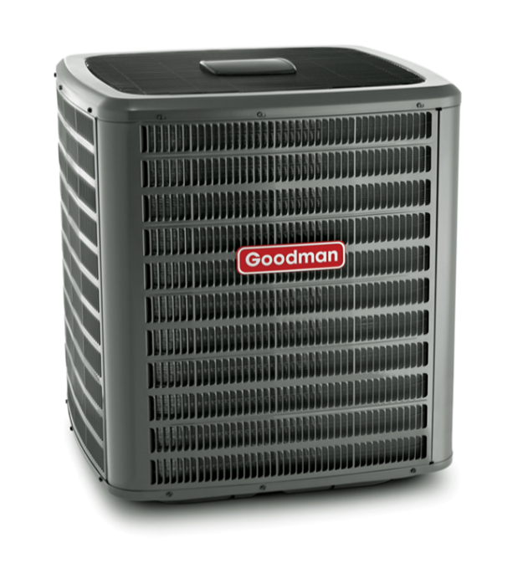
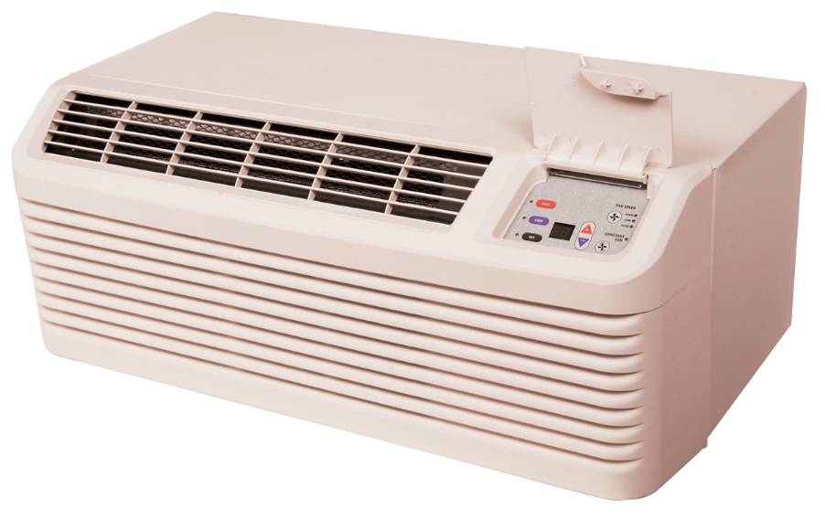

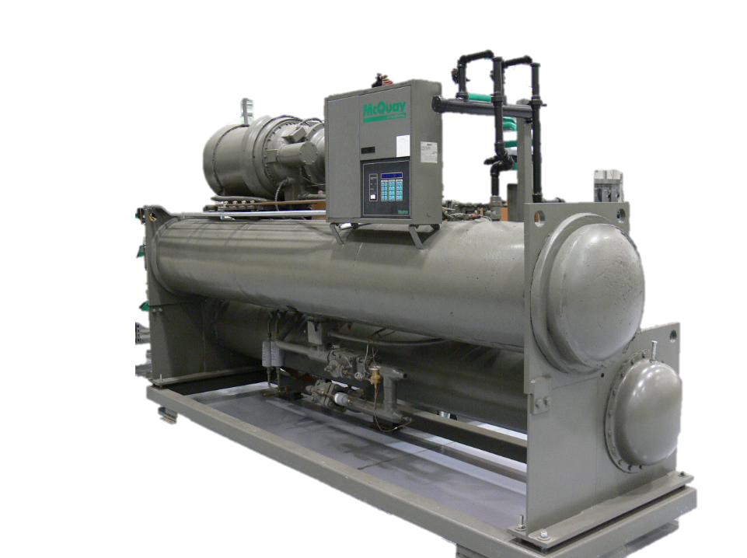
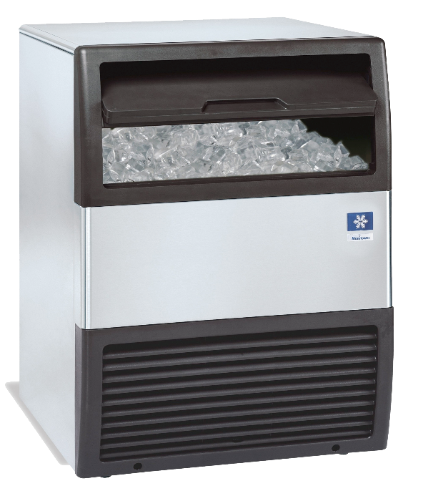
EPA Section 608 Preparatory Class
Notes:
ESCO EPA Section 608 Preparatory Manual 9th Edition V2 Page1
This power point is intended to prepare technicians for the Environmental Protection Agency’s (EPA) Section 608 Certification examination and contains information a technician will require to successfully complete the exam. This power point is meant to serve as a guide for reviewing material related to Section 608 of the Clean Air Act Amendment and is not intended as a formal refrigeration training course. Technicians preparing for this examination should be familiar with the basic vapor-compression refrigeration cycle, common service equipment, and procedures.
This power point has been developed with the most current information available at the time of this edition. Should EPA regulations change after a technician becomes certified, it is the responsibility of the technician to comply with any future changes. The EPA also reserves the right to modify the test questions and/or require new certification or recertification based on advancements in technology. The ESCO Institute will update this manual as necessary to reflect current EPA regulations and testing requirements

Slide 3
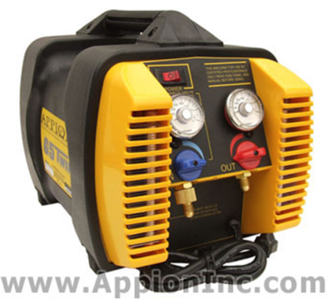
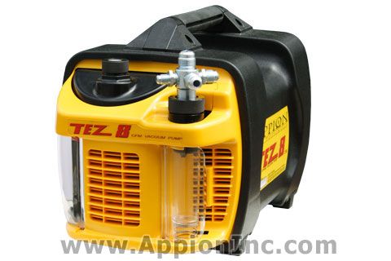
INTRODUCTION
This manual is intended to prepare technicians for the Environmental Protection Agency’s (EPA) Section 608 Certification examination and contains the information required to successfully complete the exam.
Notes:
ESCO EPA Section 608 Preparatory Manual 9th Edition V2 Page 1
This manual is intended to prepare technicians for the Environmental Protection Agency’s (EPA) Section 608 Certification examination and contains the information required to successfully complete the exam.

Slide 4
INTRODUCTION
This book serves as a guide for reviewing material related to Section 608 of the Clean Air Act and is not a formal refrigeration training course.
Technicians preparing for this examination should be familiar with the basic vapor-compression refrigeration cycle, as well as common service principles, practices, and procedures.
Notes:
ESCO EPA Section 608 Preparatory Manual 9th Edition V2 Page 1
This book serves as a guide for reviewing material related to Section 608 of the Clean Air Act and is not a formal refrigeration training course. Technicians preparing for this examination should be familiar with the basic vapor-compression refrigeration cycle, as well as common service principles, practices, and procedures.

Slide 5
INTRODUCTION
This manual has been developed with the most current information available at the time of publication.
Should EPA regulations change after a technician becomes certified, it is the responsibility of the technician to comply with these changes.
The EPA reserves the right to modify the test questions and/or require new certification or recertification based on advancements in technology.
The ESCO Institute will update this manual, as necessary, to reflect current EPA regulations and testing requirements.
Notes:
ESCO EPA Section 608 Preparatory Manual 9th Edition V2 Page 1
This manual has been developed with the most current information available at the time of publication. Should EPA regulations change after a technician becomes certified, it is the responsibility of the technician to comply with these changes. The EPA also reserves the right to modify the test questions and/or require new certification or recertification based on advancements in technology. The ESCO Institute will update this manual, as necessary, to reflect current EPA regulations and testing requirements.

Slide 6
FEDERAL REGULATIONS
Section 608 of the Clean Air Act requires all persons who maintain, service, repair, or dispose of appliances containing regulated refrigerants, be certified in proper refrigerant handling techniques as required by the National Recycling and Emission Reduction Program.
Regulated refrigerants currently include: CFC, HCFC, HFC, and HFO refrigerants.
Notes:
ESCO EPA Section 608 Preparatory Manual 9th Edition V2 Page 1
Section 608 of the Clean Air Act requires all persons who maintain, service, repair, or dispose of appliances containing regulated refrigerants, be certified in proper refrigerant handling techniques as required by the National Recycling and Emission Reduction Program. Regulated refrigerants currently include: CFC, HCFC, HFC, and HFO refrigerants.

Slide 7
FEDERAL REGULATIONS
If you maintain, service, repair, or dispose of appliances containing a regulated refrigerant, you must be certified.
This Means: YOU CANNOT WORK UNDER ANOTHER PERSON’S CERTIFICATION.
Notes:
ESCO EPA Section 608 Preparatory Manual 9th Edition V2 Page 1
If you maintain, service, repair, or dispose of appliances containing a regulated refrigerant, you must be certified.
This means you cannot work under another person’s certification.

Slide 8
BEFORE YOU BEGIN
In addition to this preparatory manual, practice questions are available to help prepare you for the EPA Section 608 examination.
You can access these practice questions, free of charge, on the ESCO website at www.escogroup.org/practice.
Notes:
ESCO EPA Section 608 Preparatory Manual 9th Edition V2 Page 1

Slide 9
BEFORE YOU BEGIN
If your examination was administered through an ESCO-approved testing location, you will be able to login to the ESCO website at www.escogroup.org to access your examination results, order replacement certification cards, update your information (i.e., address), opt out of the public certification registry, order additional training materials, etc.
Notes:
ESCO EPA Section 608 Preparatory Manual 9th Edition V2 Page 1
If your examination was administered through an ESCO-approved testing location, you will be able to login to the ESCO website at www.escogroup.org to access your examination results, order replacement certification cards, update your information (i.e., address), opt out of the public certification registry, order additional training materials, etc.

Slide 10
BEFORE YOU BEGIN
You may also contact ESCO’s customer service team, Monday-Friday, 8:00 AM 5:00 PM, Central Time at 1-800-726-9696 if you have any questions related to your certification.
Please note: if you participate in an examination that is administered in paper format (i.e., Scantron answer sheet), please allow 5-7 business days for your examination to be received at the ESCO grading center for processing.
Notes:
ESCO EPA Section 608 Preparatory Manual 9th Edition V2 Page 1
You may also contact ESCO’s customer service team, Monday-Friday, 8:00 AM 5:00 PM, Central Time at 1-800-726-9696 if you have any questions related to your certification. Please note: if you participate in an examination that is administered in paper format (i.e., Scantron answer sheet), please allow 5-7 business days for your examination to be received at ESCO’s grading center for processing.

Slide 11
OVERVIEW OF THE EXAMINATION (Core)
Core: The core covers fundamental information of the clean air act and is required for any one of the four levels of certifications. Failure to pass the core means no level of certification will be issued no matter the score on Type I, II, III.
Notes:
ESCO EPA Section 608 Preparatory Manual 9th Edition V2 Page 1
Overview of the Examination
The core covers fundamental information of the clean air act and is required for any one of the four levels of certifications. Failure to pass the core means no level of certification will be issued no matter the score on Type I, II, III.

Slide 12
OVERVIEW OF THE EXAMINATION (Core)
Core is required for any of the four levels of certifications.
Stratospheric Ozone Depletion
Global Warming Potential
Refrigerant Characteristics & Identification
Bubble And Dew Points
Low, Medium, High And Very High psi Refrigerants
Refrigerant Oils
Montreal Protocol / Clean Air Act
Recovery
Recovery Devices
Leak Detection
Dehydration Safety / General
Safety / Cylinder
Shipping
Notes:
ESCO EPA Section 608 Preparatory Manual 9th Edition Page 4
Overview of the Examination
Core is required for any of the four levels of certifications.
The core covers fundamental information of the clean air act and is required for any one of the four levels of certifications. Failure to pass the core means no level of certification will be issued no matter the score on Type I, II, III.

Slide 13
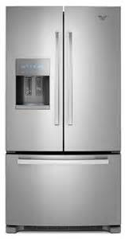
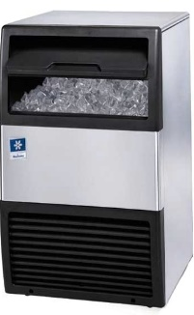
OVERVIEW OF THE EXAMINATION (Type 1)
Type I. Persons who maintain, service, repair, or dispose of small appliances must be certified as Type I technicians.
A small appliance is defined as a pre-assembled unit, hermetically sealed and factory charged with 5 lbs. or less of refrigerant.
Examples: water coolers, window units, refrigerators, freezers, de-humidifiers, ice machines, and package
terminal air conditioning.
Split-systems are not included in Type I.
Notes:
ESCO EPA Section 608 Preparatory Manual 9th Edition V2 Page 1
Type I.
Persons who maintain, service, repair, or dispose of small appliances must be certified as Type I technicians. A small appliance is defined as a pre-assembled unit, hermetically sealed and factory charged with 5 lbs. or less of refrigerant.
Examples include equipment such as water coolers, window units, refrigerators, freezers, de-humidifiers, residential ice machines, and package terminal air conditioning.
Split-systems are not included in Type I.

Slide 14
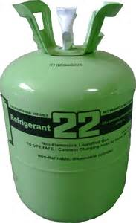
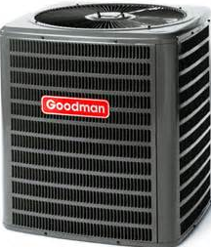
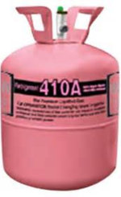
OVERVIEW OF THE EXAMINATION (Type 1I)
Type II. Persons who maintain, service, repair, or dispose of appliances, containing more than 5 lbs. of refrigerant, or if the installation of such equipment requires refrigerant charging, must be certified as Type II technicians.
Type II certification does not include small appliances or motor vehicle air-conditioning (MVAC) systems.
Notes:
ESCO EPA Section 608 Preparatory Manual 9th Edition V2 Page 1
Type II.
Persons who maintain, service, repair, or dispose of appliances, containing more than 5 lbs. of refrigerant, or if the installation of such equipment requires refrigerant charging, must be certified as Type II technicians. Type II certification does not include small appliances or motor vehicle air-conditioning (MVAC) systems.
It is important to understand the refrigerant pressure of each certification category. Type II certification includes medium-pressure, high-pressure, and very high-pressure appliances. If a system requires refrigerant line connections or charging in the field, even if it is less than 5 lbs., the technician must be certified as Type II.
High-pressure refrigerants have a pressure between 155 psig & 340 psig at a liquid-phase temperature of 104°F and medium-pressure refrigerants have a pressure between 30 psig & 155 psig at a liquid-phase temperature of 104°F.

Slide 15
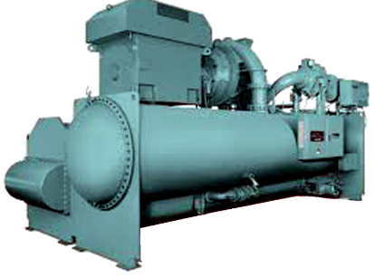
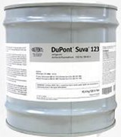
OVERVIEW OF THE EXAMINATION (Type III)
Type III. Persons who maintain, service, repair, or dispose of low-pressure appliances, such as centrifugal and chillers, must be certified as
Type III technicians.
Low-pressure appliances operate with low-pressure refrigerants, which have pressures of 30 psig, or lower, at a liquid-phase temperature of 104°F. HCFC-123 used in chillers is a “low-pressure refrigerant” under EPA’s Section 608 regulations to replace CFC-11.
Notes:
ESCO EPA Section 608 Preparatory Manual 9th EditionV2 Page 1
Type III.
Persons who maintain, service, repair, or dispose of low-pressure appliances, such as centrifugal and chillers, must be certified as Type III technicians. Low-pressure appliances operate with low-pressure refrigerants, which have pressures of 30 psig, or lower, at a liquid-phase temperature of 104°F. HCFC-123 used in chillers is a “low-pressure refrigerant” under EPA’s Section 608 regulations to replace CFC-11.

Slide 16
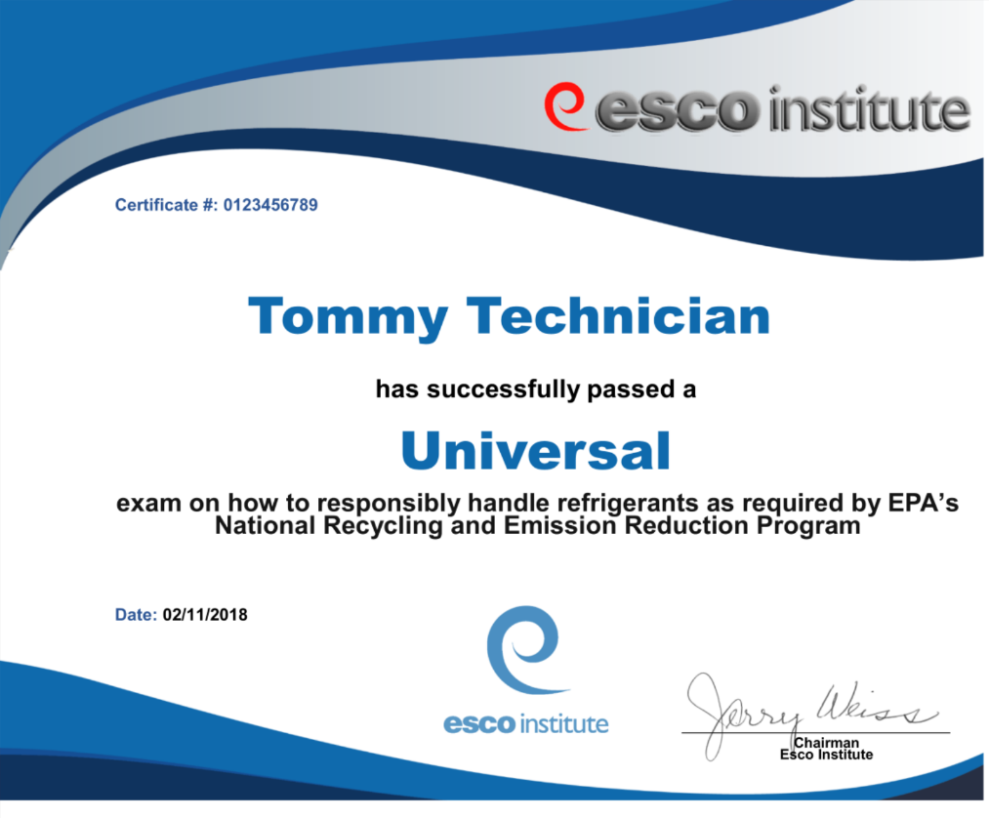
OVERVIEW OF THE EXAMINATION (Universal)
Universal. Persons, who maintain, service, or repair both low and high-pressure equipment, as well as small appliances, must be certified as Universal technicians.
Notes:
ESCO EPA Section 608 Preparatory Manual 9th Edition V2 Page 2
Universal.
Persons, who maintain, service, or repair both low and high‐pressure equipment, as well as small appliances, must be certified as Universal technicians.

Slide 17
TEST FORMAT
The test contains four sections: Core, and sections I, II, and III. Each section contains twenty-five (25) multiple-choice questions.
A technician MUST achieve a minimum passing score of 70 percent in each group/section in which they are to be certified. For example, a technician seeking Universal certification must achieve a minimum score of 70 percent, or 18 out of 25 correct, on each section of the test.
If a technician fails one or more of the sections, they may retake the failed section(s) without retaking the section(s) in which they earned a passing score. In the meantime, the technician will be certified in the Type(s) for which they received a passing score.
There is one exception; a technician MUST achieve a passing score on the Core plus any one Type to receive any certification.
Notes:
ESCO EPA Section 608 Preparatory Manual 9th Edition V2 Page 2
The test contains four sections: Core, and sections I, II, and III. Each section contains twenty-five (25) multiple-choice questions. A technician MUST achieve a minimum passing score of 70 percent in each group/section in which they are to be certified. For example, a technician seeking Universal certification must achieve a minimum score of 70 percent, or 18 out of 25 correct, on each section of the test. If a technician fails one or more of the sections, they may retake the failed section(s) without retaking the section(s) in which they earned a passing score. In the meantime, the technician will be certified in the Type(s) for which they received a passing score. There is one exception; a technician MUST achieve a passing score on the Core plus any one Type to receive any certification.

Slide 18
TEST FORMAT
The Core contains 25 general knowledge questions relating to stratospheric ozone depletion, rules and regulations of the Clean Air Act, the Montreal Protocol, refrigerant recovery, recycling and reclaiming, recovery devices, substitute refrigerants and oils, recovery techniques, dehydration, recovery cylinders, safety, and shipping.
Type I contains 25 sector-specific questions pertaining to small appliances.
Type II contains 25 sector-specific questions pertaining to medium and high-pressure appliances.
Type III contains 25 sector-specific questions pertaining to low-pressure appliances.
Notes:
ESCO EPA Section 608 Preparatory Manual 9th Edition V2 Page 2
The Core contains 25 general knowledge questions relating to stratospheric ozone depletion, rules and regulations of the Clean Air Act, the Montreal Protocol, refrigerant recovery, recycling and reclaiming, recovery devices, substitute refrigerants and oils, recovery techniques, dehydration, recovery cylinders, safety, and shipping.
Type I contains 25 sector-specific questions pertaining to small appliances.
Type II contains 25 sector-specific questions pertaining to medium and high-pressure appliances.
Type III contains 25 sector-specific questions pertaining to low-pressure appliances.

Slide 19

TEST FORMAT
Federal regulations require that this exam be conducted as a closed-book exam by an authorized test administrator (Proctor).
The only outside materials allowed during the test are a pressure-temperature chart and a calculator.
Phones are NOT allowed MUST be turned off and put away.
(Best to not allow phones in testing room.)
Notes:
ESCO EPA Section 608 Preparatory Manual 9th Edition V2 Page 2
Federal regulations require that this exam be conducted as a closed-book exam by an authorized test administrator (Proctor). The only outside materials allowed during the test are a pressure-temperature (PT) chart and a calculator. Phones are NOT allowed to be used during the examination and MUST be turned off and put away (not on the desktop) during the examination.

Slide 20


TEST FORMAT
Use of any other electronic communication device, or attempts to copy, distribute, post publicly, share photos of exam questions, etc., may result in revocation of certification and will be reported to the U.S. EPA.
Notes:
ESCO EPA Section 608 Preparatory Manual 9th Edition V2 Page 2
Use of any other electronic communication device, or attempts to copy, distribute, post publicly, share photos of exam questions, etc., may result in revocation of certification and will be reported to the U.S. EPA.

Slide 21
TEST FORMAT
Personal information required for the exam:
Picture Identification (Required)
Social security number (Used for identification purposes only.)
Home/mailing address
Date of Birth
Phone Number
Email address
Notes:
ESCO EPA Section 608 Preparatory Manual 9th Edition V2 Page 2
Certain personal information is requested on the exam. Technicians should be prepared to provide:
Picture Identification (Proctors will ask for this to verify your identity–this is required.)
Social security number (Used for identification purposes only.)
Home/mailing address
Date of Birth
Phone Number
Email address

Slide 22
TEST FORMAT
As required, all examination participants will be included in an online registry/lookup by name, city and state, as well as certification achieved.
No personal information will be included in the public registry.
Technicians will be able to opt out of this registry by logging into the ESCO website at www.escogroup.org or by contacting customer service at 800-726-9696.
Notes:
ESCO EPA Section 608 Preparatory Manual 9th Edition V2 Page 2
As required, all examination participants will be included in an online registry/lookup by name, city and state, as well as certification achieved. (No personal information will be included in the public registry.) Technicians will be able to opt out of this registry by logging into the ESCO website at www.escogroup.org or by contacting customer service at 800-726-9696.

Slide 23
TEST FORMAT
Technicians should carefully study the Core and section(s) related to the Type(s) of certification in which they are seeking to achieve a passing score.
Free EPA practice exams can be found online at: www.escogroup.org/practice
Practice exams are provided to give exam candidates a sample of the types of questions they can expect to encounter on the exam and are not intended to be a sole study source.
Notes:
ESCO EPA Section 608 Preparatory Manual 9th Edition V2 Page 2
Technicians should carefully study the Core and section(s) related to the Type(s) of certification in which they are seeking to achieve a passing score.
Free EPA practice exams can be found online at: www.escogroup.org.
Practice exams are provided to give exam candidates a sample of the types of questions they can expect to encounter on the exam and are not intended to be a sole study source.

Slide 24
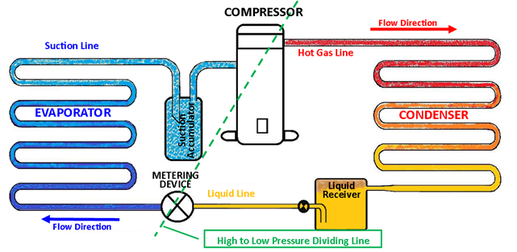
VAPOR - COMPRESSION REFRIGERATION CYCLE
Low
High
Notes:
ESCO EPA Section 608 Preparatory Manual 9th Edition V2 Page 3
Vapor- Compression Refrigeration Cycle
The compressor is the heart of the vapor-compression refrigeration cycle. Low-pressure, low-temperature, superheated refrigerant vapor enters the compressor and is compressed, changing it to a high-pressure, high-temperature, superheated vapor. It then moves to the condenser where some of the heat is removed, de-superheating and condensing it into a liquid. Before it leaves the condenser as a high-pressure liquid, the liquid refrigerant is subcooled to a point below the liquid saturation temperature. It then flows to the metering or expansion device as a high-pressure, subcooled liquid. As the refrigerant flows through the metering device, the pressure of the liquid is reduced, causing a small percentage of the liquid to flash to a vapor (flash-gas), lowering the temperature of the remaining refrigerant to its saturation temperature. The low-pressure, low-temperature refrigerant flows into the evaporator as a
low-temperature saturated refrigerant. As the refrigerant absorbs heat, it evaporates into a low-temperature vapor. This evaporation process is referred to as direct expansion. During this process, the refrigerant vapor is superheated above its saturation temperature and then enters the suction line. From the suction line, refrigerant enters the compressor as a low-pressure, low-temperature, superheated vapor to repeat the cycle. The compressor and the metering device are the dividing points between the low-pressure and high-pressure sides of the system.

Slide 25
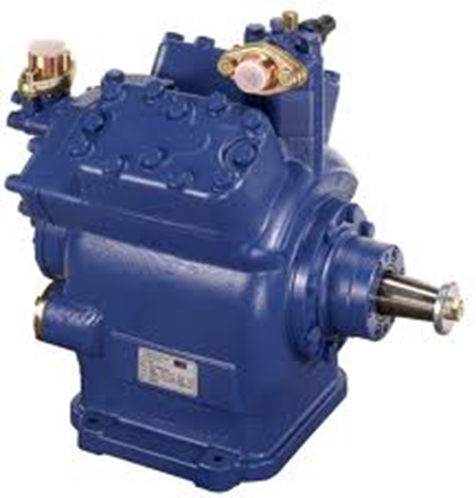
COMPRESSOR
Low-pressure and
low-temperature superheated vapor in
High-pressure & temperature, highly superheated vapor out
Notes:
ESCO EPA Section 608 Preparatory Manual 9th Edition V2 Page 3
The compressor is the heart of the vapor-compression refrigeration cycle. Low-pressure, low-temperature superheated refrigerant vapor entering the compressor is compressed, changing it to a high-pressure, high-temperature, superheated vapor.

Slide 26
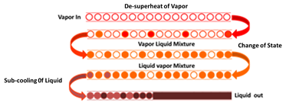
CONDENSER
Three stages of the condenser:
De-superheats
Change of state (Vapor to Liquid)
Subcools
Notes:
ESCO EPA Section 608 Preparatory Manual 9th Edition V2 Page 3
The refrigerant then moves to the condenser where the heat is removed, de-superheating and condensing it into a liquid. Before it leaves the condenser, the liquid refrigerant is subcooled to a point below the liquid saturation temperature.

Slide 27
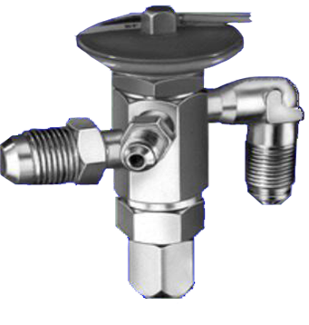
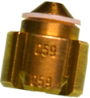
METERING DEVICE
Low-pressure liquid and
flash-gas out
High-pressure subcooled liquid in
TEV
Fixed Orifice
Notes:
ESCO EPA Section 608 Preparatory Manual 9th Edition V2 Page 3
The refrigerant then flows to the metering device as a high-pressure, subcooled liquid. As the refrigerant flows through the metering device, the liquid is reduced to a low-pressure causing a small percentage of the liquid to flash to a vapor (flash-gas) lowering the remaining refrigerant to its saturation temperature.

Slide 28
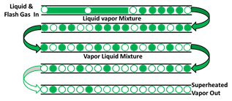
EVAPORATOR
Low-pressure & temperature superheated vapor leaves
Low-pressure & temperature liquid with some flash-gas enters
Notes:
ESCO EPA Section 608 Preparatory Manual 9th Edition V2 Page 3
The low-pressure, low-temperature refrigerant flows into the evaporator as a low-temperate liquid with some flash-gas. As the refrigerant absorbs heat, it evaporates into a low-temperature vapor. Before refrigerant vapor exits the evaporator and enters the suction line, additional heat superheats the vapor above its saturation temperature.

Slide 29
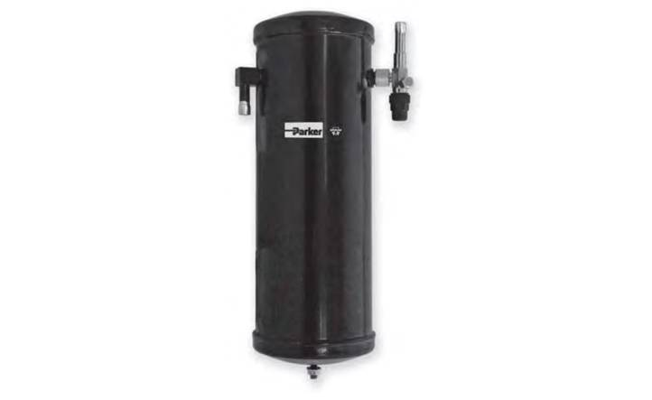
ACCESSORIES
A system that uses a thermostatic expansion valve (TEV) is usually equipped with a receiver located in the liquid line, directly following the condenser.
High-Pressure Liquid
Receiver
Notes:
ESCO EPA Section 608 Preparatory Manual 9th Edition V2 Page 3
A system that uses a thermostatic expansion valve (TEV) is usually equipped with a receiver located in the liquid line, directly following the condenser. The receiver should be used on systems with varying loads to ensure liquid to the expansion valve.

Slide 30
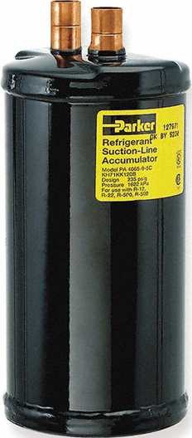
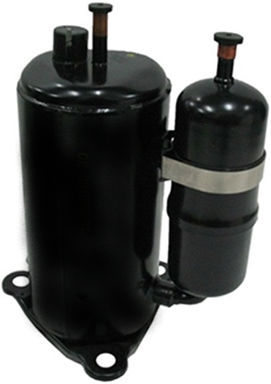
ACCESSORIES
An accumulator when used is located in the suction line.
Accumulators prevent any liquid refrigerant that may flow from the evaporator from flowing into the compressor.
Notes:
ESCO EPA Section 608 Preparatory Manual 9th Edition V2 Page 3
Accumulators are used to protect the compressor by preventing any liquid refrigerant from flowing into it.

Slide 31
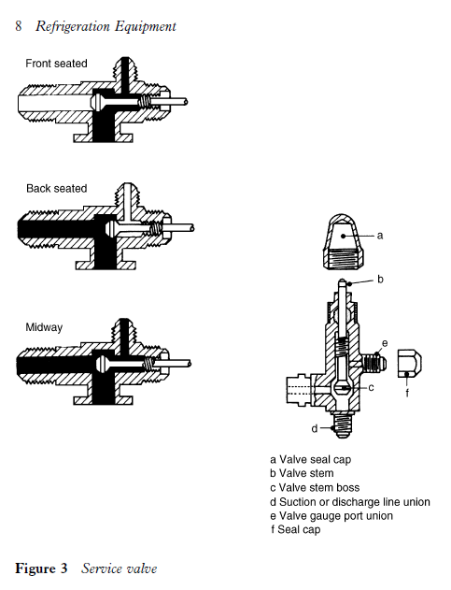
ACCESSORIES
Service valve in back-seated position.
Service Port
Back-Seated
Position
Line
Port
Line
Port
Compressor
Port
Notes:
ESCO EPA Section 608 Preparatory Manual 9th Edition V2 Page 3
A system may have service valves, access valves or process stubs to gain access for service. The valve must be back-seated (turn the valve stem counter-clockwise as far as possible) to close the service or gauge port before removing the service manifold hoses.

Slide 32
ACCESSORIES
Service valve in front-seated position.
Service
Port
Front- Seated
Position
Line Port
Compressor
Port
Notes:
ESCO EPA Section 608 Preparatory Manual 9th Edition V2 Page 3
Never front-seat (turn the valve stem clockwise as far as it will go) a service valve when the system is in operation.
The black solid color is where the refrigerant will flow in the front-seated position. The line port is closed, and compressor port is open to the service port.

Slide 33
ACCESSORIES
Service Valve in Mid-seated position.
Service
Port
Mid-Seated
Position
Line Port
Compressor
Port
Notes:
ESCO EPA Section 608 Preparatory Manual 9th Edition V2 Page 3
All three connections are open in the crack-seat position. The line port, compressor port, and service port are all open.
This position is for servicing and checking pressures.

Slide 34
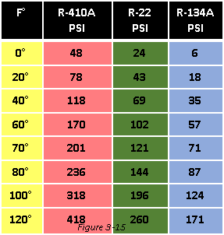
HOW TO USE THE PRESSURE -TEMPERATURE CHART
A pressure-temperature (PT) chart provides the pressure-temperature relationship of refrigerants.
At 70°F, the psi for 410A is 201 psi.
Notes:
ESCO EPA Section 608 Preparatory Manual 9th Edition V2 Page 4
A pressure-temperature (PT) chart provides the pressure-temperature relationship of refrigerants used in the HVACR industry. The charts are based on the saturation properties for which a refrigerant evaporates and condenses. Liquid must be present for the relationship to match. For example, a PT chart will indicate a cylinder at 70°F containing 1 ounce or 10 lbs of liquid R-410A will have a pressure of 201 psig. Likewise, the evaporator or condensing temperature can be found by comparing the operating suction or high-side pressure for the type of refrigerant to the corresponding temperature.

Slide 35
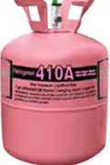
PRESSURE -TEMPERATURE RELATIONSHIP
Whether the tank is half full or has just a few ounces of liquid, the pressure will be the same if both tanks are at the same temperature.
80°F
236 Psig
80°F
236 Psig
410A
410A
Notes:
ESCO EPA Section 608 Preparatory Manual 9th Edition V2 Page 4
Whether the tank is half full or has just a few ounces of liquid, the pressure will be the same if both tanks are at the same temperature.

Slide 36
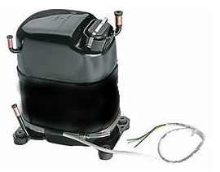
REFRIGERATION SERVICE
Refrigerant will migrate to a compressor's crankcase and mix with the oil when there is a difference between the oil pressure and refrigerant vapor pressure.
The compressor crankcase heater is used to help prevent this refrigerant migration.
Notes:
ESCO EPA Section 608 Preparatory Manual 9th Edition V2 Page 4
Refrigerant will migrate to a compressor's crankcase and mix with the oil when there is a difference between the oil pressure and refrigerant vapor pressure. The compressor crankcase heater is used to help prevent this refrigerant migration.

Slide 37
REFRIGERATION SERVICE
An oil sample should be taken when the unit has had a leak or a major component failure.
Refrigerant oil samples are also taken when moisture, acid, oil sludge formation, oil waxing, or residual acidic oil from a burn-out are suspected problems.
Notes:
ESCO EPA Section 608 Preparatory Manual 9th Edition V2 Page 4
An oil sample should be taken when unit has had a leak or a major component failure. Refrigerant oil samples are also taken when moisture, acid, oil sludge formation, oil waxing, or residual acidic oil from a burn-out are suspected problems.

Slide 38
REFRIGERATION SERVICE
Finding and repairing leaks in the system will conserve refrigerant when servicing an appliance.
Flushing field tubing with liquid refrigerant to clean the tubing after a burn-out is not recommended, and it is unlawful.
Notes:
ESCO EPA Section 608 Preparatory Manual 9th Edition V2 Page 4
Finding and repairing leaks in the system will conserve refrigerant when servicing an appliance. Flushing field tubing with liquid refrigerant to clean the tubing after a burn-out is not recommended, and it is unlawful.

Slide 39
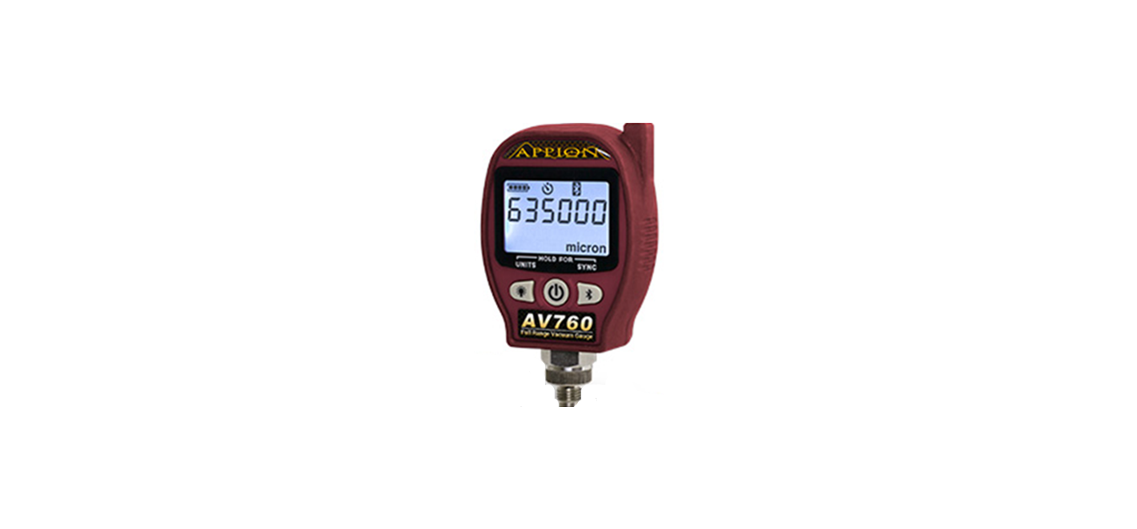
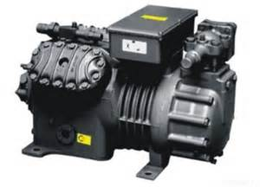
REFRIGERATION SERVICE
After making a major repair, the appliance should be dehydrated by evacuating the system to a minimum of 500 microns. This minimum level is required for HFC systems with POE oil.
Under no circumstance should a hermetic compressor be operated when there is a vacuum in the system; electrical arcing could burn the terminals inside the compressor.
500
Micron
Notes:
ESCO EPA Section 608 Preparatory Manual 9th Edition V2 Page 4
After making a major repair, the appliance should be dehydrated by evacuating the system to a minimum of 500 microns. This minimum level is required for HFC and all systems with POE oil. Under no circumstance should a hermetic compressor be operated when there is a vacuum in the system; electrical arcing could burn the terminals inside the compressor.

Slide 40
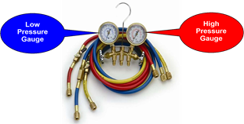
GAUGE MANIFOLD SET
One of the most important tools for an HVACR technician is the gauge manifold set.
The compound gauge measures low-pressure (psig) and vacuum (inches Hg).
Depending on the refrigerant, the high-pressure gauge may be rated at 500 or 800 psig.
Notes:
ESCO EPA Section 608 Preparatory Manual 9th Edition V2 Page 4
One of the most important tools for an HVACR technician is the gauge manifold set. The left side, compound gauge (blue) and the right side, high-pressure gauge (red), are attached to the manifold to measure system pressures. Hoses are used to connect the manifold to the refrigeration system’s access ports or service valves to gain access to system pressures. The compound gauge measures low-pressure (psig) and vacuum (inches Hg). The high-pressure gauge measures high-side (discharge) pressure. Depending on the refrigerant, the high-pressure gauge may be rated at 500 or 800 psig. The manifold is also equipped with a center port, (usually a yellow hose), that can be connected to a recovery device, evacuation vacuum pump, or charging device.

Slide 41
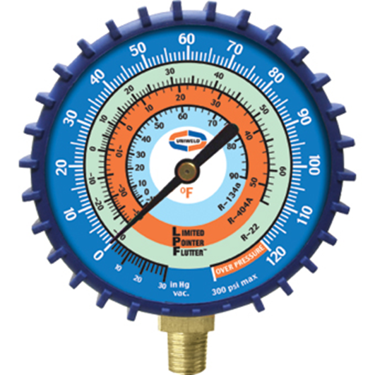
GAUGE MANIFOLD SET
The compound pressure gauge measures system pressure for the low side in pounds per square inch gauge (psig) and vacuum in inches of mercury (Hg).
Vacuum
Retard
Notes:
ESCO EPA Section 608 Preparatory Manual 9th Edition V2 Page 5
The compound pressure gauge measures system pressure for the low side in pounds per square inch gauge (psig) and vacuum in inches of mercury (Hg).

Slide 42
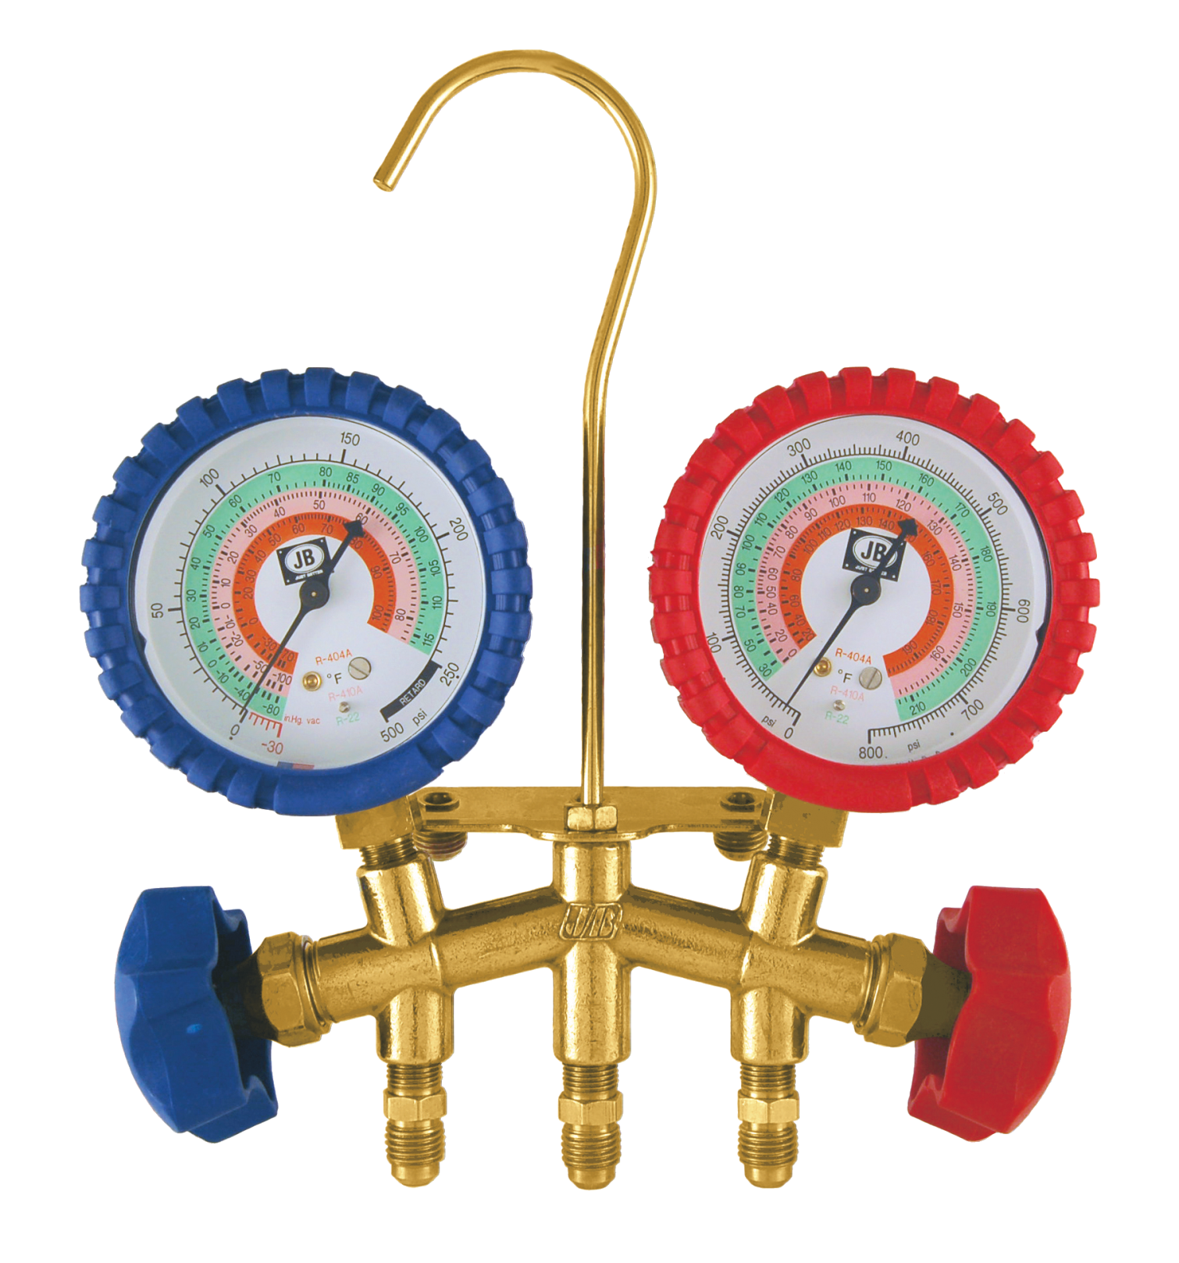
GAUGE MANIFOLD SET
High-Pressure Gauge
PSI
Refrigerant Saturation
Temperatures
Notes:
ESCO EPA Section 608 Preparatory Manual 9th Edition V2 Page 5
Most high-pressure gauges range from 0 to 800 psig.

Slide 43
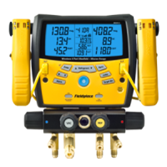
GAUGE MANIFOLD SET
An electronic manifold may have combined temperature probes to measure refrigerant line temperatures for calculating system superheat and subcooling.
Notes:
ESCO EPA Section 608 Preparatory Manual 9th Edition V2 Page 5
An electronic manifold or gauge may have combined temperature probes to measure refrigerant line temperatures for calculating system superheat and subcooling.

Slide 44
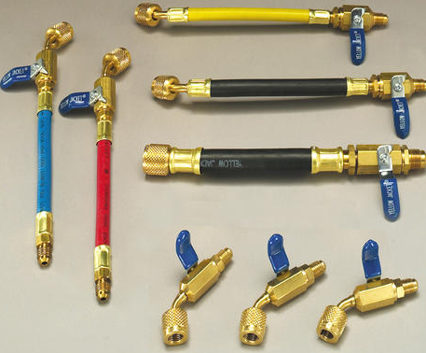
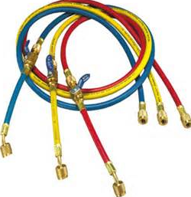
GAUGE MANIFOLD SET
EPA recommends that hoses be equipped with low-loss fittings or valves that manually close, or which close automatically, to minimize refrigerant loss when hoses are disconnected.
Notes:
ESCO EPA Section 608 Preparatory Manual 9th Edition V2 Page 5
EPA recommends that hoses be equipped with low-loss fittings or valves that manually close or which close automatically to minimize refrigerant loss when hoses are disconnected. The hoses used for service and with recovery equipment must be equipped with low-loss fittings.

Slide 45
DE-MINIMIS RELEASE
Minor releases when connecting or disconnecting hoses for service or recovery are considered a De-Minimis release.
This type of release is not considered unlawful.
Notes:
ESCO EPA Section 608 Preparatory Manual 9th Edition V2 Page 5
Minor releases when connecting or disconnecting hoses for service or recovery are considered a de-minimis release. A de-minimis release is not considered to be unlawful and is acceptable in normal service of equipment.

Slide 46
CAUTION
The gauge manifold and hoses must be pressure-rated to handle the refrigerant being used.
Notes:
ESCO EPA Section 608 Preparatory Manual 9th Edition V2 Page 5
Caution: The gauge manifold and hoses must be pressure-rated to handle the refrigerant being used.

Slide 47
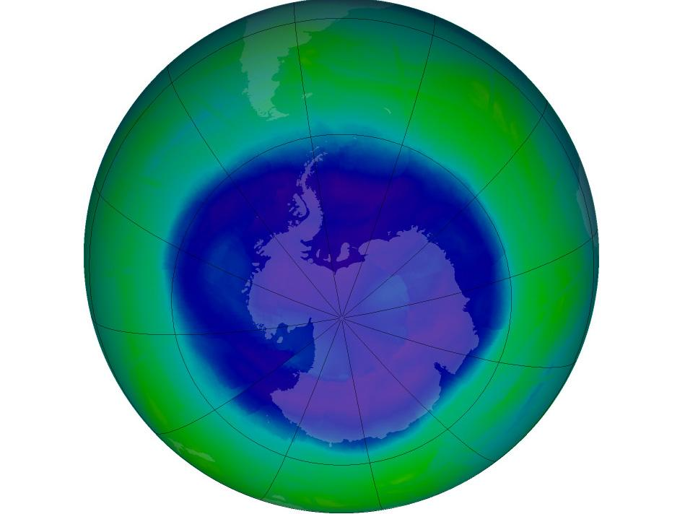
Stratospheric Ozone Depletion
Core
This Photo by Unknown Author is licensed under CC BY-SA
Notes:
ESCO EPA Section 608 Preparatory Manual 9th Edition V2 Page 6

Slide 48
Core Contents
Stratospheric Ozone Depletion
Global Warming Potential
Refrigerant Characteristics & Identification
Bubble And Dew Points
Low, Medium, High And Very High-pressure Refrigerants
Refrigerant Oils
Montreal Protocol / Clean Air Act
Recovery
Recovery Devices
Leak Detection
Dehydration
Safety / General
Safety / Cylinder
Shipping
Notes:
ESCO EPA Section 608 Preparatory Manual 9th Edition V2 Pages 6-15
There are 14 topics in the core section.

Slide 49

STRATOSPHERIC OZONE DEPLETION
Stratospheric ozone helps form the earth's protective shield.
The ozone layer protects the earth from ultraviolet radiation from the sun.
Notes:
ESCO EPA Section 608 Preparatory Manual 9th Edition V2 Page 6
Stratospheric ozone helps form the earth's protective shield. The ozone layer protects the earth from ultraviolet radiation from the sun.

Slide 50
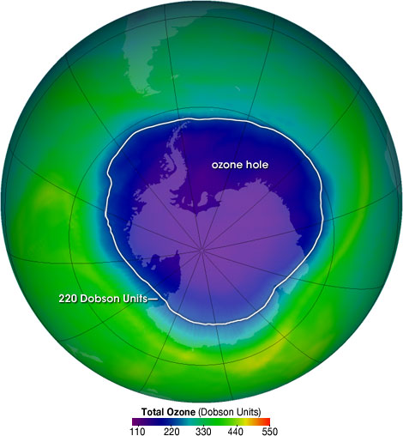
The Ozone Hole
Image Source: http://ozonewatch.gsfc.nasa.gov/facts/hole.html
Notes:
ESCO EPA Section 608 Preparatory Manual 9th Edition V2 Page 6
The ozone hole image shows the very low values (blue and purple colored area) centered over Antarctica on October 4, 2004.
The biggest hole recorded was in 2006.

Slide 51
STRATOSPHERIC OZONE DEPLETION
30 Miles
EARTH
Stratosphere
7 Miles
Notes:
ESCO EPA Section 608 Preparatory Manual 9th Edition V2 Page 6
Brief explanation of the Earth’s atmosphere layers.
Based on the vertical temperature distribution in the Earth's atmosphere, four semi-horizontal layers or spheres can be distinguished: the troposphere, stratosphere, mesosphere, and thermosphere. The stratosphere and mesosphere together are called the middle atmosphere, and their region also overlaps with the ionosphere, which is a region defined on the basis of the electric charges of the particles there.
The stratosphere is part of the earth's atmosphere which extends from the top of the troposphere from 7 miles to about 30 miles above the surface. This is the part of the atmosphere we are concerned about.

Slide 52
OZONE DEPLETION POTENTIAL
Ozone depletion potential (or ODP) measures the ability of a substance to destroy ozone in the stratosphere.
Notes:
ESCO EPA Section 608 Preparatory Manual 9th Edition V2 Page 6
Ozone depletion potential (or ODP) measures the ability of a substance to destroy ozone in the stratosphere.

Slide 53
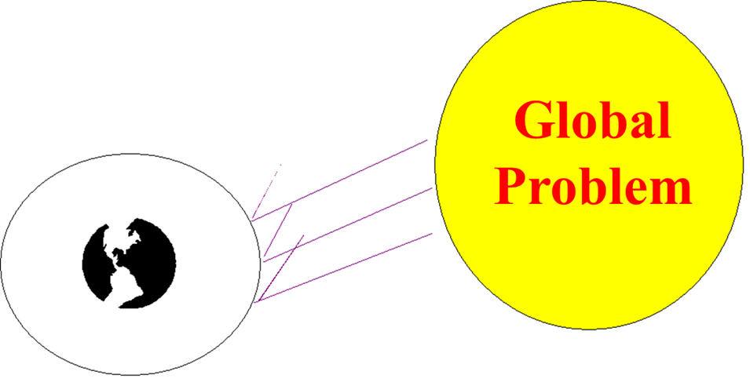
STRATOSPHERIC OZONE DEPLETION
Ozone depletion in the stratosphere is a global problem which affects everyone on the planet.
Notes:
ESCO EPA Section 608 Preparatory Manual 9th Edition V2 Page 6
Ozone depletion in the stratosphere is a global problem which affects everyone on the planet.

Slide 54
STRATOSPHERIC OZONE DEPLETION
One of the most serious results from the thinning and damaging of the stratospheric ozone layer is an increase in the rates of skin cancer in humans.
Notes:
ESCO EPA Section 608 Preparatory Manual 9th Edition V2 Page 6
One of the most serious results from the thinning and damaging of the stratospheric ozone layer is an increase in the rates of skin cancer in humans. Another human health effect that has increased from damage to the stratospheric ozone layer is the increase in cases of cataracts. Stratospheric ozone depletion can also have an effect on the environment, causing decreased crop yields and damage to marine organisms.

Slide 55
STRATOSPHERIC OZONE DEPLETION
Another human health effect that has increased from damage to the stratospheric ozone layer is the increase in cases of cataracts.
Notes:
ESCO EPA Section 608 Preparatory Manual 9th Edition V2 Page 6
Another human health effect that has increased from damage to the stratospheric ozone layer is the increase in cases of cataracts. Stratospheric ozone depletion can also have an effect on the environment, causing decreased crop yields and damage to marine organisms.

Slide 56
STRATOSPHERIC OZONE DEPLETION
Stratospheric ozone depletion can also have an effect on the environment, causing decreased crop yields and damage to marine organisms.
Notes:
ESCO EPA Section 608 Preparatory Manual 9th Edition V2 Page 6
Stratospheric ozone depletion can also have an effect on the environment, causing decreased crop yields and damage to marine organisms.

Slide 57
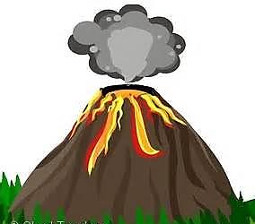
STRATOSPHERIC OZONE DEPLETION
Source of Chlorine in the Stratosphere
Air samples taken over erupting volcanoes show that volcanoes contribute only a small quantity of Chlorine as compared to CFCs and HCFCs.
Notes:
ESCO EPA Section 608 Preparatory Manual 9th Edition V2 Page 6
There has been some controversy over the subject of ozone depletion. Some believed that the chlorine found in the stratosphere comes from natural sources such as volcanic eruptions. However, air samples taken over erupting volcanoes show that volcanoes add only small quantities of chlorine to the atmosphere compared to the amount of chlorine added to the atmosphere from chlorine-containing refrigerants.

Slide 58
STRATOSPHERIC OZONE DEPLETION
The rise in Chlorine measured in the stratosphere matches the rise in the amount of Fluorine, which has different natural sources than Chlorine, over the past two decades.
The rise in the amount of Chlorine measured by NASA and other agencies in the stratosphere over the past twenty years matches the rise in CFC and HCFC emissions over the same period.
Notes:
ESCO EPA Section 608 Preparatory Manual 9th Edition V2 Page 6
In addition, the rise in the amount of chlorine measured in the stratosphere over the past four decades matches the rise in the amount of Fluorine, which has different natural sources than chlorine over the same period. Also, the rise in the amount of chlorine measured by NASA and other agencies in the stratosphere over the past twenty years matches the rise in CFC and HCFC emissions over the same period. The evidence is clear, chlorine containing refrigerants have changed the natural balance, thus depleting the ozone layer.

Slide 59
STRATOSPHERIC OZONE DEPLETION
The evidence is clear, chlorine containing refrigerants have changed the natural balance, thus depleting the ozone layer.
Chlorine is the Culprit
Notes:
ESCO EPA Section 608 Preparatory Manual 9th Edition V2 Page 6
The evidence is clear, chlorine containing refrigerants have changed the natural balance, thus depleting the ozone layer.

Slide 60

STRATOSPHERIC OZONE DEPLETION
An ozone molecule consists of three oxygen atoms (O₃).
Notes:
ESCO EPA Section 608 Preparatory Manual 9th Edition V2 Page 6
An ozone molecule, in the stratosphere consists of molecules containing 3 oxygen atoms. .

Slide 61

STRATOSPHERIC OZONE DEPLETION
Fluorine
Chlorine
CL
FL
CARBON
UV Radiation
CL
CL
CFC Molecule
Notes:
ESCO EPA Section 608 Preparatory Manual 9th Edition V2 Page 6
The ultraviolet radiation from the Sun sheers the chlorine atom from a CFC or HCFC molecule. This chlorine atom is then attracted to an ozone molecule.

Slide 62
STRATOSPHERIC OZONE DEPLETION
When CFCs and HCFCs reach the stratosphere, the sun’s UV radiation causes them to break apart.
O
O
O
O
Cl
O
Cl
O
Chlorine
Atom
Ozone Molecule
Made of up 3
Oxygen Atoms
Chlorine
Monoxide
Diatomic
Oxygen
Notes:
ESCO EPA Section 608 Preparatory Manual 9th Edition V2 Page 6
When a chlorine atom encounters an ozone molecule, it takes one of the ozone’s 3 oxygen atoms, forming a compound called chlorine monoxide (CIO), and leaves an oxygen O₂ molecule behind. Molecular Oxygen is composed of only one type of element: Oxygen. There are two atoms of oxygen, therefore 'diatomic.'

Slide 63
STRATOSPHERIC OZONE DEPLETION
The chlorine monoxide will collide with another ozone molecule, releasing its Oxygen atom, forming two O₂ molecules, leaving the chlorine free to attack another ozone molecule.
A single chlorine atom can last in the Stratosphere for 120 years destroying up to 100,000 ozone molecules.
CL
O
O
O
Notes:
ESCO EPA Section 608 Preparatory Manual 9th Edition V2 Page 6
The chlorine monoxide will collide with another ozone molecule, releasing its Oxygen atom, forming two O₂ molecules, leaving the chlorine free to attack another ozone molecule. A single chlorine atom can last in the Stratosphere for 120 years destroying up to 100,000 ozone molecules.

Slide 64
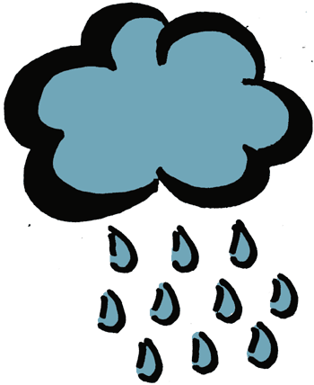
STRATOSPHERIC OZONE DEPLETION
The chlorine in CFCs & HCFCs will neither dissolve in water nor break down into compounds that dissolve in water, so it does not rain out of the atmosphere.
Naturally-occurring chlorine will dissolve in water and rain out of the atmosphere.
Notes:
ESCO EPA Section 608 Preparatory Manual 9th Edition V2 Page 6
Unlike other chlorine compounds and naturally-occurring chlorine, the chlorine in CFCs and HCFCs will neither dissolve in water nor break down into compounds that dissolve in water, so they do not rain out of the atmosphere.

Slide 65
HFCs
HFCs are made up of Hydrogen, Fluorine, and Carbon.
They do not contain chlorine that effects the ozone layer, but most HFCs have a high Global Warming Potential (GWP).
Notes:
ESCO EPA Section 608 Preparatory Manual 9th Edition V2 Page 6
HFCs are made up of Hydrogen, Fluorine and Carbon. They do not contain chlorine that effects the ozone layer, but most HFCs have a high Global Warming Potential (GWP).

Slide 66
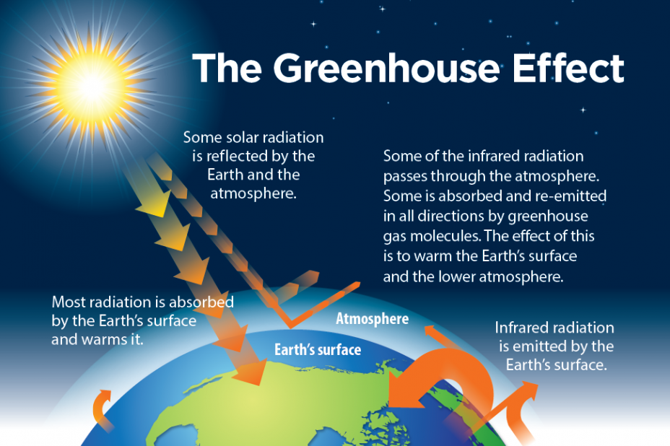
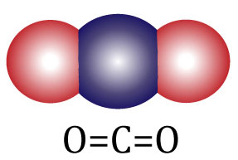
GLOBAL WARMING POTENTIAL
Global Warming Potential (GWP) was established to provide comparisons of the global warming impacts of different gases over a span of time.
Carbon Dioxide (CO₂) is used as the baseline measurement for global warming potential and has a value of 1.
Notes:
ESCO EPA Section 608 Preparatory Manual 9th Edition V2 Page 6
Global Warming Potential (GWP) was established to provide comparisons of the global warming impacts of different gases over a span of time. Carbon Dioxide (CO₂) is used as the baseline measurement for global warming potential and has a value of 1.

Slide 67
GLOBAL WARMING POTENTIAL
Most HFC refrigerants, such as R-410A, have global warming potentials thousands of times greater compared to carbon dioxide.
Hydrocarbon (HC) and Hydrofluoroolefins (HFO) refrigerants have the lowest global warming potential compared to CFCs, HCFCs, and HFCs.
Notes:
ESCO EPA Section 608 Preparatory Manual 9th Edition V2 Page 6
Most HFC refrigerants, such as R-410A, have global warming potentials thousands of times greater compared to carbon dioxide. Hydrocarbon (HC) and Hydrofluoroolefin (HFO) refrigerants have the lowest global warming potential compared to CFCs, HCFCs, and HFCs.

Slide 68

GLOBAL WARMING POTENTIAL
The global warming potential of isobutane (R-600a), propane (R-290), and R-441A are significantly lower when compared to the GWPs of HFCs such as R-134a, R-407C, R-404A, and R-410A.
Notes:
ESCO EPA Section 608 Preparatory Manual 9th Edition V2 Page 6
The global warming potential of isobutane (R-600a), propane (R-290), and R-441A are significantly lower when compared to the GWPs of HFCs such as R-134a, R-407C, R-404A, and R-410A.

Slide 69
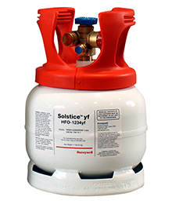
GLOBAL WARMING POTENTIAL
With non-ozone depleting and very low global warming potential characteristics, Hydrofluoroolefin (HFO) refrigerants are a good fit for HVACR equipment.
Most HFCs have very high global warming potentials; a characteristic that makes them damaging to the environment.
Notes:
ESCO EPA Section 608 Preparatory Manual 9th Edition V2 Page 6
With non-ozone depleting and very low global warming potential characteristics, hydrofluoroolefin (HFO) refrigerants are a good fit for HVACR equipment.
Most HFCs have very high global warming potentials; a characteristic that makes them damaging to the environment.

Slide 70
REFRIGERANT CHARACTERISTICS & IDENTIFICATION
Refrigerants may be identified by type (CFC, HCFC, HFC, HFO, HC) and American Society of Heating Refrigerating and Air-Conditioning Engineers (ASHRAE) number or with “R” plus the ASHRAE number such as HFC-134a or R-134a.
Notes:
ESCO EPA Section 608 Preparatory Manual 9th Edition V2 Page 7
Refrigerants may be identified by type (CFC, HCFC, HFC, HFO, HC) and American Society of Heating Refrigerating and Air-Conditioning Engineers (ASHRAE) number or with “R” plus the ASHRAE number such as HFC-134a or R-134a.

Slide 71



REFRIGERANT CHARACTERISTICS & IDENTIFICATION
ASHRAE Refrigerant Classification
A - Safest
B - Toxicity level to humans
L - Flammability
1 - no flammability
2L- slight flammability
2 - low flammability
3 - high flammability
Safety Group
High Flammability | A3 | B3
Low Flammability | A2 | B2
Slight Flammability | A2L | B2L
No Flammability | A1 | B1
Low
Low
Higher
Toxicity
Notes:
ESCO EPA Section 608 Preparatory Manual 9th Edition V2 Page 7
ASHRAE has grouped refrigerants by Class A (safest) or B, depending on their toxicity level to humans. Flammability is indicated by a 1 (no flammability), 2 (low flammability), or 3 (high flammability),

Slide 72
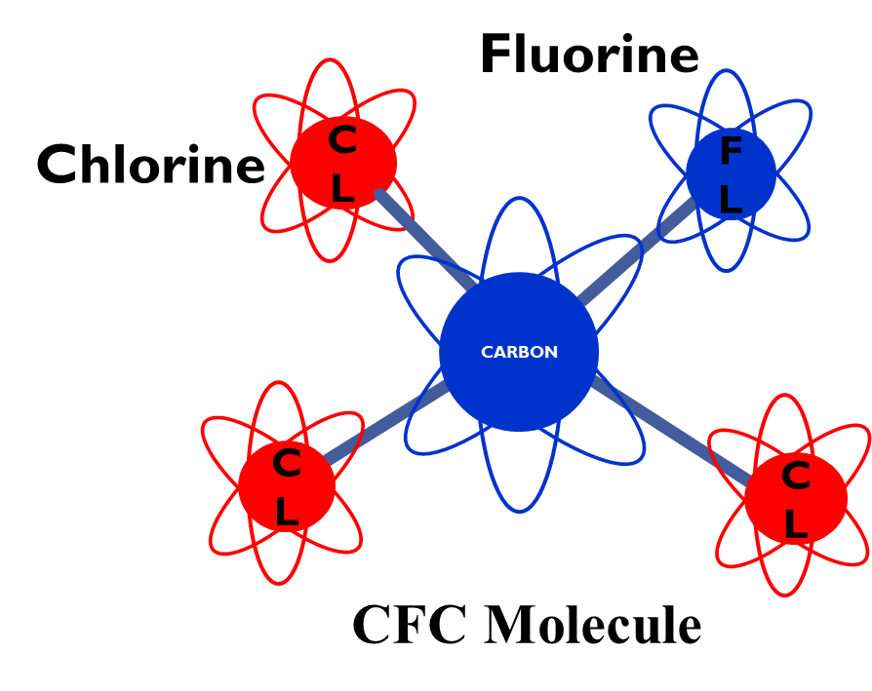
REFRIGERANT CHARACTERISTICS & IDENTIFICATION
Chlorofluorocarbon (CFC) refrigerants have the highest ozone depletion potential (ODP) and are the most harmful to stratospheric ozone.
CFC refrigerants contain chlorine, fluorine, and carbon.
Chlorine is the component that poses a threat to the stratospheric ozone.
Examples of CFC: R-11 and R-12.
Notes:
ESCO EPA Section 608 Preparatory Manual 9th Edition V2 Page 7
Chlorofluorocarbon (CFC) refrigerants have the highest ozone depletion potential (ODP) and are the most harmful to stratospheric ozone. CFC refrigerants contain chlorine, fluorine, and carbon. Chlorine is the component that poses a threat to the stratospheric ozone. Examples of CFC refrigerants include R-11 and R-12.

Slide 73
REFRIGERANT CHARACTERISTICS & IDENTIFICATION
Hydrochlorofluorocarbon (HCFC) refrigerants contain hydrogen, chlorine, fluorine, and carbon.
The hydrogen makes them a little less harmful to the stratospheric ozone when compared to CFCs.
HCFC refrigerants that have an ozone depletion potential of more than zero, ranging between zero and one.
Examples of HCFC: R-22 and R-123
H
F
C
F
Cl
HCFC Molecule
Notes:
ESCO EPA Section 608 Preparatory Manual 9th Edition V2 Page 7
Hydrochlorofluorocarbon (HCFC) refrigerants contain hydrogen, chlorine, fluorine, and carbon. The hydrogen makes them a little less harmful to the stratospheric ozone when compared to CFCs. R-22 and R-123 are examples of HCFC refrigerants that have an ozone depletion potential of more than zero, ranging between zero and one.

Slide 74
REFRIGERANT CHARACTERISTICS & IDENTIFICATION
Hydrofluorocarbon (HFC) refrigerants contain hydrogen, fluorine, and carbon atoms connected by single bonds between the atoms.
HFCs have the lowest/no ozone depletion potential but do have an effect on global warming. HFC refrigerants do not contain harmful chlorine.
Examples of HFCs
R-134a, R-410A, R-404A, R-407C, and R-422B.
F
F
F
C
C
H
F
H
HFC Molecule
Notes:
ESCO EPA Section 608 Preparatory Manual 9th Edition V2 Page 7
Hydrofluorocarbon (HFC) refrigerants contain hydrogen, fluorine, and carbon atoms connected by single bonds between the atoms.
HFCs have the lowest/no ozone depletion potential but do have an effect on global warming. HFC refrigerants do not contain harmful chlorine.
Examples of HFCs are R-134a, R-410A, R-404A, R-407C, and R-422B.

Slide 75
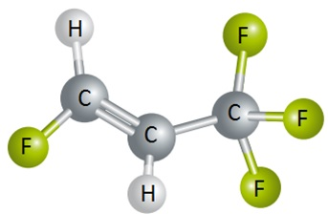
REFRIGERANT CHARACTERISTICS & IDENTIFICATION
Hydrofluoroolefins (HFO) refrigerants contain hydrogen, fluorine, and carbon atoms connected with at least one double bond between the carbon atoms.
HFOs have no ozone depletion potential but do have a very small effect on global warming.
HFO Molecule
Notes:
ESCO EPA Section 608 Preparatory Manual 9th Edition V2 Page 7
Hydrofluoroolefins (HFO) refrigerants contain hydrogen, fluorine, and carbon atoms connected with at least one double bond between the carbon atoms. HFOs have no ozone depletion potential but do have a very small effect on global warming.

Slide 76
REFRIGERANT CHARACTERISTICS & IDENTIFICATION
HFOs are less flammable than hydrocarbon refrigerants but most are still mildly flammable so are classified as A2L.
HFO refrigerants contain fluorine making them less flammable than hydrocarbon refrigerants.
HFO refrigerants are miscible in POE lubricants.
R-1234yf is an HFO refrigerant used in chillers.
Notes:
ESCO EPA Section 608 Preparatory Manual 9th Edition V2 Page 7
HFOs are less flammable than hydrocarbon refrigerants but most are still mildly flammable so are classified as A2L. HFO refrigerants contain fluorine making them less flammable than hydrocarbon refrigerants. HFO refrigerants are miscible in POE lubricants. R-1234yf is an HFO refrigerant used in low-pressure chillers.

Slide 77
REFRIGERANT CHARACTERISTICS & IDENTIFICATION
Hydrocarbon (HC) refrigerants are an elementary compound of hydrogen and carbon. Although flammable, these refrigerants pose the least amount of danger to the environment.
HCs have no ozone depletion potential and a very small effect on global warming, with GWP values less than 10. Isobutane (R-600a) and Propane (R-290) are examples of HCs.
Some HC refrigerants are considered natural refrigerants.
Notes:
ESCO EPA Section 608 Preparatory Manual 9th Edition V2 Page 7
Hydrocarbon (HC) refrigerants are an elementary compound of hydrogen and carbon. Although flammable, these refrigerants pose the least amount of danger to the environment. HCs have no ozone depletion potential and a very small effect on global warming, with GWP values less than 10. Isobutane (R-600a) and Propane (R-290) are examples of HCs. Some HC refrigerants are considered natural refrigerants.

Slide 78
REFRIGERANT CHARACTERISTICS & IDENTIFICATION
Propane cylinders for grilling should never be used as a refrigerant, as they contain impurities that can damage refrigeration equipment.
Notes:
ESCO EPA Section 608 Preparatory Manual 9th Edition V2 Page 7
Note: Propane cylinders for grilling should never be used as a refrigerant, as they contain impurities that can damage refrigeration equipment.

Slide 79
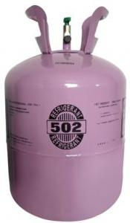
REFRIGERANT CHARACTERISTICS & IDENTIFICATION
Azeotropic refrigerant mixtures contains two or more refrigerants. At a certain pressure, an azeotropic mixture evaporates and condenses at a constant temperature.
It acts like a single component refrigerant over its entire range. Thus, azeotropic mixtures act as a pure compound.
500 Series
Notes:
ESCO EPA Section 608 Preparatory Manual 9th Edition V2 Page 7
Azeotropic refrigerant mixtures contains two or more refrigerants. At a certain pressure, an azeotropic mixture evaporates and condenses at a constant temperature. It acts like a single component refrigerant over its entire range. Thus, azeotropic mixtures act as a pure compound.

Slide 80
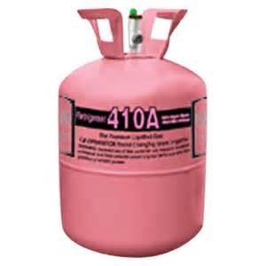
REFRIGERANT CHARACTERISTICS & IDENTIFICATION
Zeotropic or non-azeotropic refrigerant mixtures are mixtures of components that have different boiling points. This mixture is a blend of refrigerant.
The blend may be binary (two-part) or ternary (three-part).
Notes:
ESCO EPA Section 608 Preparatory Manual 9th Edition V2 Page 8
Zeotropic or non-azeotropic refrigerant mixtures are mixtures of components that have different boiling points. This mixture is a blend of refrigerant. The blend may be binary (two-part) or ternary (three-part).

Slide 81
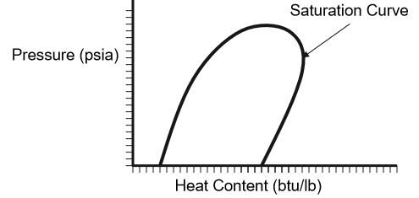


REFRIGERANT CHARACTERISTICS & IDENTIFICATION
Blended refrigerants are normally associated with having what is called “temperature glide”.
This is due to the blended parts having different pressures for the same saturation temperature.
Temperature glide can range a few tenths of a degree to 12 degrees or more.
Glide
Superheat Zone
Subcool
Zone
Saturation
Bubble Point
Dew Point
Notes:
ESCO EPA Section 608 Preparatory Manual 9th Edition V2 Page 8
Blended refrigerants are normally associated with having what is called “temperature glide”. This is due to the blended parts having different pressures for the same saturation temperature. Temperature glide can range a few tenths of a degree to 12 degrees or more.

Slide 82
BUBBLE AND DEW POINTS
Zeotropic and some near-azeotropic blends use bubble and dew points to indicate condensing and evaporation temperatures on a pressure-temperature chart.
Bubble point (Liquid) values are used when charging by condenser subcooling.
Dew point (Vapor) values are used for charging by suction or evaporator superheat.
Bubble Point
Dew Point
Notes:
ESCO EPA Section 608 Preparatory Manual 9th Edition V2 Page 8
Zeotropic and some near-azeotropic blends use bubble and dew points to indicate condensing and evaporation temperatures on a pressure-temperature chart. Bubble point is used when charging by condenser subcooling. Dew point is used for charging by suction or evaporator superheat. The relationship of pressures and temperatures are based on the refrigerant’s temperature glide.

Slide 83
BUBBLE AND DEW POINTS
Zeotropic and some near-azeotropic blends use bubble and dew points to indicate condensing and evaporation temperatures on a pressure-temperature chart.
Bubble point is used when charging by condenser subcooling.
Dew point is used for charging by suction or evaporator superheat.
Notes:
SAME INFO AS SLIDE 77
ESCO EPA Section 608 Preparatory Manual 9th Edition Page 11
Zeotropic and some near-azeotropic blends use bubble and dew points to indicate condensing and evaporation temperatures on a pressure-temperature chart.
Bubble point is used when charging by condenser subcooling.
Dew point is used for charging by suction or evaporator superheat.
The relationship of pressures and temperatures are based on the refrigerant’s temperature glide.

Slide 84
BUBBLE AND DEW POINTS
The R-400 series of refrigerants are near-azeotropic blends that can leak from a system at uneven rates due to different vapor pressures which can affect the percentage of each refrigerant remaining in the system.
The proper charging method for R-400 series blended refrigerants is to weigh the refrigerant into the high side of the system as a liquid. When adding refrigerant to an undercharged system, liquid refrigerant is throttled into the low side with the system operating.
Notes:
ESCO EPA Section 608 Preparatory Manual 9th Edition V2 Page 8
The R-400 series of refrigerants are near-azeotropic blends that can leak from a system at uneven rates due to different vapor pressures which can affect the percentage of each refrigerant remaining in the system. The proper charging method for R-400 series blended refrigerants is to weigh the refrigerant into the high side of the system as a liquid. When adding refrigerant to an undercharged system, liquid refrigerant is throttled into the low side with the system operating.

Slide 85
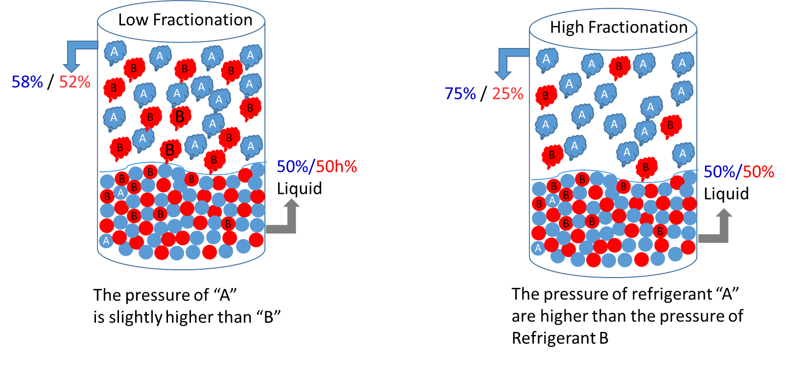
BUBBLE AND DEW POINTS
There is concern of using blended refrigerants in systems that develop a leak.
There may be fractionization of the refrigerant (refrigerant leaking at uneven rates due to different vapor pressures).
R-407C is one of the refrigerants that has a high temperature glide and may easily experience fractionation.
Notes:
ESCO EPA Section 608 Preparatory Manual 9th Edition V2 Page 8
There is concern of using blended refrigerants in systems that develop a leak.
There may be fractionization of the refrigerant (refrigerant leaking at uneven rates due to different vapor pressures).
R-407C is one of the refrigerants that has a high temperature glide and may easily experience fractionation.

Slide 86
BUBBLE AND DEW POINTS
Even though the pressure-temperature relationship and operating characteristics may be almost the same, the refrigerants cannot be interchanged.
Although the saturation pressure-temperature behavior of two refrigerants might be similar, potential of the refrigerants to oxidize copper tubing must also be considered.
Notes:
ESCO EPA Section 608 Preparatory Manual 9th Edition V2 Page 8
Even though the pressure-temperature relationship and operating characteristics may be almost the same, the refrigerants cannot be interchanged. Although the saturation pressure-temperature behavior of two refrigerants might be similar, potential of the refrigerants to oxidize copper tubing must also be considered.

Slide 87

BUBBLE AND DEW POINTS
Due to flammability of some HCs and HFOs, equipment must be designed to handle the refrigerant.
Therefore, EPA regulates the maximum amount of refrigerant that can be used in the new systems by their type and use.
Notes:
ESCO EPA Section 608 Preparatory Manual 9th Edition V2 Page 8
Due to flammability of some HCs and HFOs, equipment must be designed to handle the refrigerant. Therefore, EPA regulates the maximum amount of refrigerant that can be used in the new systems by their type and use.

Slide 88
BUBBLE AND DEW POINTS
When retrofitting or converting a system to use a different refrigerant, only EPA-approved substitutes can be used.
Remember, EPA does not approve any substitute refrigerants as direct drop-in replacements to service an R-22 or any other system.
Notes:
ESCO EPA Section 608 Preparatory Manual 9th Edition V2 Page 8
When retrofitting or converting a system to use a different refrigerant, only EPA-approved substitutes can be used. Remember, EPA does not approve any substitute refrigerants as direct drop-in replacements to service an R-22 or any other system.

Slide 89
LOW, MEDIUM, HIGH, AND VERY HIGH PRESSURE
To better define leak rates and service recovery levels the EPA lists refrigerants in four liquid-phase pressure ranges at 104°F condensing temperature.
Notes:
ESCO EPA Section 608 Preparatory Manual 9th Edition V2 Page 8
To better define leak rates and service recovery levels the EPA lists refrigerants in four liquid-phase pressure ranges at 104°F condensing temperature.

Slide 90
LOW, MEDIUM, HIGH, AND VERY HIGH PRESSURE
Low-pressure refrigerants have a pressure of 30 psig or lower at a liquid-phase temperature of 104°F.
Examples:
CFC-11, HCFC-123, HFC-245fa, HFO-1233zd
Notes:
ESCO EPA Section 608 Preparatory Manual 9th Edition V2 Page 8
To better define leak rates and service recovery levels the EPA lists refrigerants in four liquid-phase pressure ranges at 104°F condensing temperature.
Low-pressure refrigerants have a pressure of 30 psig or lower at a liquid-phase temperature of 104°F.
Examples: CFC-11, HCFC-123, HFC-245fa, HFO-1233zd

Slide 91
LOW, MEDIUM, HIGH, AND VERY HIGH PRESSURE
Medium-pressure refrigerants have a pressure between 30 psig & 155 psig at a liquid-phase temperature of 104°F.
Examples:
CFC-12, HCFC-124, HCFC-409A, HFC-134a, HC-600a,
HFO-1234yf, HFO-1234ze
Notes:
ESCO EPA Section 608 Preparatory Manual 9th Edition V2 Page 8
Medium-pressure refrigerants have a pressure between 30 psig & 155 psig at a liquid-phase temperature of 104°F.
Examples: CFC-12, HCFC-124, HCFC-409A, HFC-134a, HC-600a, HFO-1234yf, HFO-1234ze

Slide 92
LOW, MEDIUM, HIGH AND VERY HIGH PRESSURE
High-pressure refrigerants have a pressure between 155 psig & 340 psig at a liquid-phase temperature of 104°F.
Examples:
HCFC-22, HFC-404A, HFC-407C, HFC-422B, HFC-422D,
HFC-410A, HC-441A, R-717
Notes:
ESCO EPA Section 608 Preparatory Manual 9th Edition V2 Page 8
High-pressure refrigerants have a pressure between 155 psig & 340 psig at a liquid-phase temperature of 104°F.
Examples: HCFC-22, HFC-404A, HFC-407C, HFC-422B, HFC-422D, HFC-410A, HC-441A, R-717

Slide 93
LOW, MEDIUM, HIGH AND VERY HIGH PRESSURE
Very high-pressure refrigerants have a pressure over 340 psig at a liquid-phase temperature of 104°F.
Examples:
C0₂ (R-744)
Notes:
ESCO EPA Section 608 Preparatory Manual 9th Edition V2 Page 8
Very high-pressure refrigerants have a pressure over 340 psig at a liquid-phase temperature of 104°F.
Examples: CO₂ (R-744)

Slide 94

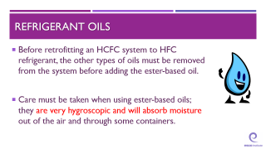

REFRIGERANT OILS
Most HCFC binary (two-part) and ternary (three- part) blends use a synthetic alkylbenzene lubricant.
When retrofitting HCFC equipment to HFC refrigerants or when working with newly manufactured systems, synthetic polyolester oil is most commonly used.
Ester-based oils cannot be mixed with any other type of oil.
Notes:
ESCO EPA Section 608 Preparatory Manual 9th Edition V2 Page 8
Most HCFC binary (two-part) and ternary (three-part) blends use a synthetic alkylbenzene lubricant. When retrofitting HCFC equipment to HFC refrigerants or when working with newly manufactured systems, synthetic polyolester oil is most commonly used. Ester-based oils cannot be mixed with any other type of oil.

Slide 95
REFRIGERANT OILS
Before retrofitting an HCFC system to HFC refrigerant, the other types of oils must be removed from the system before adding the ester-based oil.
Care must be taken when using ester-based oils; they are very hygroscopic and will absorb moisture out of the air and through some containers.
Notes:
ESCO EPA Section 608 Preparatory Manual 9th Edition V2 Page 8
Before retrofitting an HCFC system to HFC refrigerant, the other types of oils must be removed from the system before adding the ester-based oil. Care must be taken when using ester-based oils; they are very hygroscopic and will absorb moisture out of the air and through some containers.

Slide 96
MONTREAL PROTOCOL AND CLEAN AIR ACT
Notes:
ESCO EPA Section 608 Preparatory Manual 9th Edition V2 Page 9
The United States Environmental Protection Agency (EPA) regulates Section 608 of the Federal Clean Air Act which establishes the rules for regulating all Class I (Ozone-Depleting Substances such as CFCs), Class II (HCFCs), and substitute refrigerants. Failure to comply could cost you and your company.

Slide 97

MONTREAL PROTOCOL AND CLEAN AIR ACT
The United States is part of the Montreal Protocol which is an international treaty that addresses ozone-depleting substances and their alternatives.
Montreal Protocol
Treaty
Notes:
ESCO EPA Section 608 Preparatory Manual 9th Edition V2 Page 9
The United States is part of the Montreal Protocol which is an international treaty that addresses ozone-depleting substances and their alternatives.

Slide 98
MONTREAL PROTOCOL AND CLEAN AIR ACT
To stop damage to the stratospheric ozone layer, the U.S. is phasing out, or has already phased out, the use of chlorofluorocarbons (CFCs), hydrochlorofluorocarbons (HCFCs), and other refrigerants that are harmful to the environment.
Notes:
ESCO EPA Section 608 Preparatory Manual 9th Edition V2 Page 9
To stop damage to the stratospheric ozone layer, the U.S. is phasing out, or has already phased out, the use of chlorofluorocarbons (CFCs), hydrochlorofluorocarbons (HCFCs), and other refrigerants that are harmful to the environment.

Slide 99
MONTREAL PROTOCOL AND CLEAN AIR ACT
Section 608 of the Clean Air Act sets forth the rules and regulations for refrigerant handling in the HVACR industry.
Section 608 certification allows a technician to purchase or handle regulated refrigerants.
Distributors that sell HCFC, HFC, or another regulated refrigerant must verify the purchaser is, or employs, a Section 608 certified technician.
Notes:
ESCO EPA Section 608 Preparatory Manual 9th Edition V2 Page 9
Section 608 of the Clean Air Act sets forth the rules and regulations for refrigerant handling in the HVACR industry.
Section 608 certification allows a technician to purchase or handle regulated refrigerants.
Distributors that sell HCFC, HFC, or another regulated refrigerant must verify the purchaser is, or employs, a Section 608 certified technician.

Slide 100
MONTREAL PROTOCOL AND CLEAN AIR ACT
Anyone performing any activity that violates the refrigerant circuit, including removal of refrigerant or replacing a component containing a regulated refrigerant must be certified at the proper level and have the type of recovery equipment required.
Notes:
ESCO EPA Section 608 Preparatory Manual 9th Edition V2 Page 9
Anyone performing any activity that violates the refrigerant circuit, including removal of refrigerant or replacing a component containing a regulated refrigerant must be certified at the proper level and have the type of recovery equipment required.

Slide 101

MONTREAL PROTOCOL AND CLEAN AIR ACT
It is illegal to knowingly release CFC, HCFC, or HFC refrigerants during the service, maintenance, repair, or disposal of appliances.
A technician must have their Section 608 certification card in their possession when preforming an activity regulated by Section 608.
If your Section 608 certification card is lost, request a replacement from your certifying organization not the EPA.
Notes:
ESCO EPA Section 608 Preparatory Manual 9th Edition V2 Page 9
It is illegal to knowingly release CFC, HCFC, or HFC refrigerants during the service, maintenance, repair, or disposal of appliances. A technician must have their Section 608 certification card in their possession when preforming an activity regulated by Section 608.
If your Section 608 certification card is lost, request a replacement from your certifying organization not the EPA.

Slide 102
MONTREAL PROTOCOL AND CLEAN AIR ACT
A person is not required to be a Section 608 certified technician when servicing an external electric circuit or sections of the system that do not involve the refrigerant components of an HVACR appliance.
Notes:
ESCO EPA Section 608 Preparatory Manual 9th Edition V2 Page 9
A person is not required to be a Section 608 certified technician when servicing an external electric circuit or sections of the system that do not involve the refrigerant components of an HVACR appliance.

Slide 103
MONTREAL PROTOCOL AND CLEAN AIR ACT
The Clean Air Act (EPA’s regulations) allows for releasing an exempt refrigerant (e.g., ammonia and CO₂) or a small amount of refrigerant, mixed with nitrogen (a leak trace gas) for leak detection.
Notes:
ESCO EPA Section 608 Preparatory Manual 9th Edition V2 Page 9
The Clean Air Act (EPA’s regulations) allows for releasing an exempt refrigerant (e.g., ammonia and CO₂) or a small amount of refrigerant, mixed with nitrogen (a leak trace gas) for leak detection.

Slide 104
MONTREAL PROTOCOL AND CLEAN AIR ACT
As of 2017, a technician can be fined $44,539 per day, per violation, for violating the Clean Air Act, including knowingly releasing non-exempt refrigerant from appliances.
VIOLATORS will be FINED
Notes:
ESCO EPA Section 608 Preparatory Manual 9th Edition V2 Page 9
As of 2017, a technician can be fined $44,539 per day, per violation, for violating the Clean Air Act, including knowingly releasing non-exempt refrigerant from appliances.

Slide 105



MONTREAL PROTOCOL AND CLEAN AIR ACT
Service technicians who violate the Clean Air Act provisions may lose their certification in addition to paying fines and being required to appear in court.
Notes:
ESCO EPA Section 608 Preparatory Manual 9th Edition V2 Page 9
Service technicians who violate the Clean Air Act provisions may lose their certification in addition to paying fines and being required to appear in court.

Slide 106

MONTREAL PROTOCOL AND CLEAN AIR ACT
It is the technician's responsibility to comply with any future changes in the law or EPA regulations after a technician becomes certified.
2025
Notes:
ESCO EPA Section 608 Preparatory Manual 9th Edition V2 Page 9
It is the technician's responsibility to comply with any future changes in the law or EPA regulations after a technician becomes certified.

Slide 107
MONTREAL PROTOCOL AND CLEAN AIR ACT
State and local governments may establish laws that contain stricter requirements than the Clean Air Act/EPA regulations.
Notes:
ESCO EPA Section 608 Preparatory Manual 9th Edition V2 Page 9
State and local governments may establish laws that contain stricter requirements than the Clean Air Act/EPA regulations.

Slide 108
MONTREAL PROTOCOL AND CLEAN AIR ACT
The EPA’s Significant New Alternatives Policy (SNAP) Program identifies refrigerants with lower overall risks to human health and the environment.
Notes:
ESCO EPA Section 608 Preparatory Manual 9th Edition V2 Page 9
The EPA’s Significant New Alternatives Policy (SNAP) Program identifies refrigerants with lower overall risks to human health and the environment.

Slide 109
MONTREAL PROTOCOL AND CLEAN AIR ACT
The phase-out for the production and imports of newly manufactured R-22 and HCFC-142b in the U.S. will be in the year 2020.
After the phase-out of all HCFC refrigerants in 2030, supplies of those refrigerants for equipment servicing will come from recovered and reclaimed gas.
Notes:
ESCO EPA Section 608 Preparatory Manual 9th Edition V2 Page 9
The phase-out for the production and imports of newly manufactured R-22 and HCFC-142b in the U.S. will be in the year 2020. After the phase-out of all HCFC refrigerants in 2030, supplies of those refrigerants for equipment servicing will come from recovered and reclaimed gas.

Slide 110
MONTREAL PROTOCOL AND CLEAN AIR ACT
It is not a violation of the refrigerant management regulations under the Clean Air Act to service a system that uses CFCs or HCFCs after the phase-out of those refrigerants.
Notes:
ESCO EPA Section 608 Preparatory Manual 9th Edition V2 Page 9
It is not a violation of the refrigerant management regulations under the Clean Air Act to service a system that uses CFCs or HCFCs after the phase-out of those refrigerants.

Slide 111
MONTREAL PROTOCOL AND CLEAN AIR ACT
Reclaimed refrigerant must meet AHRI Standard 700 before it can be resold under EPA’s regulations.
Technicians can only charge used CFC, HCFC, or HFC refrigerants back into the same appliance or into another appliance owned by the same owner.
Used refrigerant may no longer meet the AHRI Standard for virgin refrigerant so it cannot change ownership without being reclaimed.
Notes:
ESCO EPA Section 608 Preparatory Manual 9th Edition V2 Page 9
Reclaimed refrigerant must meet AHRI Standard 700 before it can be resold under EPA’s regulations. Technicians can only charge used CFC, HCFC, or HFC refrigerants back into the same appliance or into another appliance owned by the same owner. Used refrigerant may no longer meet the AHRI Standard for virgin refrigerant so it cannot change ownership without being reclaimed.

Slide 112
MONTREAL PROTOCOL AND CLEAN AIR ACT
All CFC, HCFC, HFC, and HFO refrigerant recovery equipment must meet EPA standards.
Recovery equipment must be tested according to AHRI Standard 740.
Recovery machines may be able to recover one or multiple types of refrigerants.
Notes:
ESCO EPA Section 608 Preparatory Manual 9th Edition V2 Page 9
All CFC, HCFC, HFC, and HFO refrigerant recovery equipment must meet EPA standards.
Recovery equipment must be tested according to AHRI Standard 740.
Recovery machines may be able to recover one or multiple types of refrigerants.

Slide 113
MONTREAL PROTOCOL AND CLEAN AIR ACT
Desiccant dehumidifiers are NOT covered by EPA Section 608 regulations as they do not contain a refrigerant.
Notes:
ESCO EPA Section 608 Preparatory Manual 9th Edition V2 Page 9
Desiccant dehumidifiers are NOT covered by EPA Section 608 regulations as they do not contain a refrigerant.

Slide 114


MONTREAL PROTOCOL AND CLEAN AIR ACT
Self-contained recovery devices remove refrigerant from an appliance without the assistance of components in the appliance.
Recovery equipment that relies on the compressor in the appliance and/or the pressure of the refrigerant in the appliance is considered to be system-dependent.
Notes:
ESCO EPA Section 608 Preparatory Manual 9th Edition V2 Page 9
Self-contained recovery devices remove refrigerant from an appliance without the assistance of components in the appliance.
Recovery equipment that relies on the compressor in the appliance and/or the pressure of the refrigerant in the appliance is considered to be system-dependent.

Slide 115

MONTREAL PROTOCOL AND CLEAN AIR ACT
To make it easier to recover refrigerant, EPA regulations require appliances that do not have service valves to have a service aperture or process stub.
Notes:
ESCO EPA Section 608 Preparatory Manual 9th Edition V2 Page 9
To make it easier to recover refrigerant, EPA regulations require appliances that do not have service valves to have a service aperture or process stub.

Slide 116
MONTREAL PROTOCOL AND CLEAN AIR ACT
When disposing of appliances with 5-50 pounds of refrigerant, EPA does not require technicians (or the company employing the technician) to record the model and serial number of the appliance. However, records that must be kept include;
• type of refrigerant recovered
• quantity of refrigerant, by type
• quantity recovered from disposed appliances in each calendar month
• quantity of refrigerant, by type, sent for reclamation or destruction.
Notes:
ESCO EPA Section 608 Preparatory Manual 9th Edition V2 Page 10
When disposing of appliances with 5-50 pounds of refrigerant, EPA does not require technicians (or the company employing the technician) to record the model and serial number of the appliance. However, records that must be kept include;
type of refrigerant recovered
quantity of refrigerant, by type
quantity recovered from disposed appliances in each calendar month
quantity of refrigerant, by type, sent for reclamation or destruction.

Slide 117
MONTREAL PROTOCOL AND CLEAN AIR ACT
EPA’s refrigerant management regulations exempt certain refrigerants from the venting prohibition.
This can occur when and if the EPA determines that a certain refrigerant does not pose a threat to the environment if released.
Some natural refrigerants, such as carbon dioxide (CO₂), can be purchased by someone who is not Section 608 certified.
Notes:
ESCO EPA Section 608 Preparatory Manual 9th Edition V2 Page 10
EPA’s refrigerant management regulations exempt certain refrigerants from the venting prohibition.
This can occur when and if the EPA determines that a certain refrigerant does not pose a threat to the environment if released.
Some natural refrigerants, such as carbon dioxide (CO₂), can be purchased by someone who is not Section 608 certified.

Slide 118
MONTREAL PROTOCOL AND CLEAN AIR ACT
It is lawful to service existing R-22 systems and use existing supplies of R-22.
It is not legal to top off an R-22 charge with another refrigerant such as R-410A.
Topping off one type of refrigerant with another can void equipment warranty, ruin the refrigerant, damage the equipment, and cause severe personal injury, or death.
Notes:
ESCO EPA Section 608 Preparatory Manual 9th Edition V2 Page 10
It is lawful to service existing R-22 systems and use existing supplies of R-22.
It is not legal to top off an R-22 charge with another refrigerant such as R-410A.
Topping off one type of refrigerant with another can void equipment warranty, ruin the refrigerant, damage the equipment, and cause severe personal injury, or death.

Slide 119
MONTREAL PROTOCOL AND CLEAN AIR ACT
When discarding any disposable cylinders of CFCs, HCFCs, HFCs or HFOs, recover all remaining refrigerant, render the cylinder useless, and recycle the metal.
Notes:
ESCO EPA Section 608 Preparatory Manual 9th Edition V2 Page 10
When discarding any disposable cylinders of CFCs, HCFCs, HFCs or HFOs, recover all remaining refrigerant, render the cylinder useless, and recycle the metal.

Slide 120
MONTREAL PROTOCOL AND CLEAN AIR ACT
Before opening or disposing of any appliance containing a chlorofluorocarbon (CFC), hydrochlorofluorocarbon (HCFC), or hydrofluorocarbon (HFC) refrigerant, recover the refrigerant to the approved EPA recovery or evacuation levels.
Notes:
ESCO EPA Section 608 Preparatory Manual 9th Edition V2 Page 10
Before opening or disposing of any appliance containing a chlorofluorocarbon (CFC), hydrochlorofluorocarbon (HCFC), or hydrofluorocarbon (HFC) refrigerant, recover the refrigerant to the approved EPA recovery or evacuation levels.

Slide 121
MONTREAL PROTOCOL AND CLEAN AIR ACT
Under the Section 608 “Safe Disposal Requirements”, it is the final person in the disposal chain that is responsible for ensuring that any CFC, HCFC, or HFC refrigerant has been removed from household refrigerators or other appliances before they are disposed of.
Notes:
ESCO EPA Section 608 Preparatory Manual 9th Edition V2 Page 10
Under the Section 608 “Safe Disposal Requirements”, it is the final person in the disposal chain that is responsible for ensuring that any CFC, HCFC, or HFC refrigerant has been removed from household refrigerators or other appliances before they are disposed of.

Slide 122


MONTREAL PROTOCOL AND CLEAN AIR ACT
The knowingly release of a CFC, HCFC, HFC or HFO refrigerant during the service, maintenance, repair, vandalism, theft, or disposal of appliances is illegal.
Refrigerants emitted when cutting a line without properly evacuating the appliance violates the venting prohibition.
Notes:
ESCO EPA Section 608 Preparatory Manual 9th Edition V2 Page 10
The knowingly release of a CFC, HCFC, HFC or HFO refrigerant during the service, maintenance, repair, vandalism, theft, or disposal of appliances is illegal. Refrigerants emitted when cutting a line without properly evacuating the appliance violates the venting prohibition.

Slide 123


MONTREAL PROTOCOL AND CLEAN AIR ACT
Venting refrigerant from a recovery machine or recovery cylinder after use is also illegal.
Records of recovered refrigerant must be kept to ensure venting does not take place after recovery from an appliance.
Notes:
ESCO EPA Section 608 Preparatory Manual 9th Edition V2 Page 10
Venting refrigerant from a recovery machine or recovery cylinder after use is also illegal. Records of recovered refrigerant must be kept to ensure venting does not take place after recovery from an appliance.

Slide 124

MONTREAL PROTOCOL AND CLEAN AIR ACT
Small quantities of isobutane, used in household freezers, can be vented.
Releasing mixtures of nitrogen and refrigerant that result from adding nitrogen to a fully charged appliance to leak check the appliance is considered a violation of the prohibition on venting.
Only a few ounces of refrigerant mixed with nitrogen is considered a leak trace gas and may be released without recovery.
Notes:
ESCO EPA Section 608 Preparatory Manual 9th Edition V2 Page 10
Small quantities of isobutane, used in household freezers, can be vented.
Releasing mixtures of nitrogen and refrigerant that result from adding nitrogen to a fully charged appliance to leak check the appliance is considered a violation of the prohibition on venting.
Only a few ounces of refrigerant mixed with nitrogen is considered a leak trace gas and may be released without recovery.

Slide 125


RECOVER
Recover means to remove refrigerant, in any condition from a system and store it in an approved recovery cylinder or container.
Recovered refrigerant may be charged into the same system, another system with the same ownership, or shipped to an approved reclaimer.
Notes:
ESCO EPA Section 608 Preparatory Manual 9th Edition V2 Page 11
The processes of recovery, recycling, and reclaiming sound similar, but they are quite different.
Recover means to remove refrigerant, in any condition from a system and store it in an approved recovery cylinder or container.
Recovered refrigerant may be charged into the same system, another system with the same ownership, or shipped to an approved reclaimer.

Slide 126

RECYLE
Recycle means to extract refrigerant from an appliance (except motor vehicle air conditioners or MVACs) and clean the refrigerant for reuse in equipment of the same owner without meeting all of the requirements for reclamation.
Notes:
ESCO EPA Section 608 Preparatory Manual 9th Edition V2 Page 11
Recycle means to extract refrigerant from an appliance (except motor vehicle air conditioners or MVACs) and clean the refrigerant for reuse in equipment of the same owner without meeting all of the requirements for reclamation. In general, recycled refrigerant is refrigerant that is cleaned using oil separation and single or multiple passes through devices, such as replaceable core filter-driers, which reduce moisture, acidity, and particulate matter. Recycled refrigerant may be charged into the same system or another system with the same ownership.

Slide 127

RECLAIM
Reclaim means to process refrigerant to a level equal to new (virgin) product specifications as determined by chemical analysis. Reclaimed refrigerants must meet AHRI 700 Standards, before it can be sold.
Notes:
ESCO EPA Section 608 Preparatory Manual 9th Edition V2 Page 11
Reclaim means to process refrigerant to a level equal to new (virgin) product specifications as determined by chemical analysis. Reclaimed refrigerants must meet AHRI 700 Standards, before it can be sold.

Slide 128
RECOVERY DEVICES
Refrigerant recovery and/or recycling equipment manufactured after November 15, 1993 must be certified and labeled by an EPA-approved equipment testing organization to meet EPA standards.
An EPA-approved certification label is required on all new recovery equipment.
Notes:
ESCO EPA Section 608 Preparatory Manual 9th Edition V2 Page 11
Refrigerant recovery and/or recycling equipment manufactured after November 15, 1993 must be certified and labeled by an EPA-approved equipment testing organization to meet EPA standards. An EPA-approved certification label is required on all new recovery equipment.

Slide 129


RECOVERY DEVICES
There are two basic types of recovery devices:
“System-dependent” (passive) which captures refrigerant with the assistance of components in the appliance from which refrigerant is being recovered.
"Self-contained” (active) which has its own means to draw the refrigerant out of the appliance.
Notes:
ESCO EPA Section 608 Preparatory Manual 9th Edition V2 Page 11
There are two basic types of recovery devices: “System-dependent” (passive) which captures refrigerant with the assistance of components in the appliance from which refrigerant is being recovered, into non pressurized container. "Self-contained” (active) which has its own means to draw the refrigerant out of the appliance.

Slide 130


RECOVERY DEVICES
The recovery time will be increased if the appliance is located in:
Low ambient temperature condition
Long hoses are used between the unit and the recovery machine
Long and small diameter hoses between the unit and recovery machine should be avoided as they will cause excessive pressure drop and increase recovery time.
Notes:
ESCO EPA Section 608 Preparatory Manual 9th Edition V2 Page 11
The recovery time will be increased if the appliance is located in low ambient temperatures or long hoses are used between the unit and the recovery machine. Long and small diameter hoses between the unit and recovery machine should be avoided as they will cause excessive pressure drop and increase recovery time.

Slide 131
RECOVERY DEVICES
Upon completion of refrigerant liquid transfer between recovery unit and the refrigeration system, guard against trapping liquid refrigerant in the service hose between closed service valves.
Notes:
ESCO EPA Section 608 Preparatory Manual 9th Edition V2 Page 11
Upon completion of refrigerant liquid transfer between recovery unit and the refrigeration system, guard against trapping liquid refrigerant in the service hose between closed service valves.

Slide 132

RECOVERY DEVICES
The technician must have a separate refrigerant recovery cylinder for each type of refrigerant recovered and should have a separate cylinder for refrigerants known to be mixed.
If servicing systems that use HFC-134a, HFC-410A and HCFC-22, then three cylinders are required even though two are HFCs.
R-134a
R-410A
R-22
Notes:
ESCO EPA Section 608 Preparatory Manual 9th Edition V2 Page 11
The technician must have a separate refrigerant recovery cylinder for each type of refrigerant recovered and should have a separate cylinder for refrigerants known to be mixed. If servicing systems that use HFC-134a, HFC-410A and HCFC-22, then three cylinders are required even though two are HFCs.

Slide 133

RECOVERY DEVICES
It is important not to mix refrigerants in the same container when recovering as refrigerants that are mixed be may be impossible to reclaim and there may be an added cost to have them destroyed.
Do Not Mix
Notes:
ESCO EPA Section 608 Preparatory Manual 9th Edition V2 Page 11
It is important not to mix refrigerants in the same container when recovering as refrigerants that are mixed be may be impossible to reclaim and there may be an added cost to have them destroyed.

Slide 134
RECOVERY DEVICES
Technicians can only charge used CFC, HCFC, or HFC refrigerants back into the same appliance or into another appliance with the same owner.
Used refrigerant may no longer meet the AHRI standard for virgin refrigerant so it cannot change ownership without being reclaimed.
Notes:
ESCO EPA Section 608 Preparatory Manual 9th Edition V2 Page 11
Technicians can only charge used CFC, HCFC, or HFC refrigerants back into the same appliance or into another appliance with the same owner. Used refrigerant may no longer meet the AHRI standard for virgin refrigerant so it cannot change ownership without being reclaimed.

Slide 135
LEAK DETECTION
Leak detection methods and devices used must be approved by the manufacturer.
The wrong type of electronic leak detector used with a flammable refrigerant can cause an explosion and bodily injuries.
Notes:
ESCO EPA Section 608 Preparatory Manual 9th Edition V2 Page 12
To determine the general area of a small leak, the use of an electronic or ultrasonic leak detector is considered to be the most effective. To cause the least amount of damage to the environment, newly installed systems should be pressurized with dry nitrogen for leak detection purposes.

Slide 136

LEAK DETECTION
To determine the general area of a small leak, the use of an electronic or ultrasonic leak detector is considered to be the most effective.
To cause the least amount of damage to the environment, newly installed systems should be pressurized with dry nitrogen for leak detection purposes.
Notes:
ESCO EPA Section 608 Preparatory Manual 9th Edition V2 Page 12
To determine the general area of a small leak, the use of an electronic or ultrasonic leak detector is considered to be the most effective. To cause the least amount of damage to the environment, newly installed systems should be pressurized with dry nitrogen for leak detection purposes.

Slide 137

LEAK DETECTION
If an electronic leak detector is to be used, a trace of the system refrigerant can be added to the system along with the dry nitrogen.
A leak trace gas is not considered a refrigerant under the EPA’s refrigerant management regulations.
Notes:
ESCO EPA Section 608 Preparatory Manual 9th Edition V2 Page 12
If an electronic leak detector is to be used, a trace of the system refrigerant can be added to the system along with the dry nitrogen.
The trace gas should be the same as the refrigerant the appliance is going to be charged with.
A leak trace gas is not considered a refrigerant under the EPA’s refrigerant management regulations.

Slide 138

LEAK DETECTION
Once the general area of the leak is located, the use of soap bubbles will aid in pinpointing the leak.
Finding and repairing leaks in a system will conserve refrigerant for future use.
Notes:
ESCO EPA Section 608 Preparatory Manual 9th Edition V2 Page 12
Once the general area of the leak is located, the use of soap bubbles will aid in pinpointing the leak.
Finding and repairing leaks in a system will conserve refrigerant for future use.

Slide 139

LEAK DETECTION
Upon completion of a leak repair, and before recharging the system, install a new filter drier, and complete a standing-pressure leak check at the maximum system pressure.
For safety, any system designed to contain a flammable hydrocarbon (HC) or HFO refrigerant has to have a leak test before evacuating to 500 microns or lower.
Notes:
ESCO EPA Section 608 Preparatory Manual 9th Edition V2 Page 12
Upon completion of a leak repair, and before recharging the system, install a new filter drier, and complete a standing-pressure leak check at the maximum system pressure.
For safety, any system designed to contain a flammable hydrocarbon (HC) or HFO refrigerant has to have a leak test before evacuating to 500 microns or lower.

Slide 140

LEAK DETECTION
Unlike natural gas, flammable hydrocarbon or HFO refrigerants do not contain odorants to indicate their presence.
Odorants do not need to be added to systems containing flammable refrigerants.
Notes:
ESCO EPA Section 608 Preparatory Manual 9th Edition V2 Page 12
Unlike natural gas, flammable hydrocarbon or HFO refrigerants do not contain odorants to indicate their presence. Odorants do not need to be added to systems containing flammable refrigerants.

Slide 141


DEHYDRATION
The reason for dehydrating a refrigeration system is to remove water and water vapor, and it is important to follow proper dehydration procedures.
If moisture is allowed to remain in an operating refrigeration system, hydrochloric and hydrofluoric acids may form.
Notes:
ESCO EPA Section 608 Preparatory Manual 9th Edition V2 Page 12
The reason for dehydrating a refrigeration system is to remove water and water vapor, and it is important to follow proper dehydration procedures. If moisture is allowed to remain in an operating refrigeration system, hydrochloric and hydrofluoric acids may form.

Slide 142

DEHYDRATION
To dehydrate a system, it should be evacuated. It is not possible to over-evacuate a system.
Most manufacturers require system evacuation to 500 microns, or lower, which can be measured with a micron gauge.
500
Notes:
ESCO EPA Section 608 Preparatory Manual 9th Edition V2 Page 12
To dehydrate a system, it should be evacuated. It is not possible to over-evacuate a system. Most manufacturers require system evacuation to 500 microns, or lower, which can be measured with a micron gauge.

Slide 143

DEHYDRATION
Never evacuate a system to the ambient air without first following proper recovery procedures and attaining the mandated recovery level required by EPA regulations.
Notes:
ESCO EPA Section 608 Preparatory Manual 9th Edition V2 Page 12
Never evacuate a system to the ambient air without first following proper recovery procedures and attaining the mandated recovery level required by EPA regulations.

Slide 144



DEHYDRATION
The factors affecting the speed and efficiency of evacuation are:
Size of equipment being evacuated
Ambient temperature
Amount of moisture in the system
The size of the vacuum pump and suction hose
½ Hose
Notes:
ESCO EPA Section 608 Preparatory Manual 9th Edition V2 Page 12
The factors that affect the speed and efficiency of evacuation are; size of equipment being evacuated, ambient temperature, amount of moisture in the system, the size of the vacuum pump and vacuum lines.

Slide 145


DEHYDRATION
In addition, vacuum lines (hoses) should be equal to or larger than the pump intake connection.
The brand of a micron gauge does not usually affect the speed of evacuation, but the method used to connect it to the system may.
Notes:
ESCO EPA Section 608 Preparatory Manual 9th Edition V2 Page 12
In addition, vacuum lines (hoses) should be equal to or larger than the pump intake connection.
The brand of a micron gauge does not usually affect the speed of evacuation, but the method used to connect it to the system may.

Slide 146

DEHYDRATION
The piping connection to the vacuum pump should be as short a length as possible and as large in diameter as possible.
For accurate readings during evacuation, the system vacuum gauge should be connected as far away from the vacuum pump as possible.
Measuring a final system vacuum should be done with the system isolated and the vacuum pump turned off.
¼” Hose
Notes:
ESCO EPA Section 608 Preparatory Manual 9th Edition V2 Page 12
The piping connection to the vacuum pump should be as short a length as possible and as large in diameter as possible.
For accurate readings during evacuation, the system vacuum gauge should be connected as far away from the vacuum pump as possible.
Measuring a final system vacuum should be done with the system isolated and the vacuum pump turned off.

Slide 147


DEHYDRATION
A system that will not hold a vacuum after it has been evacuated probably has a leak.
During evacuation, you may wish to heat the refrigeration system to decrease dehydration time.
Tapping a compressor with a rubber mallet will aid in releasing trapped refrigerant from the oil.
Notes:
ESCO EPA Section 608 Preparatory Manual 9th Edition V2 Page 12
A system that will not hold a vacuum after it has been evacuated probably has a leak.
During evacuation, you may wish to heat the refrigeration system to decrease dehydration time.
Tapping a compressor with a rubber mallet will aid in releasing trapped refrigerant from the oil.

Slide 148


DEHYDRATION
Dehydration is complete when the vacuum gauge/indicator shows that you have reached and held the required vacuum of 500 microns or less.
If the pressure increases then stops for a few minutes then rises more, there is probably moisture left in the system.
If the pressure steadily rises, there is probably a leak.
Notes:
ESCO EPA Section 608 Preparatory Manual 9th Edition V2 Page 13
Dehydration is complete when the vacuum gauge/indicator shows that you have reached and held the required vacuum of 500 microns or less. If the pressure increases then stops for a few minutes then rises more, there is probably moisture left in the system. If the pressure steadily rises, there is probably a leak.

Slide 149





SAFETY/GENERAL
The EPA is concerned not only with the prevention of refrigerant venting, but with the technician’s overall safety.
When handling and filling refrigerant cylinders or operating recovery or recycling equipment, you should wear safety glasses, protective gloves, and follow all equipment manufacturer’s safety precautions.
Make sure your recovery machine is grounded when in use, especially when recovering a flammable refrigerant.
Notes:
ESCO EPA Section 608 Preparatory Manual 9th Edition V2 Page 13
The EPA is concerned not only with the prevention of refrigerant venting, but with the technician’s overall safety. When handling and filling refrigerant cylinders or operating recovery or recycling equipment, you should wear safety glasses, protective gloves, and follow all equipment manufacturer’s safety precautions. Make sure your recovery machine is grounded when in use, especially when recovering a flammable refrigerant.

Slide 150


SAFETY/GENERAL
When pressurizing a system with nitrogen, you should:
Charge through a regulator.
Insert a relief valve in the downstream line from the pressure regulator.
Relief valves MUST NOT be installed in series. If corrosion build-up is found within the body of a relief valve, the valve MUST be replaced.
Notes:
ESCO EPA Section 608 Preparatory Manual 9th Edition V2 Page 13
When pressurizing a system with nitrogen, you should always charge through a pressure regulator and a relief valve in the downstream line from the pressure regulator. Relief valves MUST NOT be installed in series. If corrosion build-up is found within the body of a relief valve, the valve MUST be replaced.

Slide 151


SAFETY/GENERAL
When leak checking a system, NEVER pressurize the system with oxygen or compressed air.
When mixed with some refrigerants or compressor oil, oxygen or compressed air can cause an explosion.
Oil, Oxygen
Notes:
ESCO EPA Section 608 Preparatory Manual 9th Edition V2 Page 13
When leak checking a system, NEVER pressurize the system with oxygen or compressed air. When mixed with some refrigerants or compressor oil, oxygen or compressed air can cause an explosion.

Slide 152




SAFETY/GENERAL
Never pressurize the system with oxygen or compressed air!
To determine the safe pressure for leak testing, check the equipment data plate.
No oxygen!
Notes:
ESCO EPA Section 608 Preparatory Manual 9th Edition V2 Page 13
When leak checking a system, NEVER pressurize the system with oxygen or compressed air. When mixed with some refrigerants or compressor oil, oxygen or compressed air can cause an explosion. To determine the safe pressure for leak testing, check the equipment data plate for the maximum low-side test pressure value.

Slide 153

SAFETY/GENERAL
To determine the safe pressure for leak testing, check the equipment data plate for the maximum low-side test pressure value.
Notes:
ESCO EPA Section 608 Preparatory Manual 9th Edition V2 Page 13
To determine the safe pressure for leak testing, check the equipment data plate for the maximum low-side test pressure value.

Slide 154

SAFETY/GENERAL
NEVER expose refrigerants to open flames or glowing hot metal surfaces.
Although reclaimers may accept visibly burned recovery tanks, at high temperatures, refrigerants decompose and form acids.
Notes:
ESCO EPA Section 608 Preparatory Manual 9th Edition V2 Page 13
NEVER expose refrigerants to open flames or glowing hot metal surfaces. Although reclaimers may accept visibly burned recovery tanks, at high temperatures, refrigerants decompose and form acids.

Slide 155

SAFETY/GENERAL
Hydrochloric acid is formed if the refrigerant contains chlorine.
Hydrofluoric acid is formed if the refrigerant contains fluorine
Notes:
ESCO EPA Section 608 Preparatory Manual 9th Edition V2 Page 13
Hydrochloric acid is formed if the refrigerant contains chlorine.
Hydrofluoric acid is formed if the refrigerant contains fluorine.
Heating a refrigerant cylinder can result in an explosion and cause serious injuries.

Slide 156


SAFETY/GENERAL
Heating a refrigerant cylinder can result in an explosion and cause serious injuries.
If oxygen is also present, it is possible to form carbon monoxide, carbon dioxide, and phosgene gas.
Notes:
ESCO EPA Section 608 Preparatory Manual 9th Edition V2 Page 13
Heating a refrigerant cylinder can result in an explosion and cause serious injuries. If oxygen is also present, it is possible to form carbon monoxide, carbon dioxide, and phosgene gas.

Slide 157
SAFETY/GENERAL
If a hydrocarbon (HC) refrigerant is released into a space, and an ignition source is provided an explosion can occur if the refrigerant concentration is above the Lower Flammability Limit (LFL) and below the Upper Flammability Limit (UFL) with an ignition source.
Notes:
ESCO EPA Section 608 Preparatory Manual 9th Edition V2 Page 13
If a hydrocarbon (HC) refrigerant is released into a space, and an ignition source is provided an explosion can occur if the refrigerant concentration is above the Lower Flammability Limit (LFL) and below the Upper Flammability Limit (UFL) with an ignition source.

Slide 158

SAFETY/GENERAL
When working with any solvents, chemicals, or refrigerants, Safety Data Sheets (SDS) should be reviewed by the technician to reference compatibility with other materials.
Silicone elastomers, for example, which are used in seals and gaskets, are not compatible with HFO refrigerants.
SDS
SHEETS
Notes:
ESCO EPA Section 608 Preparatory Manual 9th Edition V2 Page 13
When working with any solvents, chemicals, or refrigerants, Safety Data Sheets (SDS) should be reviewed by the technician to reference compatibility with other materials. Silicone elastomers, for example, which are used in seals and gaskets, are not compatible with HFO refrigerants.

Slide 159

SAFETY/GENERAL
Refrigerant vapors, or mist, in high concentrations, should not be inhaled; they may cause heart irregularities or unconsciousness.
In most refrigerant accidents where death occurs, oxygen deprivation is the major cause.
According to the ASHRAE refrigerant safety classification, A1 designations would be the safest.
Notes:
ESCO EPA Section 608 Preparatory Manual 9th Edition V2 Page 13
Refrigerant vapors, or mist, in high concentrations, should not be inhaled; they may cause heart irregularities or unconsciousness. In most refrigerant accidents where death occurs, oxygen deprivation is the major cause.
According to the ASHRAE refrigerant safety classification standard, A1 designations would be the safest.
R-410A is considered to be non-toxic but it, as any other refrigerant in high concentrations, can cause asphyxia.

Slide 160
SAFETY/GENERAL
Never apply an open flame or live steam to a flammable refrigerant cylinder, do not cut or weld any refrigerant line while refrigerant is in the unit, and do not use oxygen to purge lines or to pressurize the machine.
HFO-1234yf is classified A2L not as an A3 (higher flammability) refrigerant like Isobutane (R-600a), Propane (R-290) and R-441A (Hydrocarbon blend).
Notes:
ESCO EPA Section 608 Preparatory Manual 9th Edition V2 Page 13
Prior to recovery of any flammable refrigerant ensure that the refrigeration system and recovery unit is grounded. Never apply an open flame or live steam to a flammable refrigerant cylinder, do not cut or weld any refrigerant line while refrigerant is in the unit, and do not use oxygen to purge lines or to pressurize the machine. A sufficient concentration of the refrigerant in the space and an ignition source are most likely to lead to an explosion with refrigerants. HFO-1234yf is classified A2L not as an A3 (higher flammability) refrigerant like Isobutane (R-600a), Propane (R-290) and R-441A (Hydrocarbon blend).

Slide 161
SAFETY/GENERAL
A red color marking is required on all process tubes and other pipes through which a flammable refrigerant flows/passes and where a service connection is probable.
The red marking must extend a minimum of one inch in both directions from such locations.
Notes:
ESCO EPA Section 608 Preparatory Manual 9th Edition V2 Page 13
A red color marking is required on all process tubes and other pipes through which a flammable refrigerant flows/passes and where a service connection is probable.
The red marking must extend a minimum of one inch in both directions from such locations.

Slide 162

SAFETY/GENERAL
In the event of a large release of CFC, HCFC, HFC, HFO, HC, or any refrigerant in a contained area, a self-contained breathing apparatus (SCBA) is required.
IMMEDIATELY VACATE AND VENTILATE THE AREA.
Notes:
ESCO EPA Section 608 Preparatory Manual 9th Edition V2 Page 13
In the event of a large release of CFC, HCFC, HFC, HFO, HC, or any refrigerant in a contained area a self-contained breathing apparatus (SCBA) or leaving the area is required.
In large quantities, all refrigerants can cause suffocation because they can displace oxygen. Inhaling refrigerant vapors or mist may cause heart irregularities, unconsciousness, and oxygen deprivation leading to death (asphyxia).

Slide 163

SAFETY/GENERAL
An alcohol spray should be used to remove ice from sight glasses or viewing glasses.
Notes:
ESCO EPA Section 608 Preparatory Manual 9th Edition V2 Page 13
An alcohol spray should be used to remove ice from sight glasses or viewing glasses.

Slide 164


SAFETY/CYLINDER
A refrigerant recovery cylinder should be free of rust, damage, be labeled, secure, and filled to no more than 80% of its capacity by weight.
Liquid
Vapor
Care must be used to prevent overfilling refrigerant storage cylinders.
Notes:
ESCO EPA Section 608 Preparatory Manual 9th Edition V2 Page 14
A refrigerant recovery cylinder should be free of rust, damage, be labeled, secure, and filled to no more than 80% of its capacity by weight.

Slide 165

SAFETY/CYLINDER
Identified by their colors, yellow tops and grey bodies.
Notes:
ESCO EPA Section 608 Preparatory Manual 9th Edition V2 Page 14
Approved refrigerant recovery cylinders can be identified by having yellow colored tops and gray bodies.

Slide 166
SAFETY/CYLINDER
One should not heat a refrigerant storage or recovery tank with an open flame because refrigerant in the tank may decompose forming a toxic material, it can result in venting refrigerant to the atmosphere from the pressure safety valve or the tank may explode, causing serious injury.
Notes:
ESCO EPA Section 608 Preparatory Manual 9th Edition V2 Page 14
One should not heat a refrigerant storage or recovery tank with an open flame because refrigerant in the tank may decompose forming a toxic material, it can result in venting refrigerant to the atmosphere from the pressure safety valve or the tank may explode, causing serious injury.

Slide 167
SAFETY/CYLINDER
When using vapor or liquid recovery, the fill level of the recovery cylinder can be controlled by:
A mechanical float device
Electronic shut-off device
Measuring the gross cylinder weight
Notes:
ESCO EPA Section 608 Preparatory Manual 9th Edition V2 Page 14
When using vapor or liquid recovery, the fill level of the recovery cylinder can be controlled by a mechanical float device, electronic shut-off device, or measuring the gross cylinder weight.

Slide 168
SAFETY/CYLINDER
The pitch of the recovery device does not control the fill level of the recovery cylinder.
Care must be used to prevent overfilling refrigerant storage cylinders.
Notes:
ESCO EPA Section 608 Preparatory Manual 9th Edition V2 Page 14
The pitch of the recovery device does not control the fill level of the recovery cylinder.
Care must be used to prevent overfilling refrigerant storage cylinders.

Slide 169
SAFETY/CYLINDER
A reusable container for refrigerant that is under high pressure (above 15 psig), at normal ambient temperature, must be hydrostatically tested every 5 years.
Notes:
ESCO EPA Section 608 Preparatory Manual 9th Edition V2 Page 14
The pitch of the recovery device does not control the fill level of the recovery cylinder.
Care must be used to prevent overfilling refrigerant storage cylinders.

Slide 170

SAFETY/CYLINDER
A disposable refrigerant cylinder may never be used to recover refrigerant.
When empty, the vapor should be recovered, reducing the pressure in a disposable cylinder to 0 psig before scrapping.
Notes:
ESCO EPA Section 608 Preparatory Manual 9th Edition V2 Page 14
A disposable refrigerant cylinder may never be used to recover refrigerant. When empty, the vapor should be recovered, reducing the pressure in a disposable cylinder to 0 psig before scrapping.

Slide 171
SHIPPING
When transporting cylinders containing used refrigerant, a Department of Transportation (DOT) classification tag and label must be attached to the cylinders.
Portable, refillable tanks or containers used to ship CFC, HCFC, or other refrigerants obtained with recovery equipment must meet DOT standards.
Notes:
ESCO EPA Section 608 Preparatory Manual 9th Edition V2 Page 14
When transporting cylinders containing used refrigerant, a Department of Transportation (DOT) classification tag and label must be attached to the cylinders. Portable, refillable tanks or containers used to ship CFC, HCFC, or other refrigerants obtained with recovery equipment must meet DOT standards.

Slide 172
SHIPPING
DOT regulations require that the number of cylinders of each gas be recorded on the shipping paper for hazard class 2.2 Nonflammable Compressed Gases.
Refrigerant cylinders must be positioned upright when they are shipped.
Notes:
ESCO EPA Section 608 Preparatory Manual 9th Edition V2 Page 14
DOT regulations require that the number of cylinders of each gas be recorded on the shipping paper for hazard class 2.2 Nonflammable Compressed Gases. Refrigerant cylinders must be positioned upright when they are shipped.

Slide 173
SHIPPING
Before shipping any used refrigerant in a cylinder, a refrigerant label to identify the type of refrigerant recovered is placed on a recovery cylinder to avoid accidental mixing of recovered refrigerants, allow the recycler to identify the contents, and allow the technician’s company to determine the amount of refrigerant recovered for recordkeeping purposes.
Notes:
ESCO EPA Section 608 Preparatory Manual 9th Edition V2 Page 14
Before shipping any used refrigerant in a cylinder, a refrigerant label to identify the type of refrigerant recovered is placed on a recovery cylinder to avoid accidental mixing of recovered refrigerants, allow the recycler to identify the contents, and allow the technician’s company to determine the amount of refrigerant recovered for recordkeeping purposes.

Slide 174

Notes:
ESCO EPA Section 608 Preparatory Manual 9th Edition V2 Page 15
The chart depicts old and new refrigerants, types of refrigerant CFC, HCFC, HFC, HC, and HFO, the Ozone Depletion Potential (ODP), the Global Warming Potential (GWP), common use, EPA pressure range, and ASHRAE class.

